Slide 1
Cartesian Vectors Unit Vectors Position Vectors Right-Hand Rule
Chap 2.5 – 2.9

Slide 2
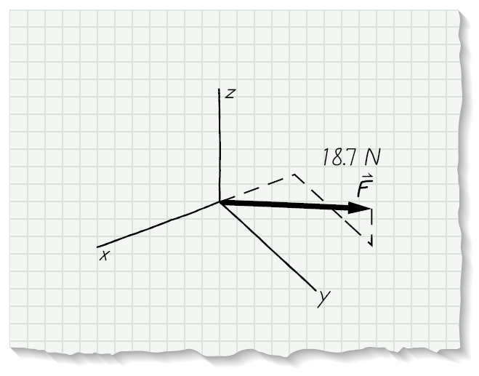
Take a hike find rectangular components…..
F = Fx + Fy + Fz

Slide 3
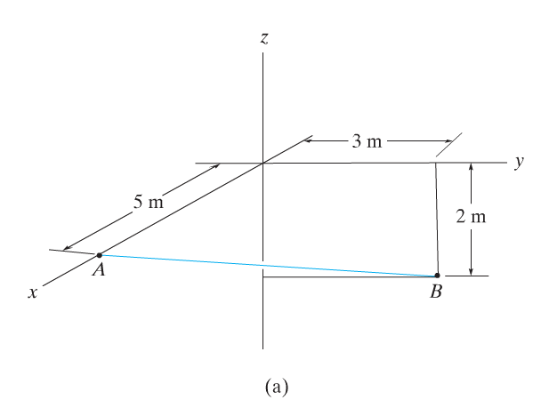
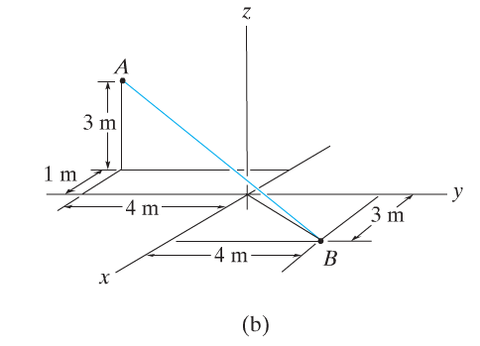
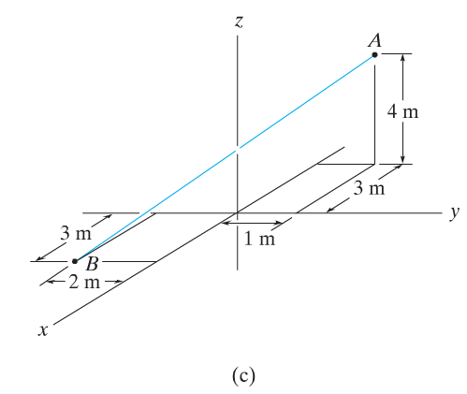
Establish the position vector from A to B.

Slide 5
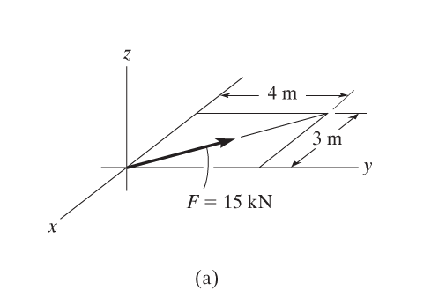
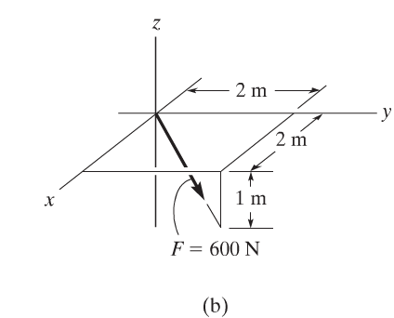
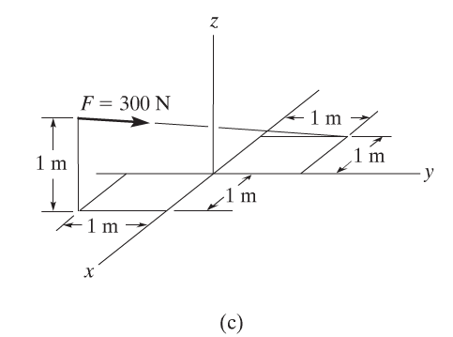
Write F as a Cartesian vector

Slide 7
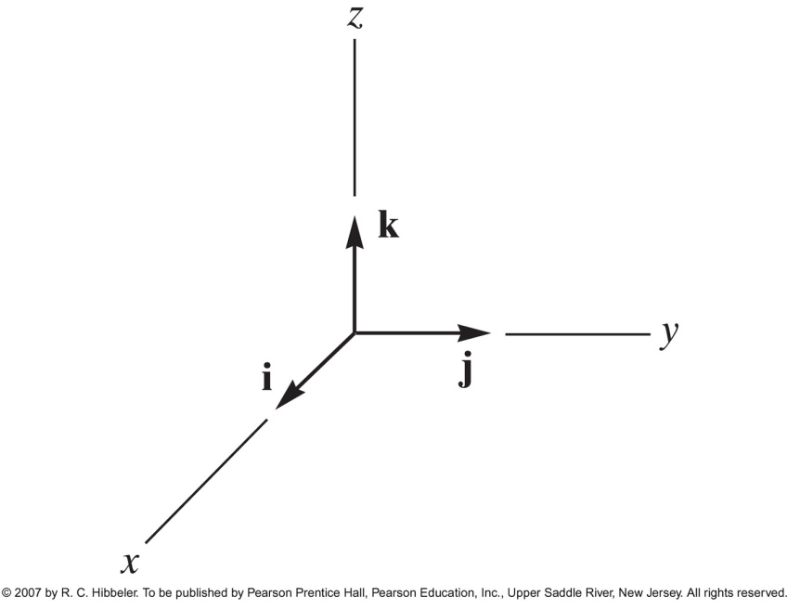
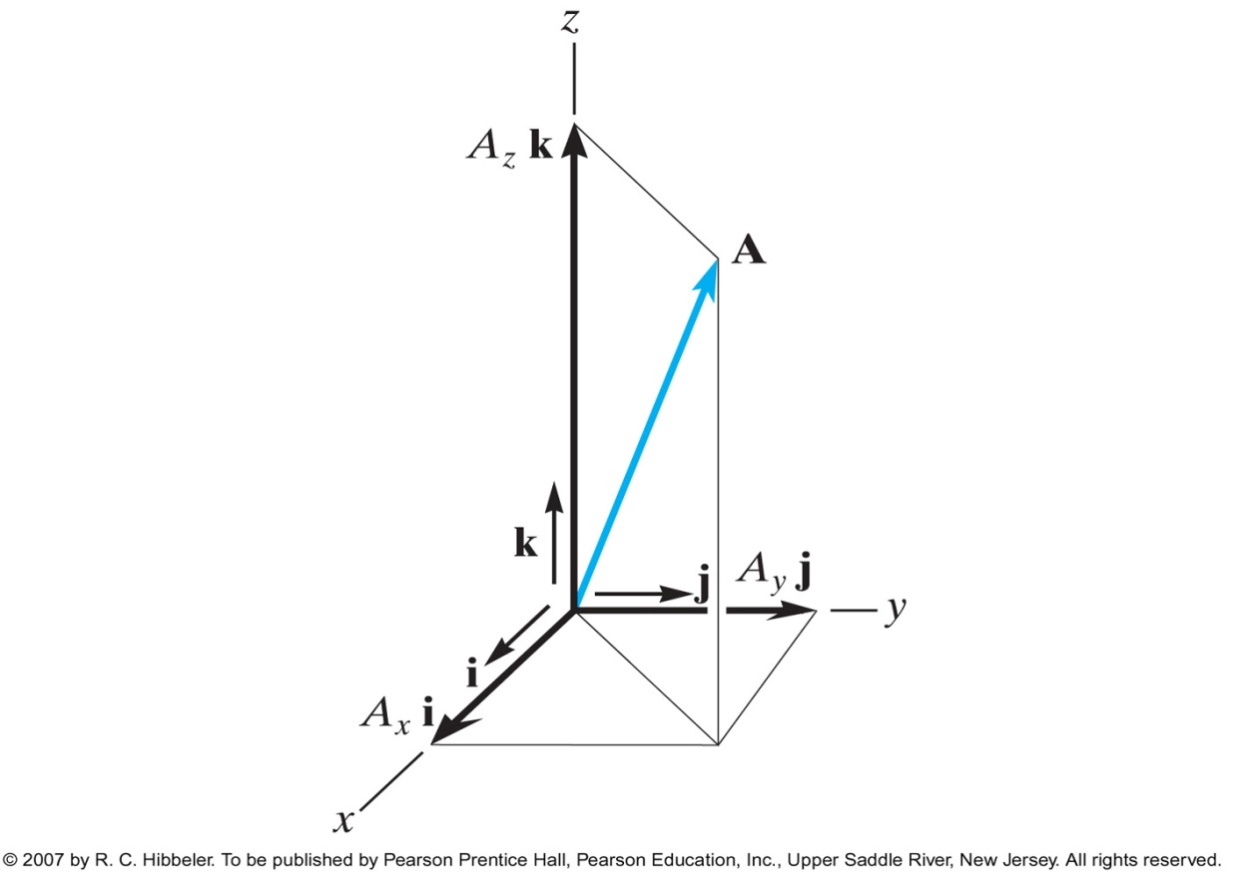
Cartesian Unit Vectors

Slide 8
Unit Vectors
vector
unit vector

Slide 9
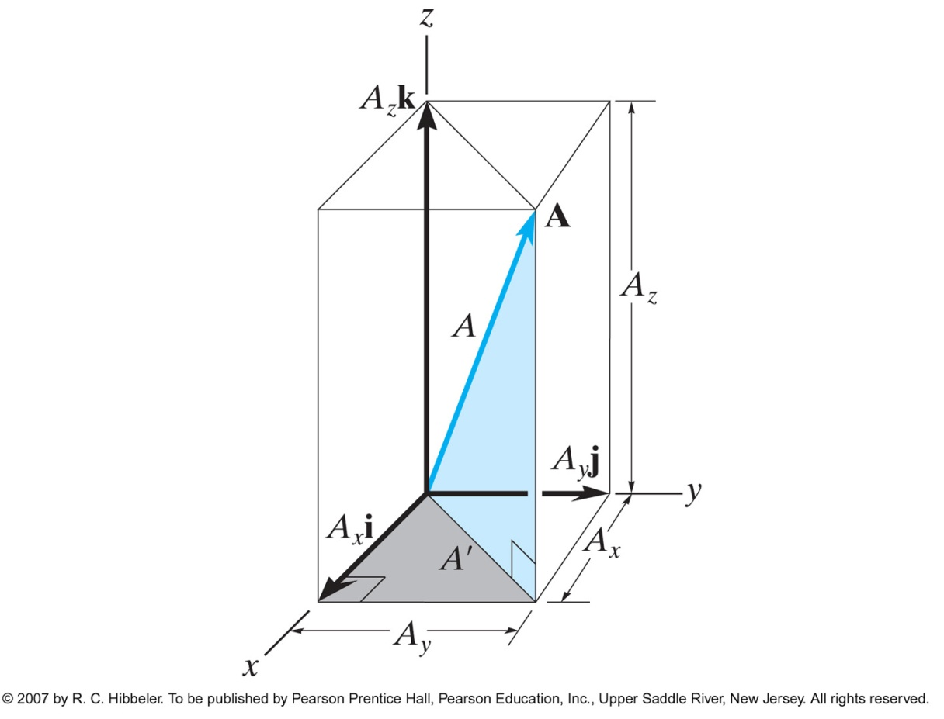
Direction of a Cartesian Vector
Coordinate direction angles

Slide 10
Direction cosines

Slide 11
Find:
a) Scalar components
b) Direction cosines

Slide 12
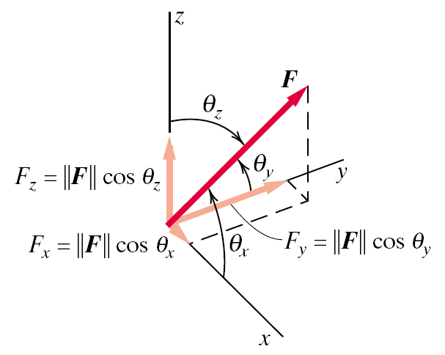
Cartesian Notation
F = Fx i + Fy j + Fz k
Direction cosines
Magnitude =

Slide 13
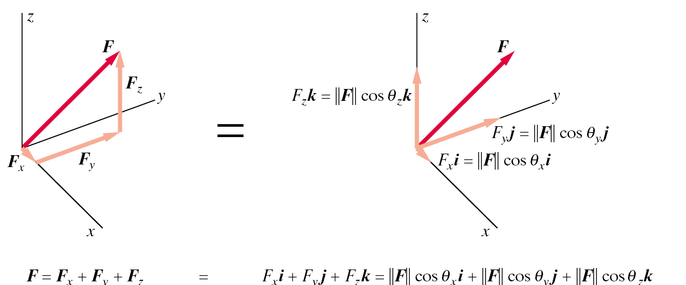
Unit vectors

Slide 14
Unit vectors

Slide 15
Find:
Direction cosines
Unit vector along its line of action
c) Vector notation

Slide 16
What is the unit vector from A to B?

Slide 17
End of Sections 2.5-2.6

Slide 18
Right-Hand Rule
Cartesian coordinate system is right-handed when:
thumb of the right hand points in the positive z direction

Slide 19
Which are right-hand coordinate systems?
x
x
y
z
y
y
z
z
x
y
x
z

Slide 20
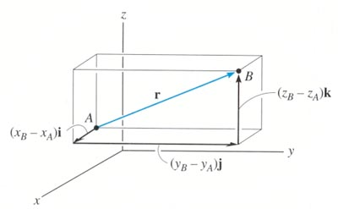
POSITION VECTOR
A position vector is defined as a fixed vector that locates a point in space relative to another point.
Consider two points, A & B, in 3-D space. Let their coordinates be (X_{A}, Y_{A}, Z_{A}) and ( X_{B}, Y_{B}, Z_{B} ), respectively.
The position vector directed from A to B, r _{AB} , is defined as
r _{AB} = {( X_{B} – X_{A} ) i + ( Y_{B} – Y_{A} ) j + ( Z_{B} – Z_{A} ) k }m
Please note that B is the ending point and A is the starting point.
ALWAYS subtract the “tail” coordinates from the “tip” coordinates!

Slide 21
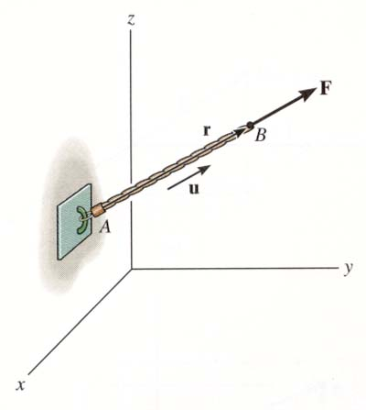
FORCE VECTOR DIRECTED ALONG A LINE
If a force is directed along a line, then we can represent the force vector in Cartesian Coordinates by using a unit vector and the force magnitude. So we need to:
a) Find the position vector, r _{AB} , along two points on that line.
b) Find the unit vector describing the line’s direction, u_{AB} = (r_{AB}/r_{AB}).
c) Multiply the unit vector by the magnitude of the force, F = F u_{AB} .

Slide 22
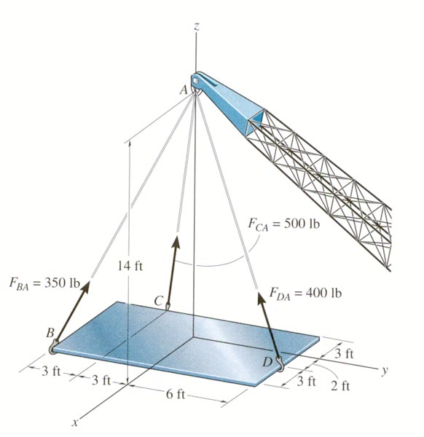
EXAMPLE
Given: 400 lb force along the cable DA.
Find: The force F_{DA} in Cartesian vector form.
Plan:
Find the position vector r_{DA} and the unit vector u_{DA.}
Find the force vector if F_{DA} = 400 lb u_{DA} . Write in Cartesian vector form.

Slide 23
EXAMPLE (continued)
The figure shows that when relating D to A, we will have to go -2 ft in the x-direction, -6 ft in the y-direction, and +14 ft in the z-direction.
r_{DA} = {-2 i – 6 j + 14 k} ft.
We can also find r_{DA} by subtracting the coordinates of D from the coordinates of A.
r_{DA} = (2² + 6² + 14²)^{0.5} = 15.36 ft
u_{DA} = r_{DA}/r_{DA} and F_{DA} = 400 u_{DA} lb
F_{DA} = 400{(-2 i – 6 j + 14 k)/15.36} lb
= {-52.1 i – 156 j + 365 k} lb

Slide 24
CONCEPT QUIZ
1. P and Q are two points in a 3-D space. How are the position vectors r_{PQ} and r_{QP} related?
A) r_{PQ} = r_{QP} B) r_{PQ} = - r_{QP}
C) r_{PQ} = 1/r_{QP} D) r_{PQ} = 2 r_{QP}
2. If F and r are force vector and position vectors, respectively, in SI units, what are the units of the expression (r * (F / F)) ?
A) Newton B) Dimensionless
C) Meter D) Newton - Meter
E) The expression is algebraically illegal.
Notes:
Answers:
1. B
2. C

Slide 25
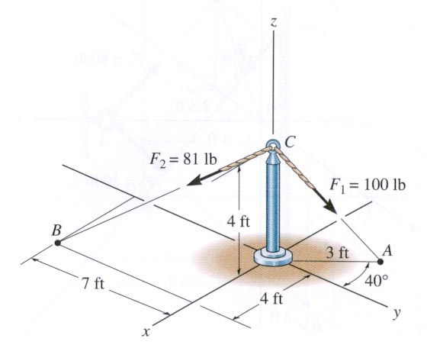
GROUP PROBLEM SOLVING
Given: Two forces are acting on a pipe as shown in the figure.
Find: The magnitude and the coordinate direction angles of the resultant force.
Plan:
Find the forces along CA and CB in the Cartesian vector form.
Add the two forces to get the resultant force, F_{R}.
Determine the magnitude and the coordinate angles of F_{R}.

Slide 26
GROUP PROBLEM SOLVING (continued)
F_{CA} = 100 lb{r_{CA}/r_{CA}}
F_{CA} = 100 lb(-3 sin 40° i + 3 cos 40° j – 4 k)/5
F_{CA} = {-38.57 i + 45.96 j – 80 k} lb
F_{CB} = 81 lb{r_{CB}/r_{CB}}
F_{CB} = 81 lb(4 i – 7 j – 4 k)/9
F_{CB} = {36 i – 63 j – 36 k} lb
F_{R} = F_{CA} + F_{CB} = {-2.57 i – 17.04 j – 116 k} lb
F_{R} = (2.57² + 17.04² + 116²) = 117.3 lb = 117 lb
α = cos⁻¹(-2.57/117.3) = 91.3°, β = cos⁻¹(-17.04/117.3) = 98.4°
γ = cos⁻¹(-116/117.3) = 172°

Slide 27
ATTENTION QUIZ
1. Two points in 3 – D space have coordinates of P (1, 2, 3) and Q (4, 5, 6) meters. The position vector r_{QP} is given by
A) {3 i + 3 j + 3 k} m
B) {- 3 i – 3 j – 3 k} m
C) {5 i + 7 j + 9 k} m
D) {- 3 i + 3 j + 3 k} m
E) {4 i + 5 j + 6 k} m
2. Force vector, F, directed along a line PQ is given by
A) (F/ F) r_{PQ} B) r_{PQ}/r_{PQ}
C) F(r_{PQ}/r_{PQ}) D) F(r_{PQ}/r_{PQ})
Notes:
Answers
1. B
2. C

Slide 28
READING QUIZ (section 2.9)
1. The dot product of two vectors P and Q is defined as
A) P Q cos θ B) P Q sin θ
C) P Q tan θ D) P Q sec θ
P
θ
Q
2. The dot product of two vectors results in a _________ quantity.
A) scalar B) vector
C) complex D) zero
Notes:
Answers:
1. A
2. A

Slide 29
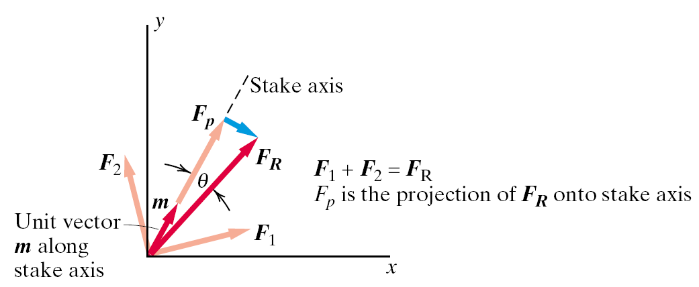
Dot product

Slide 30
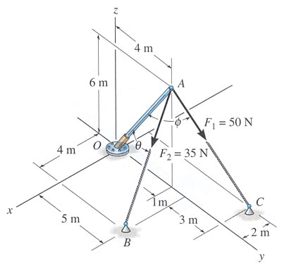
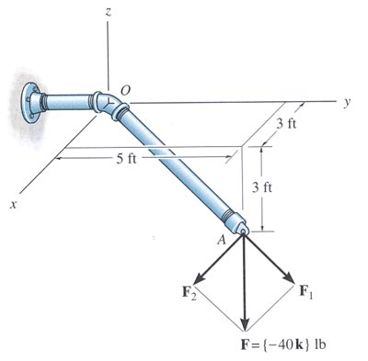
APPLICATIONS
1. Finding the angle between two vectors (angle is between the tails of the two vectors)
2. Finding the components perpendicular and parallel to a line.

Slide 31
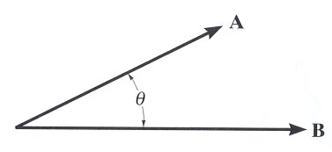
DEFINITION
The dot product of vectors A and B is defined as A•B = │A│ │B│ cos θ.
Angle θ is the smallest angle between the two vectors and is always in a range of 0º to 180º.
Dot Product Characteristics:
1. The result of the dot product is a scalar (a positive or negative number).
2. The units of the dot product will be the product of the units of the A and B vectors.

Slide 32
DOT PRODUCT DEFINITON (continued)
Examples: i • j = 0
i • i = 1
A • B = (A_{x} i + A_{y} j + A_{z} k) • (B_{x} i + B_{y} j + B_{z} k)
= A_{x} B_{x} + A_{y}B_{y} + A_{z}B_{z}

Slide 33
USING THE DOT PRODUCT TO DETERMINE THE ANGLE BETWEEN TWO VECTORS
For the given two vectors, determine the angle by:
a) finding the dot product, A • B = (A_{x}B_{x} + A_{y}B_{y} + A_{z}B_{z} ); plus,
b) finding the magnitudes of the vectors │A│ and │B│, then,
c) solve for θ, using θ = cos⁻¹ [(A • B)/(A B)], where 0º ≤ θ ≤ 180º .

Slide 34
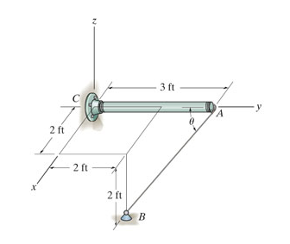
Determine the angle θ between the pole (y axis) and the wire AB
Notes:
70.5 degrees

Slide 35
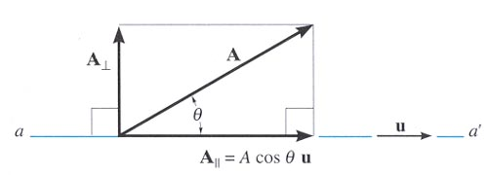
DETERMINING THE PROJECTION OF A VECTOR
You can determine the components of a vector parallel and perpendicular to a line using the dot product.
Steps:
1. Find the unit vector, U_{aa´} along line aa´
2. Find the scalar projection of A along line aa´ by
A|| = A • U = A_{x}U_{x} + A_{y}U_{y} + A_{z} U_{z}

Slide 36
DETERMINING THE PROJECTION OF A VECTOR (continued)
3. If needed, the projection can be written as a vector, A|| , by using the unit vector U_{aa´} and the magnitude found in step 2.
A|| = A|| U_{aa´}
4. The scalar and vector forms of the perpendicular component can easily be obtained by
A ⊥ = (A ² - A|| ²) ^{½} and
A ⊥ = A – A||
(rearranging the vector sum of A = A⊥ + A|| )

Slide 37
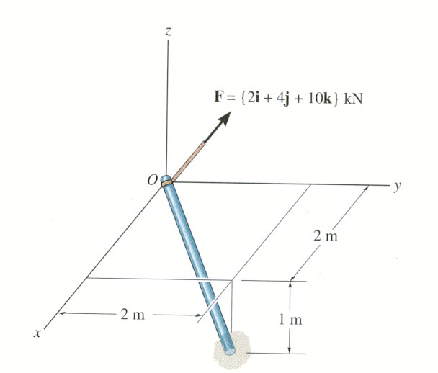
EXAMPLE
Given: The force acting on the pole
Find: The angle between the force vector and the pole, and the magnitude of the projection of the force along the pole OA.
A
Plan:
1. Get r_{OA}
2. θ = cos⁻¹{(F • r_{OA})/(F r_{OA})}
3. F_{OA} = F • u_{OA} or F cos θ

Slide 38
EXAMPLE (continued)
r_{OA} = {2 i + 2 j – 1 k} m
r_{OA} = (2² + 2² + 1²)^{1/2} = 3 m
F = {2 i + 4 j + 10 k}kN
F = (2² + 4² + 10²)^{1/2} = 10.95 kN
A
F • r_{OA} = (2)(2) + (4)(2) + (10)(-1) = 2 kN·m
θ = cos⁻¹ {(F • r_{OA})/(F r_{OA})}
θ = cos⁻¹ {2/(10.95 * 3)} = 86.5°
u_{OA} = r_{OA}/r_{OA} = {(2/3) i + (2/3) j – (1/3) k}
F_{OA} = F • u_{OA} = (2)(2/3) + (4)(2/3) + (10)(-1/3) = 0.667 kN
Or F_{OA} = F cos θ = 10.95 cos (86.51°) = 0.667 kN

Slide 39
CONCEPT QUIZ
1. If a dot product of two non-zero vectors is 0, then the two vectors must be _____________ to each other.
A) parallel (pointing in the same direction)
B) parallel (pointing in the opposite direction)
C) perpendicular
D) cannot be determined.
2. If a dot product of two non-zero vectors equals -1, then the vectors must be ________ to each other.
A) parallel (pointing in the same direction)
B) parallel (pointing in the opposite direction)
C) perpendicular
D) cannot be determined.
Notes:
Answers:
1. C
2. D

Slide 40
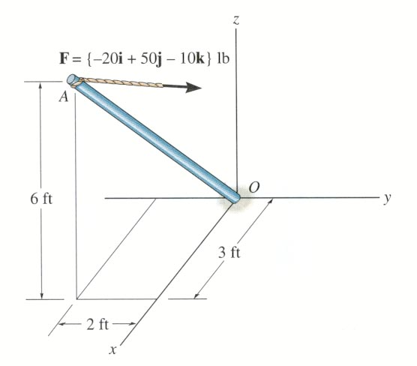
GROUP PROBLEM SOLVING
Given: The force acting on the pole.
Find: The angle between the force vector and the pole, and the magnitude of the projection of the force along the pole AO.
Plan:
1. Get r_{AO}
2. θ = cos⁻¹{(F • r_{AO})/(F r_{AO})}
3. F_{OA} = F • u_{AO} or F cos θ

Slide 41
GROUP PROBLEM SOLVING (continued)
r_{AO} = {-3 i + 2 j – 6 k} ft.
r_{AO} = (3² + 2² + 6²)^{1/2} = 7 ft.
F = {-20 i + 50 j – 10 k}lb
F = (20² + 50² + 10²)^{1/2} = 54.77 lb
F • r_{AO} = (-20)(-3) + (50)(2) + (-10)(-6) = 220 lb·ft
θ = cos⁻¹{(F • r_{AO})/(F r_{AO})}
θ = cos⁻¹ {220/(54.77 × 7)} = 55.0°
u_{AO} = r_{AO}/r_{AO} = {(-3/7) i + (2/7) j – (6/7) k}
F_{AO} = F • u_{AO} = (-20)(-3/7) + (50)(2/7) + (-10)(-6/7) = 31.4 lb
Or F_{AO} = F cos θ = 54.77 cos(55.0°) = 31.4 lb

Slide 42
ATTENTION QUIZ
1. The dot product can be used to find all of the following except ____ .
A) sum of two vectors
B) angle between two vectors
C) component of a vector parallel to another line
D) component of a vector perpendicular to another line
2. Find the dot product of the two vectors P and Q.
P = {5 i + 2 j + 3 k} m
Q = {-2 i + 5 j + 4 k} m
A) -12 m B) 12 m C) 12 m ²
D) -12 m ² E) 10 m ²
Notes:
Answers:
1. A
2. C

Slide 43
Given: 400 lb force along the cable DA.
Find: The unit vector u_{DA} and the force F_{DA} vector in Cartesian vector form.
Given: The force acting on the pole.
Find: The angle between the force vector and the pole, and the magnitude of the projection of the force along the pole AO.

Slide 44
Establish the position vector from A to B.

Slide 45
Find:
Direction cosines
Unit vector along its line of action
c) Vector notation

