Slide 1
Chapter 2 Force Vectors
Sections 2.1, 2.2, 2.3, 2.4

Slide 2
QUIZ
1. Which one of the following is a scalar quantity?
A) Force B) Position C) Mass D) Velocity
2. What is the resultant of A + B if :
A = 2i -3j and B = -1i +6j
3. What is the magnitude and direction of the resultant from #2?
4. Which of these symbolizes the addition of A + B = resultant ?
Notes:
Answers:
1. C
2. 1i +3j 3.16 Ɵ = -71.6 (from negative x-axis) or 108.44 from positive x-axis

Slide 3
SCALARS AND VECTORS (Section 2.1)
Scalars Vectors
Examples: mass, volume force, velocity
Characteristics: It has a magnitude It has a magnitude
(positive or negative) and direction
Addition rule: Simple arithmetic Parallelogram law
Special Notation: None Bold font, a line, an
arrow or a “carrot”

Slide 4
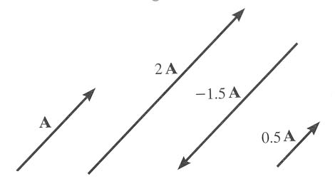
VECTOR OPERATIONS (Section 2.2)
Scalar Multiplication
and Division

Slide 5
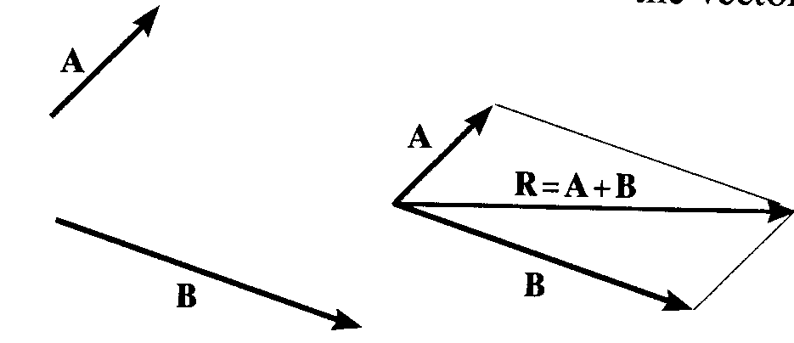
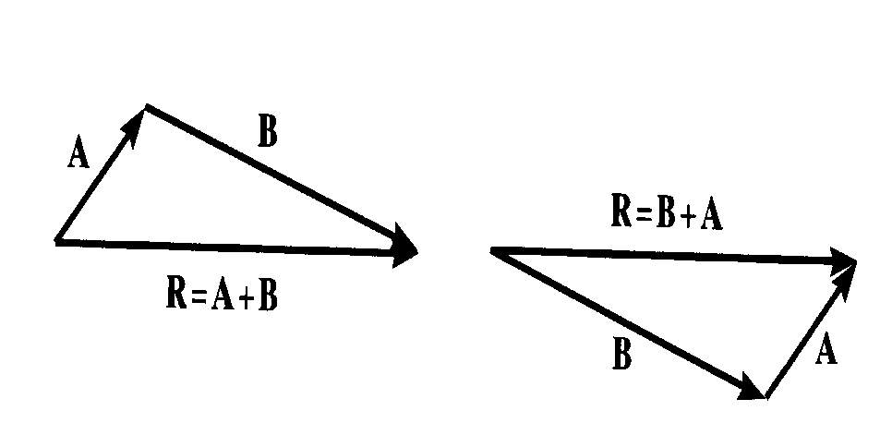
VECTOR ADDITION USING EITHER THE PARALLELOGRAM LAW OR TRIANGLE
Parallelogram Law:
Triangle method (always ‘tip to tail’):
How do you subtract a vector?
How can you add more than two concurrent vectors graphically ?

Slide 6
“Resolution” of a vector is breaking up a vector into components. It is kind of like using the parallelogram law in reverse.
RESOLUTION OF A VECTOR

Slide 7
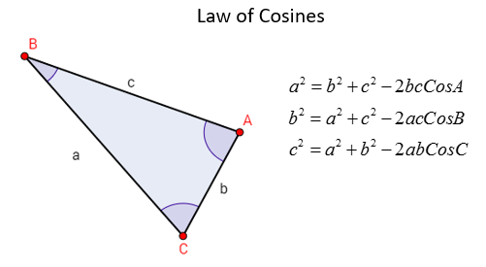
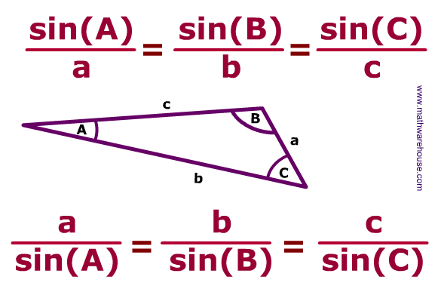
Law of Sines

Slide 8
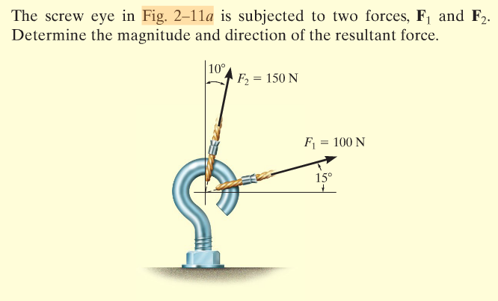

Slide 9
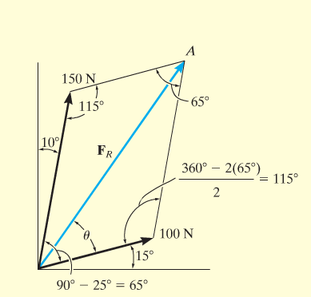
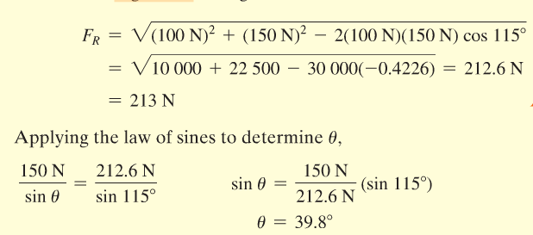

Slide 10
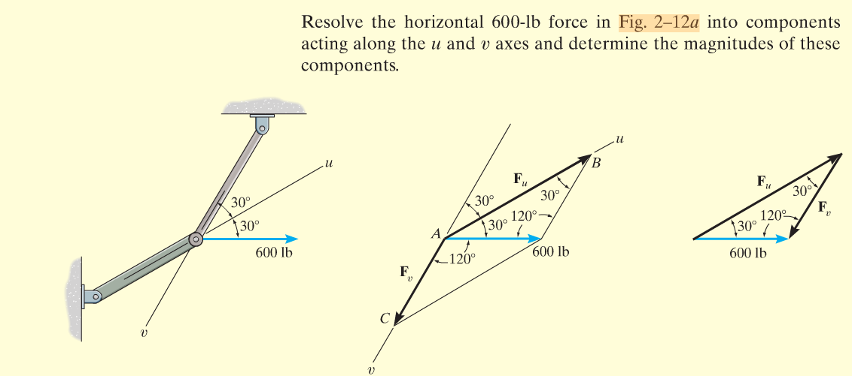
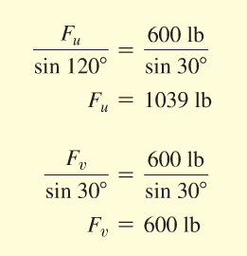

Slide 11
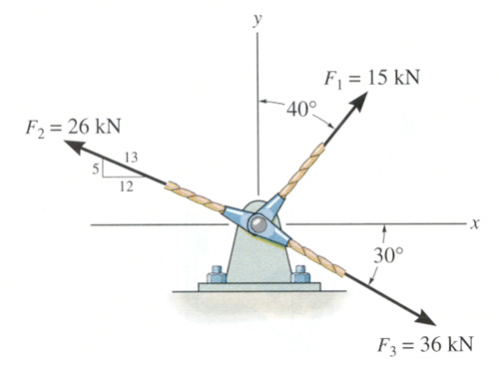
Find the magnitude and angle of the resultant force.

Slide 12
Find the magnitude and angle of the resultant force.

Slide 13
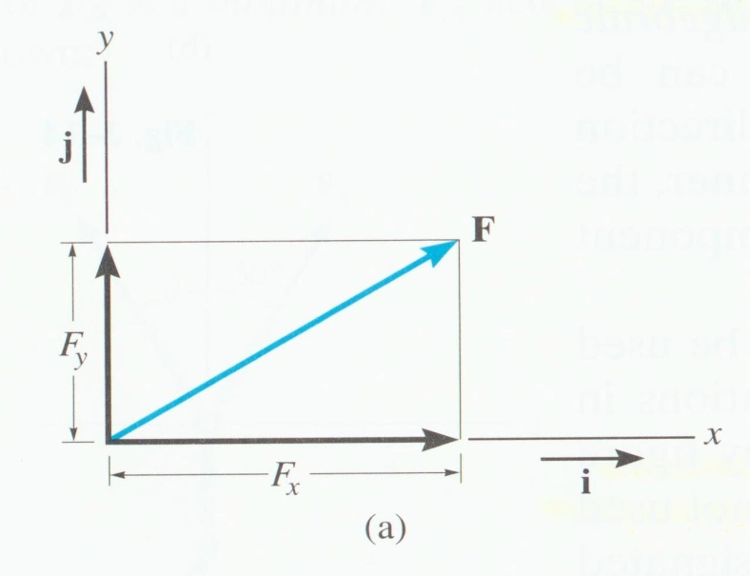
CARTESIAN VECTOR NOTATION (Section 2.4)
We ‘resolve’ vectors into components using the x and y axes system.
Each component of the vector is shown as a magnitude and a direction.
The directions are based on the x and y axes. We use the “unit vectors” i and j to designate the x and y axes.

Slide 14
Unit Vectors
vector
unit vector
Notes:
Note subscripts; although this is an awkward way to define the “sine” of the angle (from the theta x perspective) it’s a good example of why subscripts are important.

Slide 15
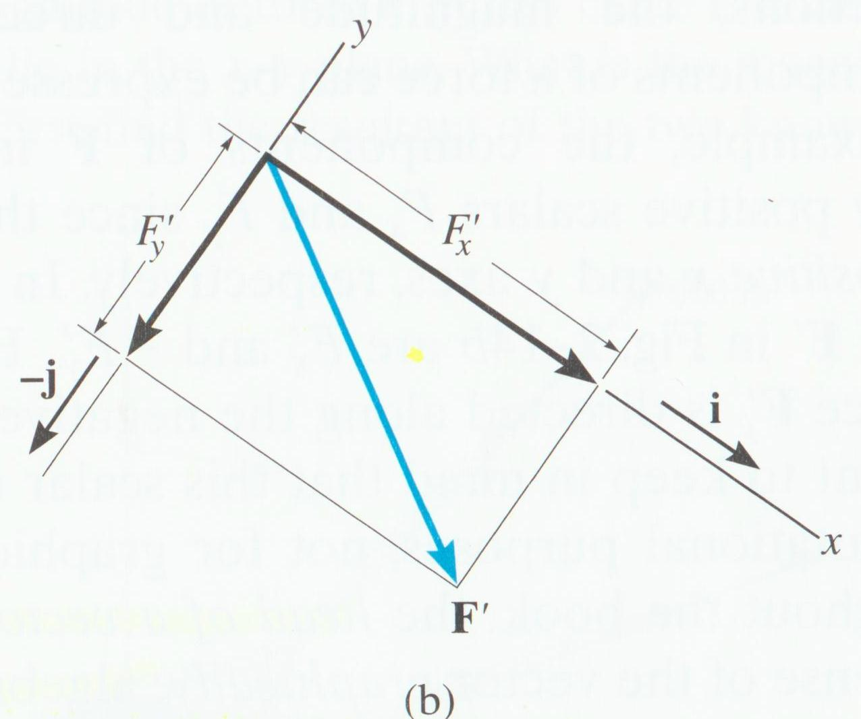
For example,
F = Fx i + Fy j
The x and y axes are always perpendicular to each other. Together,they can be directed at any inclination.

Slide 16
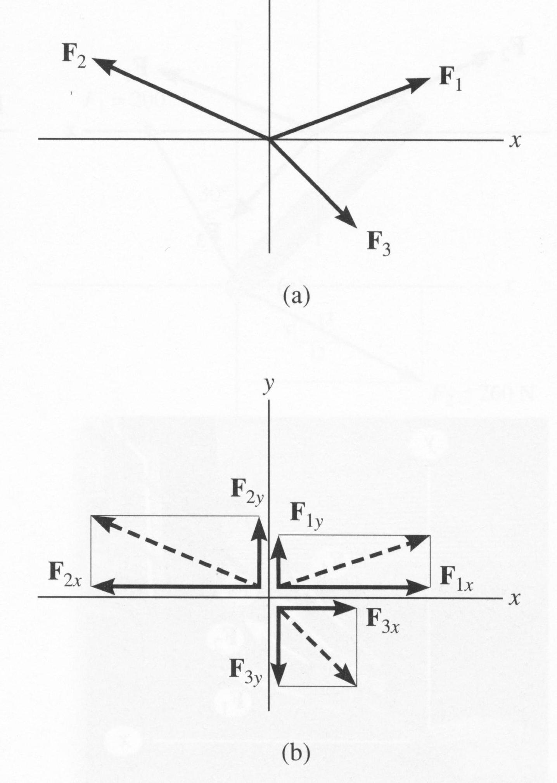
ADDITION OF SEVERAL VECTORS
Step 1 is to resolve each force into its components
Step 2 is to add all the x components together and add all the y components together. These two totals become the resultant vector.
Step 3 is to find the magnitude and angle of the resultant vector.

Slide 17
Example of this process,

Slide 18
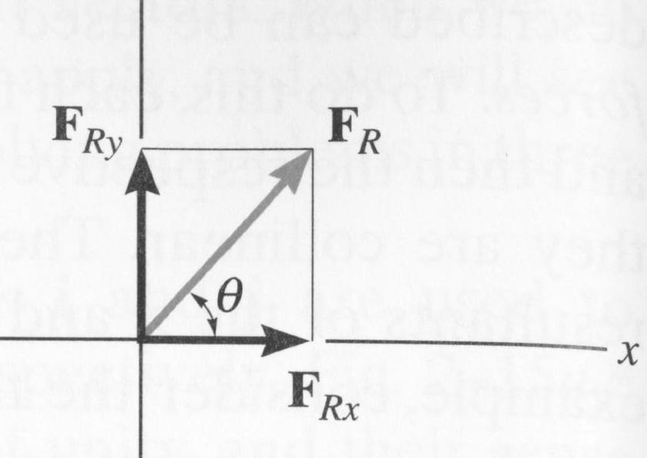
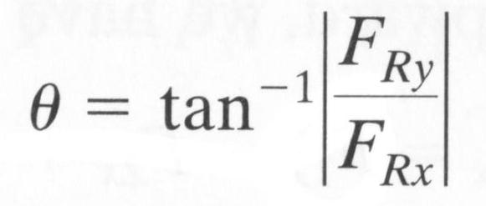
You can also represent a 2-D vector with a magnitude and angle.

Slide 19
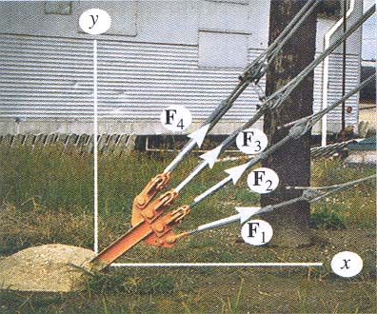
APPLICATION OF VECTOR ADDITION
There are four concurrent cable forces acting on the bracket.
How do you determine the resultant force acting on the bracket ?

Slide 20
EXAMPLE
Given: Three concurrent forces acting on a bracket.
Find: The magnitude and angle of the resultant force.
Plan:
a) Resolve the forces in their x-y components.
b) Add the respective components to get the resultant vector.
c) Find magnitude and angle from the resultant components.

Slide 21
EXAMPLE (continued)
F1 = { 15 sin 40° i + 15 cos 40° j } kN
= { 9.642 i + 11.49 j } kN
F2 = { -(12/13)26 i + (5/13)26 j } kN
= { -24 i + 10 j } kN
F3 = { 36 cos 30° i – 36 sin 30° j } kN
= { 31.18 i – 18 j } kN

Slide 22
EXAMPLE (continued)
Summing up all the i and j components respectively, we get,
FR = { (9.642 – 24 + 31.18) i + (11.49 + 10 – 18) j } kN
= { 16.82 i + 3.49 j } kN
y
FR
FR = ((16.82)² + (3.49)²)^{1/2} = 17.2 kN
φ = tan⁻¹(3.49/16.82) = 11.7°
φ
x

Slide 23
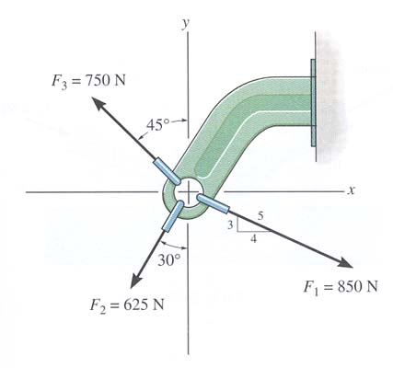
GROUP PROBLEM SOLVING
Given: Three concurrent forces acting on a bracket
Find: The magnitude and angle of the resultant force.
Plan:
a) Resolve the forces in their x-y components.
b) Add the respective components to get the resultant vector.
c) Find magnitude and angle from the resultant components.

Slide 24
GROUP PROBLEM SOLVING (continued)
F1 = { (4/5) 850 i - (3/5) 850 j } N
= { 680 i - 510 j } N
F2 = { -625 sin(30°) i - 625 cos(30°) j } N
= { -312.5 i - 541.3 j } N
F3 = { -750 sin(45°) i + 750 cos(45°) j } N
{ -530.3 i + 530.3 j } N

Slide 25
GROUP PROBLEM SOLVING (continued)
Summing up all the i and j components respectively, we get,
FR = { (680 – 312.5 – 530.3) i + (-510 – 541.3 + 530.3) j }N
= { - 162.8 i - 521 j } N
y
FR = ((162.8)² + (521)²) ^{½} = 546 N
= tan^{–1}(521/162.8) = 72.64° or
From Positive x axis θ = 180 + 72.64 = 253 °
x
φ
FR

Slide 26
ATTENTION QUIZ
1. Resolve F along x and y axes and write it in vector form. F = { ___________ } N
A) 80 cos (30°) i - 80 sin (30°) j
B) 80 sin (30°) i + 80 cos (30°) j
C) 80 sin (30°) i - 80 cos (30°) j
D) 80 cos (30°) i + 80 sin (30°) j
y
x
30°
F = 80 N
2. Determine the magnitude of the resultant (F1 + F2) force in N when F1 = { 10 i + 20 j } N and F2 = { 20 i + 20 j } N .
A) 30 N B) 40 N C) 50 N
D) 60 N E) 70 N
Notes:
Answers:
1. C
2. C

Slide 27
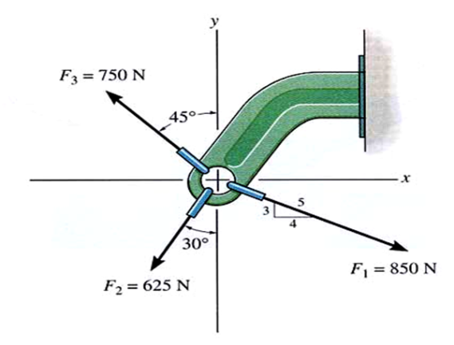
Find the magnitude and angle of the resultant force.

