Slide 1
Equilibrium of a Particle
Chapter 3.1 – 3.3

Slide 2
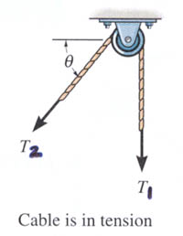
Pre-QUIZ
1) When a particle is in equilibrium, the sum of forces acting on it equals ___ . (Choose the most appropriate answer)
A) a constant B) a positive number C) zero
D) a negative number E) an integer.
2) For a frictionless pulley and cable, tensions in the cable (T₁ and T₂) are _____ .
A) T₁ > T₂
B) T₁ = T₂
C) T₁ < T₂
D) T₁ = T₂ sin θ
Notes:
Answers:
1. C
2. B

Slide 3
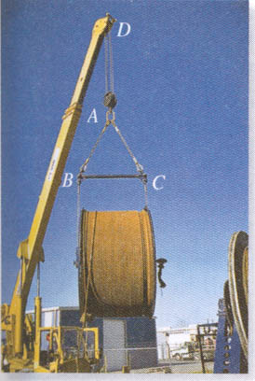
APPLICATIONS
What are the forces in cables AB and AC ? In other words, how strong does the cable need to be?

Slide 4
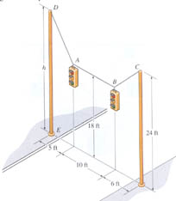
APPLICATIONS (continued)
For a given weight of the lights, what are the forces in the cables? What size of cable must you use ?

Slide 5
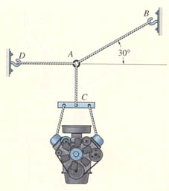
COPLANAR FORCE SYSTEMS (Section 3.3)
This is an example of a 2-D or coplanar force system. If the whole assembly is in equilibrium, then particle A is also in equilibrium.
To find the tensions in the cables draw a free body diagram and apply equations of equilibrium.
Notes:
Explain the following terms :
Coplanar force system – The forces lie on a sheet of paper (plane).
A particle – It has a mass, but a size that can be neglected.
Equilibrium – A condition of rest or constant velocity.

Slide 6
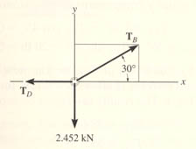
THE WHAT, WHY AND HOW OF A FREE BODY DIAGRAM (FBD)
Free Body Diagrams are one of the most important things for you to know how to draw and use.
What ? - It is a drawing that shows all external forces acting on the particle.
Why ? - It helps you write the equations of equilibrium used to solve for the unknowns (usually forces or angles).

Slide 7
How ?
1. Imagine the particle to be isolated or cut free from its surroundings.
2. Show all the forces that act on the particle.
3. Identify each force and show all known magnitudes and directions. Show all unknown magnitudes and / or directions as variables .
A
Note : Engine mass = 250 Kg
FBD at A

Slide 8
EQUATIONS OF 2-D EQUILIBRIUM
Since particle A is in equilibrium, the net force at A is zero.
So F_{AB} + F_{AC} + F_{AD} = 0
or Σ F = 0
A
FBD at A
In general, for a particle in equilibrium, Σ F = 0 or
ΣF_{x} i + ΣF_{y} j = 0 = 0 i + 0 j (A vector equation)
Or, written in a scalar form,
F_{x} = 0 and Σ F_{y} = 0
These are two scalar equations of equilibrium (E of E). They can be used to solve for up to two unknowns.

Slide 9
EXAMPLE
Note : Engine mass = 250 Kg
FBD at A
Write the scalar EofE:
+ → Σ F_{x} = T_{B} cos 30° – T_{D} = 0
+ ↑ ΣF_{y} = T_{B} sin 30° – 2.452 kN = 0
Solving the second equation gives: T_{B} = 4.90 kN
From the first equation, we get: T_{D} = 4.25 kN

Slide 10
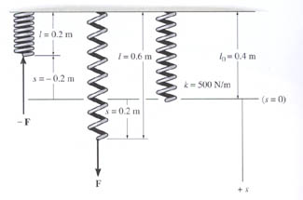
SPRINGS, CABLES, AND PULLEYS
Spring Force = spring constant * deformation, or
F = k * S
With a frictionless pulley, T₁ = T₂.

Slide 11
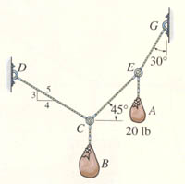
EXAMPLE
Given: Sack A weighs 20 lb. and geometry is as shown.
Find: Forces in the cables and weight of sack B.
Plan:
1. Draw a FBD for Point E.
2. Apply EofE at Point E to solve for the unknowns (T_{EG} & T_{EC}).
3. Repeat this process at C.

Slide 12
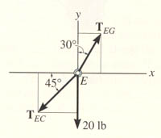
EXAMPLE (continued)
A FBD at E should look like the one to the left. Note the assumed directions for the two cable tensions.
The scalar E-of-E are:
+ → Σ F_{x} = T_{EG} sin 30º – T_{EC} cos 45º = 0
+ ↑ Σ F_{y} = T_{EG} cos 30º – T_{EC} sin 45º – 20 lbs = 0
Solving these two simultaneous equations for the two unknowns yields:
T_{EC} = 38.6 lb
T_{EG} = 54.6 lb

Slide 13
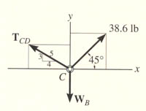
EXAMPLE (continued)
Now move on to ring C. A FBD for C should look like the one to the left.
The scalar E-of-E are:
+ → Σ F_{x} = 38.64 cos 45° – (4/5) T_{CD} = 0
+ ↑ Σ F_{y} = (3/5) T_{CD} + 38.64 sin 45° – W_{B} = 0
Solving the first equation and then the second yields
T_{CD} = 34.2 lb and W_{B} = 47.8 lb .

Slide 14
CONCEPT QUESTIONS
1000 lb
1000 lb
1000 lb
( A ) ( B ) ( C )
1) Assuming you know the geometry of the ropes, which one of these can you NOT find the forces in the cables?
2) Why?
A) The weight is too heavy.
B) The cables are too thin.
C) There are more unknowns than equations.
D) There are too few cables for a 1000 lb weight.
Notes:
Answers:
1. C
2. C

Slide 15
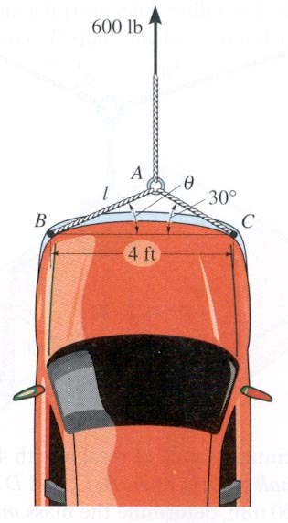
GROUP PROBLEM SOLVING
Given: The car is towed at constant speed by the 600 lb force and the angle θ is 25°.
Find: The forces in the ropes AB and AC.
Plan:
1. Draw a FBD for point A.
2. Apply the E-of-E to solve for the forces in ropes AB and AC.

Slide 16
GROUP PROBLEM SOLVING (continued)
600 lb
FBD at point A
A
25°
30°
F_{AB}
F_{AC}
Applying the scalar E-of-E at A, we get;
+ → ∑F_{x} = F_{AC} cos 30° – F_{AB} cos 25° = 0
+ → ∑F_{y} = -F_{AC} sin 30° – F_{AB} sin 25° + 600 = 0
Solving the above equations, we get;
F_{AB} = 634 lb
F_{AC} = 664 lb

Slide 17
ATTENTION QUIZ
1. Select the correct FBD of particle A.
30°
A
40°
100 lb
F1 F2
A)
A
B)
30°
40°
100 lb
A
F
F1
F2
C)
D)
30°
40°
30°
A
A
100 lb
100 lb
Notes:
Answers:
1. D

Slide 18
ATTENTION QUIZ
2. Using this FBD of Point C, the sum of forces in the x-direction (Σ F_{X}) is ___ . Use a sign convention of + → .
A) F₂ sin 50° – 20 = 0
B) F₂ cos 50° – 20 = 0
C) F₂ sin 50° – F₁ = 0
D) F₂ cos 50° + 20 = 0
F₂
20 lb
50°
C
F₁
Notes:
Answers:
2. B

Slide 19
Chapter 3
Section 3.4

Slide 20
Pre-QUIZ
1. Particle P is in equilibrium with five (5) forces acting on it in 3-D space. How many scalar equations of equilibrium can be written for point P?
A) 2 B) 3 C) 4
D) 5 E) 6
2. In 3-D, when a particle is in equilibrium, which of the following equations apply?
A) (ΣF_{x}) i + (ΣF_{y}) j + (ΣF_{z}) k = 0
B) ΣF = 0
C) ΣF_{x} = Σ F_{y} = ΣF_{z} = 0
D) All of the above.
E) None of the above.
Notes:
Answers:
1. B
2. D

Slide 21
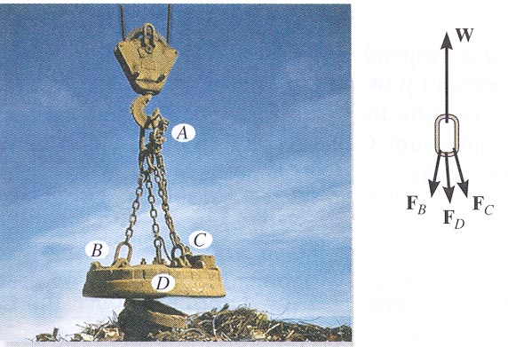
APPLICATIONS
The weights of the electromagnet and the loads are given.
Can you determine the forces in the chains?

Slide 22
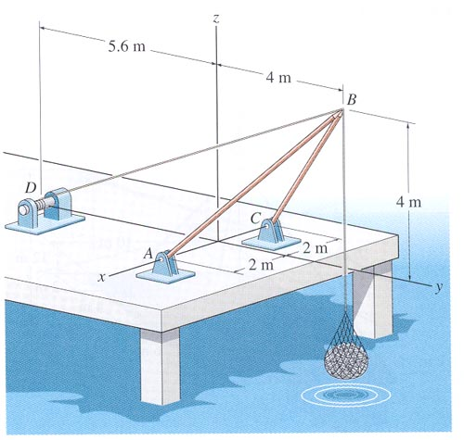
APPLICATIONS (continued)
The shear leg derrick is to be designed to lift a maximum of 500 kg of fish.
What is the effect of different offset distances on the forces in the cable and derrick legs?

Slide 23
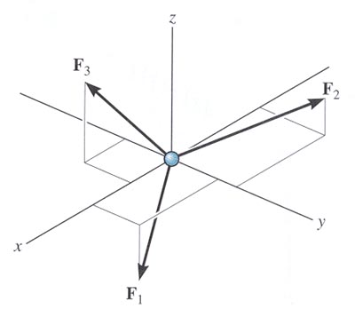
THE EQUATIONS OF 3-D EQUILIBRIUM
When a particle is in equilibrium, the vector sum of all the forces acting on it must be zero (Σ F = 0 ) .
This equation can be written in terms of its x, y and z components. This form is written as follows.
(ΣF_{x}) i + (ΣF_{y}) j + (ΣF_{z}) k = 0
This vector equation will be satisfied only when
ΣF_{x} = 0
ΣF_{y} = 0
ΣF_{z} = 0
These equations are the three scalar equations of equilibrium. They are valid at any point in equilibrium and allow you to solve for up to three unknowns.

Slide 24
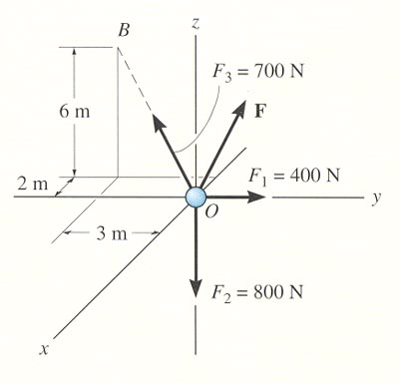
EXAMPLE #1
Given: F₁, F₂ and F₃.
Find: The force F required to keep particle O in equilibrium.
Plan:
1) Draw a FBD of particle O.
2) Write the unknown force as
F = {F_{x} i + F_{y} j + F_{z} k} N
3) Write F₁, F₂ and F₃ in Cartesian vector form.
4) Apply the three equilibrium equations to solve for the three
unknowns F_{x}, F_{y}, and F_{z}.

Slide 25
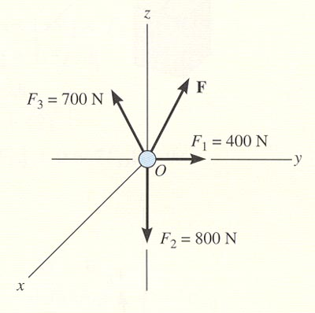
EXAMPLE #1 (continued)
F₁ = {400 j}N
F₂ = {-800 k}N
F₃ = F₃ (r_{B}/ r_{B})
= 700 N [(-2 i – 3 j + 6k)/(2² + 3² + 6²)^{½}]
= {-200 i – 300 j + 600 k} N

Slide 26
EXAMPLE #1 (continued)
Equating the respective i, j, k components to zero, we have
F_{x} = -200 + F_{X} = 0 ; solving gives F_{x} = 200 N
F_{y} = 400 – 300 + F_{y} = 0 ; solving gives F_{y} = -100 N
F_{z} = -800 + 600 + F_{z} = 0 ; solving gives F_{z} = 200 N
Thus, F = {200 i – 100 j + 200 k} N
Using this force vector, you can determine the force’s magnitude and coordinate direction angles as needed.

Slide 27
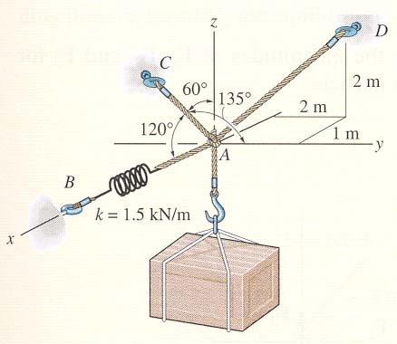
EXAMPLE #2
Given: A 100 Kg crate, as shown, is supported by three cords. One cord has a spring in it.
Find: Tension in cords AC and AD and the stretch of the spring.
Plan:
1) Draw a free body diagram of Point A. Let the unknown force magnitudes be F_{B}, F_{C}, F _{D} .
2) Represent each force in the Cartesian vector form.
3) Apply equilibrium equations to solve for the three unknowns.
4) Find the spring stretch using F_{B} = K * S .

Slide 28
EXAMPLE #2 (continued)
The weight is W = (- mg) k = (-100 kg * 9.81 m/sec²) k = {- 981 k} N
Now equate the respective i , j , k components to zero.
∑F_{x} = F_{B} – 0.5F_{C} – 0.333F_{D} = 0
∑F_{y} = - 0.707 F_{C} + 0.667 F_{D} = 0
∑F_{z} = 0.5 F_{C} + 0.667 F_{D} – 981 N = 0
Solving the three simultaneous equations yields
F_{C} = 813 N
F_{D} = 862 N
F_{B} = 693.7 N
The spring stretch is (from F = k * s)
s = F_{B} / k = 693.7 N / 1500 N/m = 0.462 m

Slide 29
CONCEPT QUIZ
1. In 3-D, when you know the direction of a force but not its magnitude, how many unknowns corresponding to that force remain?
A) One B) Two C) Three D) Four
2. If a particle has 3-D forces acting on it and is in static equilibrium, the components of the resultant force (Σ F_{x}, Σ F_{y}, and Σ F_{z} ) ___ .
A) have to sum to zero, e.g., -5 i + 3 j + 2 k
B) have to equal zero, e.g., 0 i + 0 j + 0 k
C) have to be positive, e.g., 5 i + 5 j + 5 k
D) have to be negative, e.g., -5 i - 5 j - 5 k
Notes:
Answers:
1. A
2. B

Slide 30
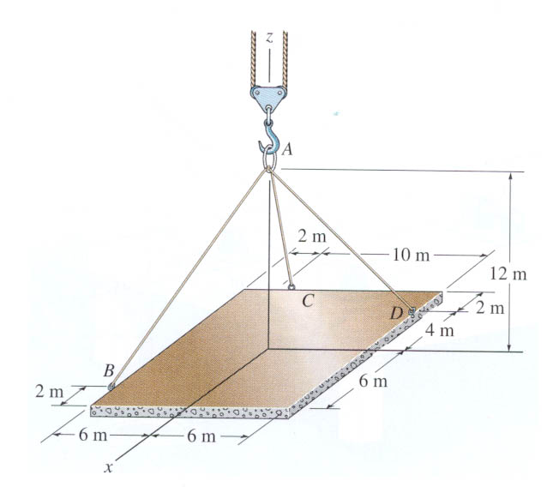
GROUP PROBLEM SOLVING
Given: A 150 Kg plate, as shown, is supported by three cables and is in equilibrium.
Find: Tension in each of the cables.
Plan:
1) Draw a free body diagram of Point A. Let the unknown force magnitudes be F_{B}, F_{C}, F _{D}
2) Represent each force in the Cartesian vector form.
3) Apply equilibrium equations to solve for the three unknowns.

Slide 31
GROUP PROBLEM SOLVING (continued)
z
FBD of Point A:
W
y
x
F_{D}
F_{B}
F_{C}
W = load or weight of plate = (mass)(gravity) = 150 (9.81) k = 1472 k N
F_{B} = F_{B}(r_{AB}/r_{AB}) = F_{B} N (4 i – 6 j – 12 k)m/(14 m)
F_{C} = F_{C} (r_{AC}/r_{AC}) = F_{C}(-6 i – 4 j – 12 k)m/(14 m)
F_{D} = F_{D}( r_{AD}/r_{AD}) = F_{D}(-4 i + 6 j – 12 k)m/(14 m)

Slide 32
GROUP PROBLEM SOLVING (continued)
The particle A is in equilibrium, hence
F_{B} + F_{C} + F_{D} + W = 0
Now equate the respective i, j, k components to zero (i.e., apply the three scalar equations of equilibrium).
∑F_{x} = (4/14)F_{B} – (6/14)F_{C} – (4/14)F_{D} = 0
∑F_{y} = (-6/14)F_{B} – (4/14)F_{C} + (6/14)F_{D} = 0
∑F_{z} = (-12/14)F_{B} – (12/14)F_{C} – (12/14)F_{D} + 1472 = 0
Solving the three simultaneous equations gives
F_{B} = 858 N
F_{C} = 0 N
F_{D} = 858 N

Slide 33
ATTENTION QUIZ
Z
1. Four forces act at point A and point A is in equilibrium. Select the correct force vector P.
A) {-20 i + 10 j – 10 k}lb
B) {-10 i – 20 j – 10 k} lb
C) {+ 20 i – 10 j – 10 k}lb
D) None of the above.
F₃ = 10 lb
P
F₂ = 10 lb
F₁ = 20 lb
A
y
X
2. In 3-D, when you don’t know the direction or the magnitude of a force, how many unknowns do you have corresponding to that force?
A) One B) Two C) Three D) Four
Notes:
Answer
1. D
2. C

Slide 34
Given: Sack A weighs 20 lb. and geometry is as shown.
Find: Forces in the cables and weight of sack B.
Notes:
You may ask the students to give a plan
You may explain why analyze at E, first, and C, later

Slide 35
Given: The car is towed at constant speed by the 600 lb force and the angle θ is 25°.
Find: The forces in the ropes AB and AC.

Slide 36
Given: A 150 Kg plate, as shown, is supported by three cables and is in equilibrium.
Find: Tension in each of the cables.

Slide 37
Given: A 100 Kg crate, as shown, is supported by three cords. One cord has a spring in it.
Find: Tension in cords AC and AD and the stretch of the spring.

