Slide 1
Statics
Chapter 4
Sections 4.7, 4.8, 4.9

Slide 2
Reading Quiz
true or false
A couple moment is a free vector.
A couple is defined as three parallel forces that have the same magnitude separated by the same distance.
3. If an object is acted upon by a bunch of forces, we can simplify those forces into one resultant force and move its point of application to get the same effect.
4. We can sum a bunch of moments on one object and get a resultant moment.
Notes:
True
False
True
True

Slide 3
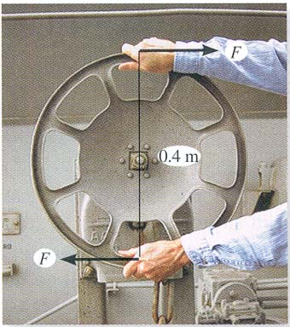
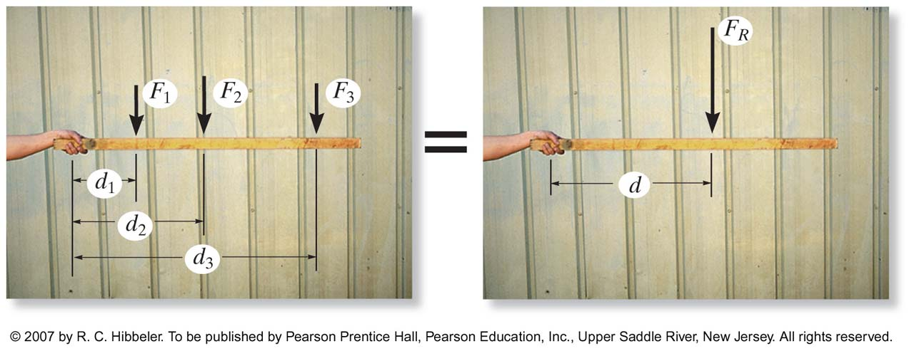
Moment Shortcuts
Recognize when you can make a problem simpler….
Couple moment
Reduction of forces
Equivalent situations

Slide 4
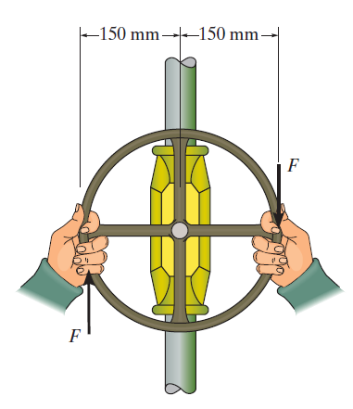
Find the moment
What moment is produced if the force is 75 pounds?

Slide 5
Find the moment
What moment is produced if the force is 75 pounds?

Slide 6
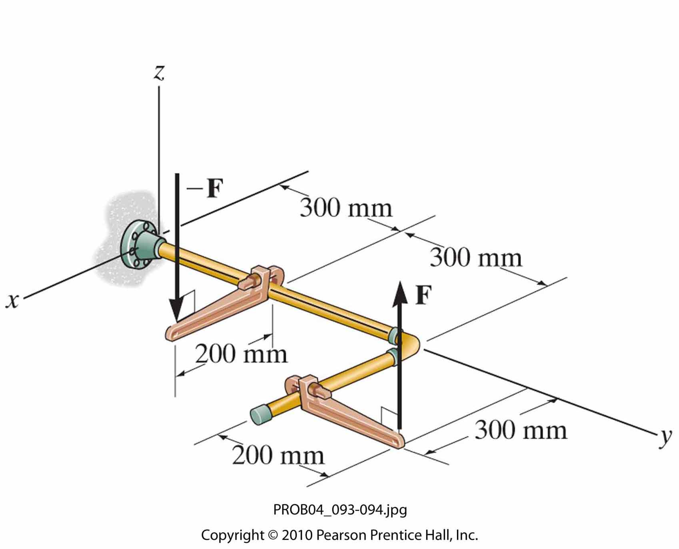
F = 80 N; find the moment

Slide 7
Equivalent Force
Equivalent Force & Moment

Slide 9
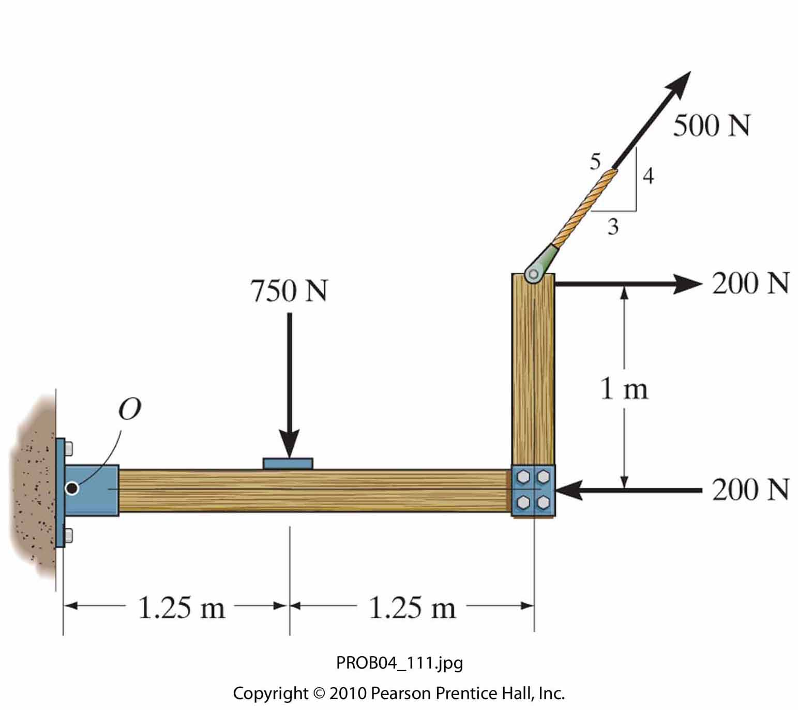
Replace the force system by a resultant force and couple moment at point O.
Replace the loading with one force located on the horizontal some distance from O.
Replace the loading with one force located on the vertical some distance from O.

Slide 10
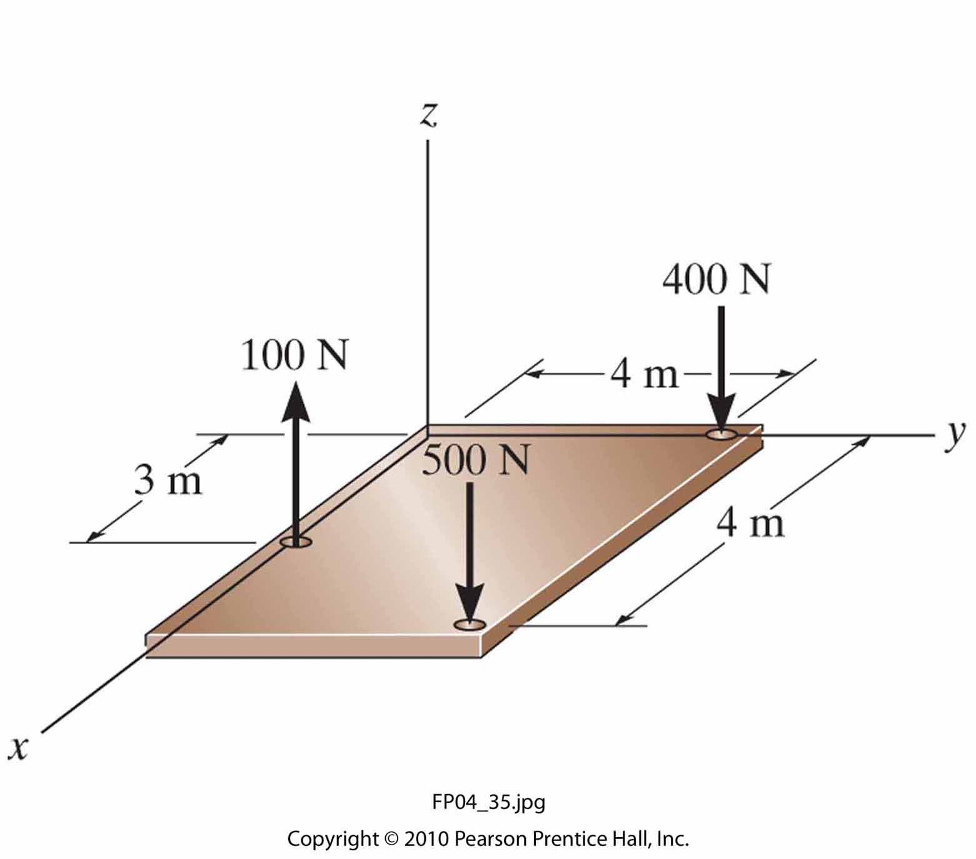
Replace the loading shown by an equivalent single resultant force and specify the x and y coordinates of its line of action

Slide 11
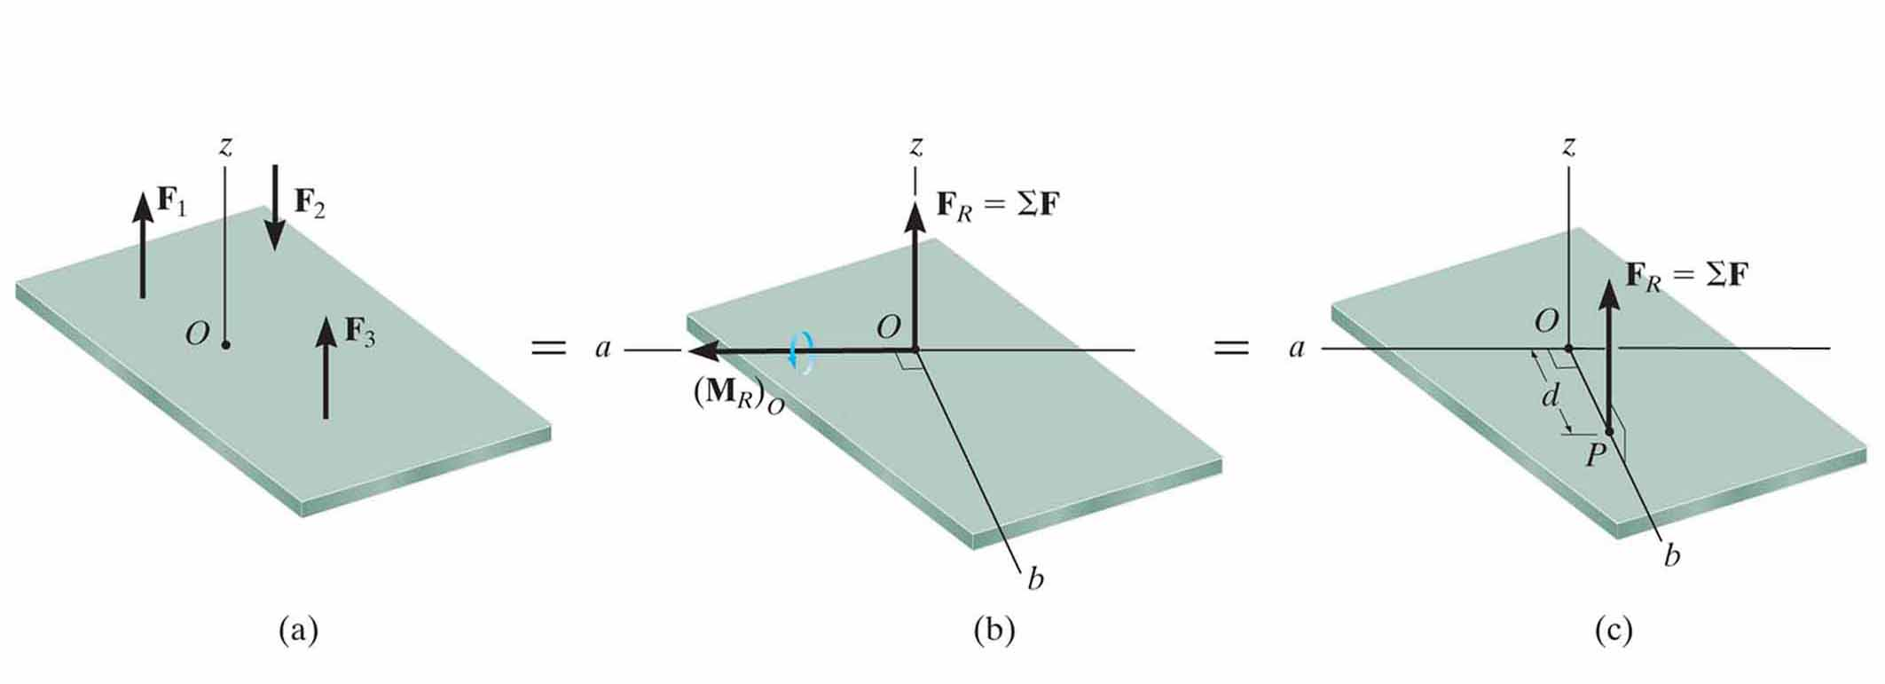
Further reduction of a system to a resultant moment

Slide 12
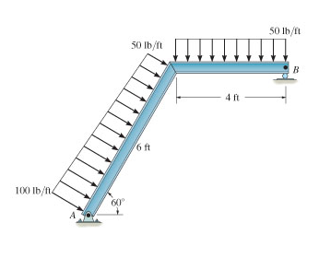
Replace the loading with an equivalent force and moment at B

Slide 14
Replace the loading shown by an equivalent single resultant force and specify the x and y coordinates of its line of action

