Slide 1
Chapter 4
NOT section 5
Sections 6-10

Slide 2
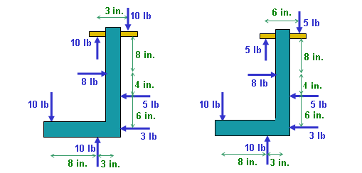
READING QUIZ
1. In statics, a couple is defined as __________ separated by a perpendicular distance.
A) two forces in the same direction.
B) two forces of equal magnitude.
C) two forces of equal magnitude acting in the same direction.
D) two forces of equal magnitude acting in opposite directions.
2. Are these two equivalent loadings?
Notes:
Answers:
1. D
2. yes

Slide 3
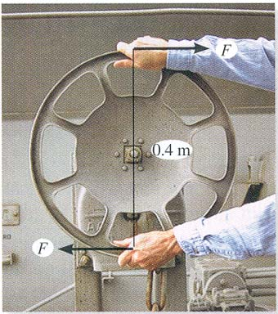
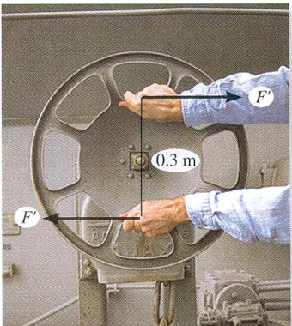
APPLICATIONS
A torque or moment of 12 N · m is required to rotate the wheel. Which one of the two grips of the wheel above will require less force to rotate the wheel?

Slide 4
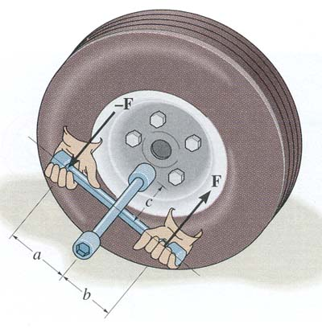
APPLICATIONS (continued)
The crossbar lug wrench is being used to loosen a lug net. What is the effect of changing dimensions a, b, or c on the force that must be applied?

Slide 5
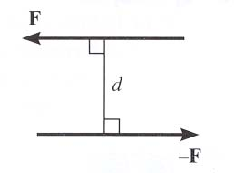
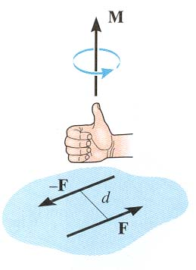
MOMENT OF A COUPLE
A couple is defined as two parallel forces with the same magnitude but opposite in direction separated by a perpendicular distance d.
The moment of a couple is defined as
M_{O} = F d (using a scalar analysis) or as
M_{O} = r × F (using a vector analysis).
Here r is any position vector from the line of action of –F to the line of action of F.

Slide 6
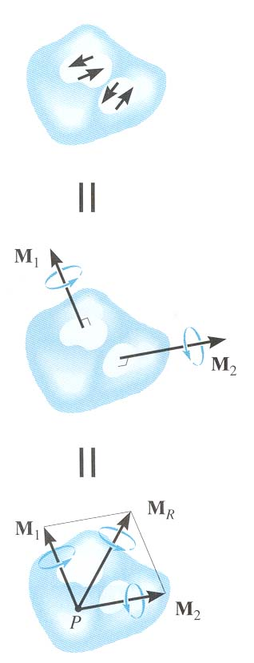
MOMENT OF A COUPLE (continued)
The net external effect of a couple is that the net force equals zero and the magnitude of the net moment equals F d
Since the moment of a couple depends only on the distance between the forces, the moment of a couple is a free vector. It can be moved anywhere on the body and have the same external effect on the body.
Moments due to couples can be added using the same rules as adding any vectors.

Slide 7
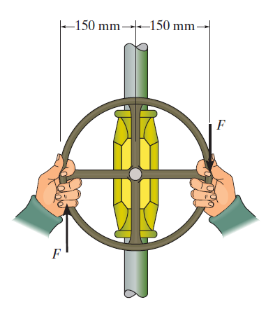
Find the moment
What moment is produced if the force is 75 pounds?

Slide 8

Find the moment
What moment is produced if the force is 75 pounds?

Slide 9
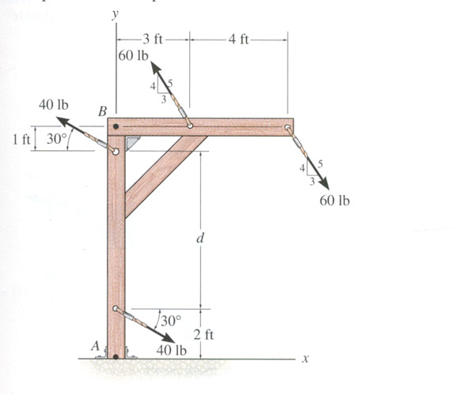
EXAMPLE - SCALAR APPROACH
Given: Two couples act on the beam and d equals 8 ft.
Find: The resultant couple
Plan:
1) Resolve the forces in x and y directions so they can be treated as couples.
2) Determine the net moment due to the two couples.

Slide 10
EXAMPLE - SCALAR APPROACH
The x and y components of the top 60 lb force are:
(4/5)(60 lb) = 48 lb vertically up
(3/5)(60 lb) = 36 lb to the left
Similarly for the top 40 lb force:
(40 lb) (sin 30°) up
(40 lb) (cos 30°) to the left
The net moment equals to
+ ΣM = -(48 lb)(4 ft) + (40 lb)(cos 30º)(8ft)
= -192.0 + 277.1 = 85.1 ft·lb

Slide 11
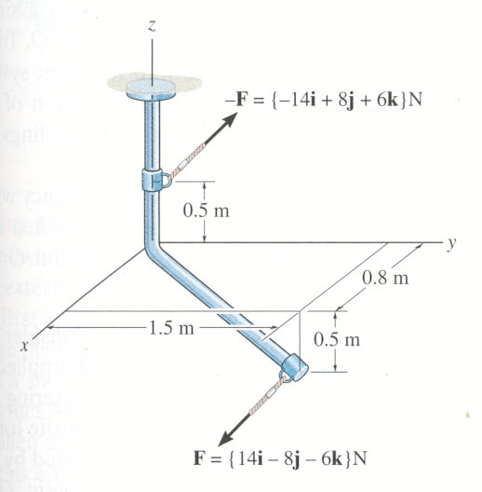
EXAMPLE – VECTOR APPROACH
Given: A force couple acting on the rod.
Find: The couple moment acting on the rod in Cartesian vector notation.
A
B
Plan:
1) Use M = r × F to find the couple moment.
2) Set r = r_{AB} and F = {14 i – 8 j – 6 k} N .
3) Calculate the cross product to find M.

Slide 12
EXAMPLE – VECTOR APPROACH
r_{AB} = {0.8 i + 1.5 j – 1 k} m
F = {14 i – 8 j – 6 k} N
A
B
M = r_{AB} × F
=
i
j
k
0.8 1.5 -1
N·m
14 -8 -6
= {i (-9 – (8)) – j (- 4.8 – (-14)) + k (-6.4 – 21)} N·m
= {-17 i – 9.2 j – 27.4 k} N·m

Slide 13
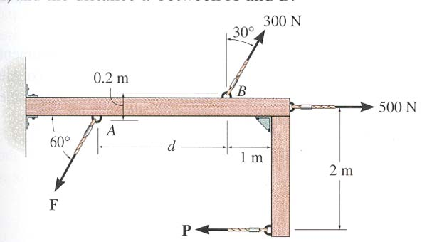
GROUP PROBLEM SOLVING – SCALAR APPROACH
Given: Two couples act on the beam. The resultant couple is zero.
Find: The magnitudes of the forces P and F and the distance d.
PLAN:
1) Use definition of a couple to find P and F.
2) Resolve the 300 N force in x and y directions.
3) Determine the net moment.
4) Equate the net moment to zero to find d.

Slide 14
GROUP PROBLEM SOLVING – SCALAR APPROACH
From the definition of a couple:
P = 500 N and
F = 300 N.
Resolve the 300 N force into vertical and horizontal components. The vertical component is (300 cos 30º) N and the horizontal component is (300 sin 30º) N.
It was given that the net moment equals zero. So
+ ΣM = - (500)(2) + (300 cos 30º)(d) - (300 sin 30º)(0.2) = 0
Now solve this equation for d.
d = (1000 + 60 sin 30º) / (300 cos 30º) = 3.96 m

Slide 15
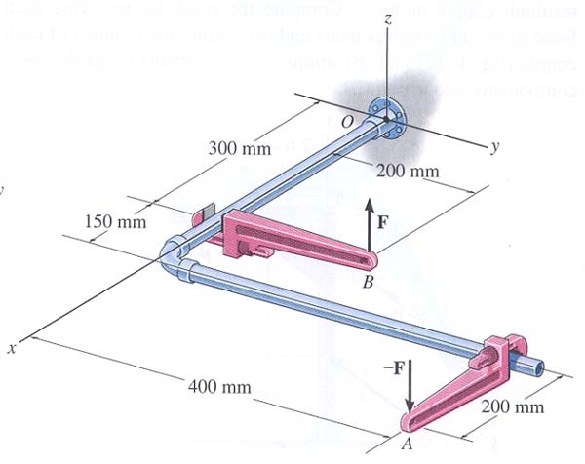
GROUP PROBLEM SOLVING – VECTOR APPROACH
Given: F = {25 k} N and - F = {- 25 k} N
Find: The couple moment acting on the pipe assembly using Cartesian vector notation.
PLAN:
1) Use M = r × F to find the couple moment.
2) Set r = r_{AB} and F = {25 k} N .
3) Calculate the cross product to find M.

Slide 16
GROUP PROBLEM SOLVING – VECTOR APPROACH
r_{AB} = { - 350 i – 200 j } mm
= { - 0.35 i – 0.2 j } m
F = {25 k} N
M = r_{AB} × F
=
N · m
= { i ( - 5 – 0 ) – j (- 8.75 – 0) + k (0) } N · m
= { -5 i + 8.75 j } N · m

Slide 17
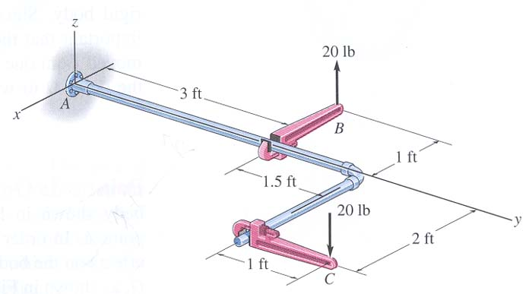
ATTENTION QUIZ
1. A couple is applied to the beam as shown. Its moment equals _____ N·m.
A) 50 B) 60
C) 80 D) 100
50 N
1m
2m
5
3
4
2. You can determine the couple moment as M = r × F
If F = { -20 k} lb, then r is
A) r_{BC} B) r_{AB}
C) r_{CB} D) r_{AC}
Notes:
Answers:
1. B – remember the definition of a couple, the picture shows the magnitude on one vector, the other vector shows the direction; so, if they are a couple, they have to have the same magnitude and same direction.
2. A

Slide 18
Do you remember from reading?
1. A general system of forces and couple moments acting on a rigid body can be reduced to a ___ .
1) single force.
2) single moment.
3) single force and two moments.
4) single force and a single moment.
2. The original force and couple system and an equivalent force-couple system have the same _____ effect on a body.
1) internal 2) external
3) internal and external 4) microscopic
Notes:
Answers:
1. D
2. B

Slide 19
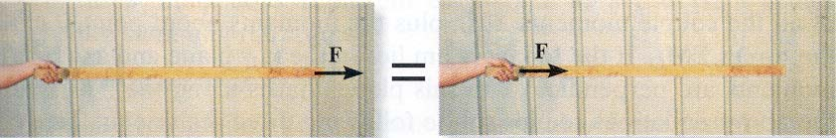
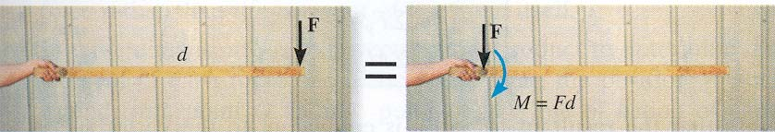
Equivalent Situations
What is the resultant effect on the person’s hand when the force is applied in four different ways ?

Slide 20
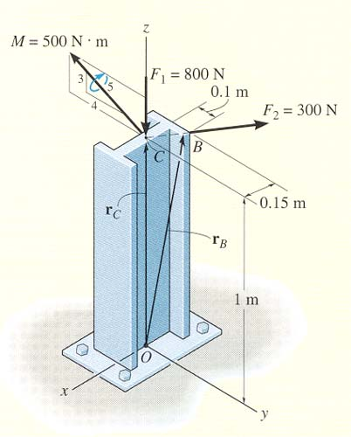
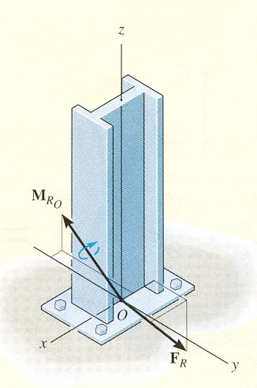
APPLICATIONS (continued)
Several forces and a couple moment are acting on this vertical section of an I-beam.
| |
Can you replace them with just one force and one couple moment at point O that will have the same external effect? If yes, how will you do that?

Slide 21
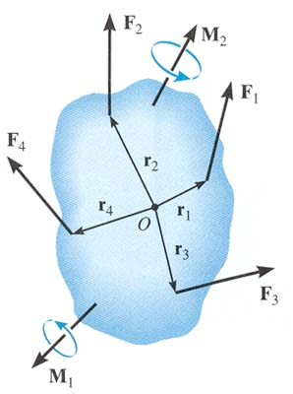
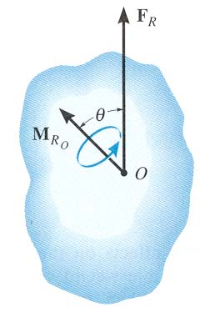
AN EQUIVALENT SYSTEM (Section 4.7)
=
When a number of forces and couple moments are acting on a body, it is easier to understand their overall effect on the body if they are combined into a single force and couple moment having the same external effect
The two force and couple systems are called equivalent systems since they have the same external effect on the body.

Slide 22
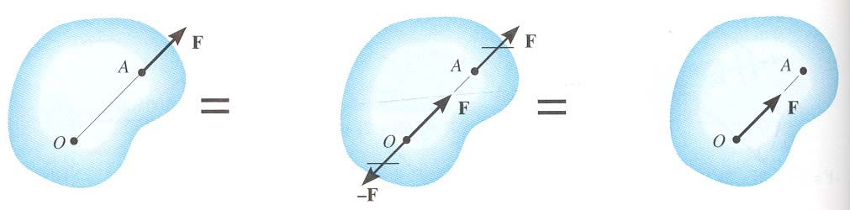
MOVING A FORCE ON ITS LINE OF ACTION
Moving a force from A to O, when both points are on the vectors’ line of action, does not change the external effect. Hence, a force vector is called a sliding vector. (But the internal effect of the force on the body does depend on where the force is applied).

Slide 23
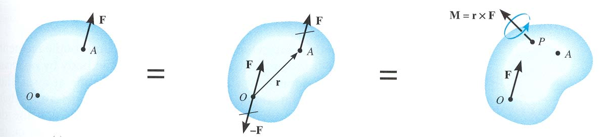
MOVING A FORCE OFF OF ITS LINE OF ACTION
Moving a force from point A to O (as shown above) requires creating an additional couple moment. Since this new couple moment is a “free” vector, it can be applied at any point P on the body.

Slide 24
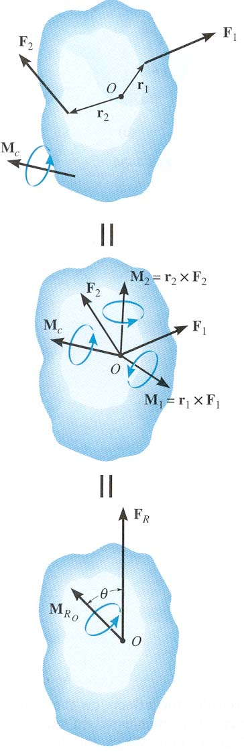
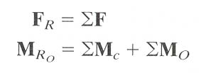
RESULTANTS OF A FORCE AND COUPLE SYSTEM
(Section 4.8)
When several forces and couple moments act on a body, you can move each force and its associated couple moment to a common point O.
Then add all the forces and couple moments together and find one resultant force-couple moment pair.

Slide 25
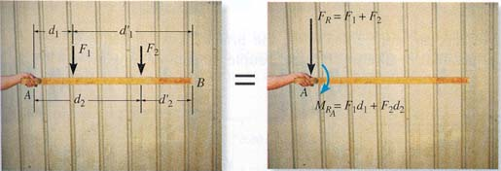
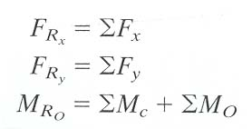
RESULTANT OF A FORCE AND COUPLE SYSTEM (continued)
If the force system lies in the x-y plane (the 2-D case), then the reduced equivalent system can be obtained using the following three scalar equations.

Slide 26
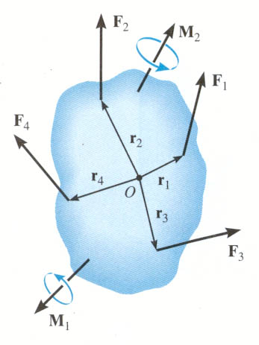
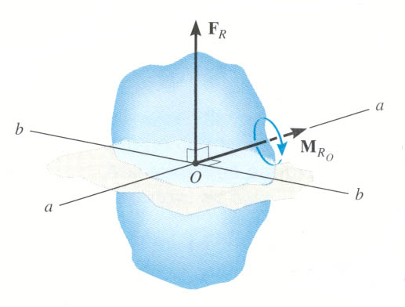
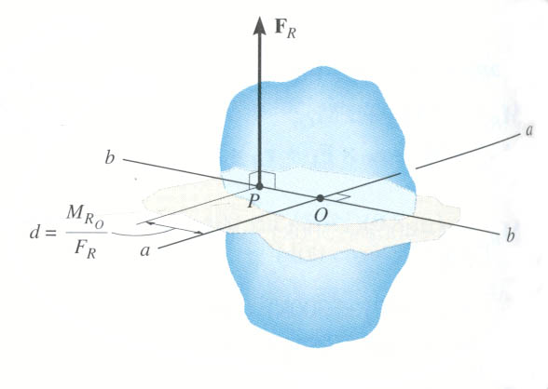
FURTHER REDUCTION OF A FORCE AND COUPLE SYSTEM (Section 4.9)
=
=
If F_{R} and M_{RO} are perpendicular to each other, then the system can be further reduced to a single force, F_{R} , by simply moving F_{R} from O to P.
In three special cases, concurrent, coplanar, and parallel systems of forces, the system can always be reduced to a single force.

Slide 27
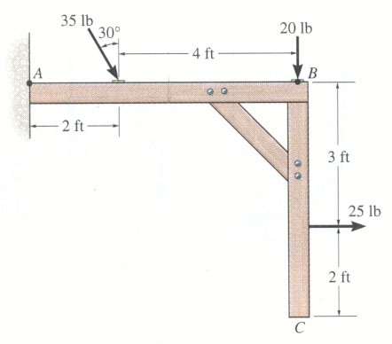
EXAMPLE #1
Given: A 2-D force and couple system as shown.
Find: The equivalent resultant force and couple moment acting at A and then the equivalent single force location along the beam AB.
Plan:
1) Sum all the x and y components of the forces to find F_{RA}.
2) Find and sum all the moments resulting from moving each force to A.
3) Shift the F_{RA} to a distance d such that d = M_{RA}/F_{Ry}

Slide 28
EXAMPLE #1 (continued)
+ → ΣF_{Rx} = 25 + 35 sin 30° = 42.5 lb
+ ↓ ΣF_{Ry} = 20 + 35 cos 30° = 50.31 lb
+ M_{RA} = 35 cos30° (2) + 20(6) – 25(3)
= 105.6 lb·ft
F_{R}
F_{R} = ( 42.5² + 50.31² )^{1/2} = 65.9 lb θ = tan⁻¹ ( 50.31/42.5) = 49.8 °
The equivalent single force F_{R} can be located on the beam AB at a distance d measured from A.
d = M_{RA}/F_{Ry} = 105.6/50.31 = 2.10 ft.

Slide 29
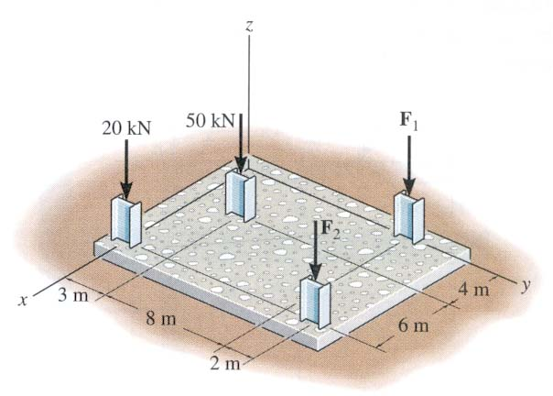
EXAMPLE #2
Given: The building slab has four columns. F₁ and F₂ = 0.
Find: The equivalent resultant force and couple moment at the origin O. Also find the location (x,y) of the single equivalent resultant force.
o
Plan:
1) Find F_{RO} = ∑F_{i} = F_{Rzo} k
2) Find M_{RO} = ∑ (r_{i} × F_{i}) = M_{RxO} i + M_{RyO} j
3) The location of the single equivalent resultant force is given as x = -M_{RyO}/F_{RzO} and y = M_{RxO}/F_{RzO}

Slide 30
EXAMPLE #2 (continued)
F_{RO} = {-50 k – 20 k} = {-70 k} kN
M_{RO} = (10 i) × (-20 k) + (4 i + 3 j)x(-50 k)
= {200 j + 200 j – 150 i} kN·m
= {-150 i + 400 j } kN·m
o
The location of the single equivalent resultant force is given as,
x = -M_{Ryo}/F_{Rzo} = -400/(-70) = 5.71 m
y = M_{Rxo}/F_{Rzo} = (-150)/(-70) = 2.14 m

Slide 31
CONCEPT QUIZ
1. The forces on the pole can be reduced to a single force and a single moment at point ____ .
A) P B) Q C) R
D) S E) Any of these points.
2. Consider two couples acting on a body. The simplest possible equivalent system at any arbitrary point on the body will have
A) one force and one couple moment.
B) one force.
C) one couple moment.
D) two couple moments.
Notes:
Answers:
E
C

Slide 32
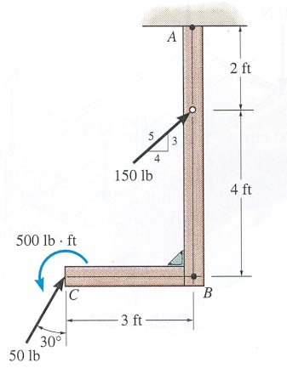
GROUP PROBLEM SOLVING
Given: A 2-D force and couple system as shown.
Find: The equivalent resultant force and couple moment acting at A.
Plan:
1) Sum all the x and y components of the forces to find F_{RA}.
2) Find and sum all the moments resulting from moving each force to A and add them to the 500 lb - ft free moment to find the resultant M_{RA} .

Slide 33
GROUP PROBLEM SOLVING (continued)
Summing the force components:
+ → ΣF_{x} = (4/5) 150 lb + 50 lb sin 30° = 145 lb
+ ↑ ΣF_{y} = (3/5) 150 lb + 50 lb cos 30° = 133.3 lb
Now find the magnitude and direction of the resultant.
F_{RA} = ( 145 ² + 133.3 ² )^{1/2} = 197 lb and θ = tan⁻¹ ( 133.3/145) = 42.6 °
+ M_{RA} = { (4/5)(150)(2) – 50 cos30° (3) + 50 sin30° (6) + 500 }
= 760 lb·ft

Slide 34
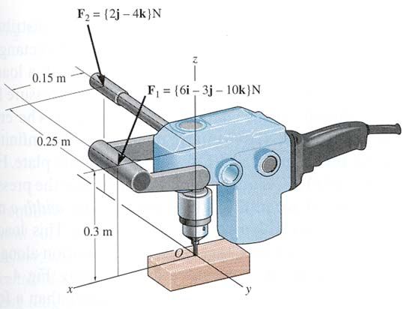
GROUP PROBLEM SOLVING (continued)
Given: Handle forces F₁ and F₂ are applied to the electric drill.
Find: An equivalent resultant force and couple moment at point O.
Plan:
a) Find F_{RO} = Σ F_{i}
b) Find M_{RO} = Σ M_{C} + Σ ( r_{i} × F_{i} )
Where,
F_{i} are the individual forces in Cartesian vector notation (CVN).
M_{C} are any free couple moments in CVN (none in this example).
R_{i} are the position vectors from the point O to any point on the line of action of F_{i} .

Slide 35
SOLUTION
F₁ = {6 i – 3 j – 10 k} N
F₂ = {0 i + 2 j – 4 k} N
F_{RO} = {6 i – 1 j – 14 k} N
r₁ = {0.15 i + 0.3 k} m
r₂ = {-0.25 j + 0.3 k} m
M_{RO} = r₁ × F₁ + r₂ × F₂
M_{RO} = {
} N·m
= {0.9 i + 3.3 j – 0.45 k + 0.4 i + 0 j + 0 k} N·m
= {1.3 i + 3.3 j – 0.45 k} N·m

Slide 36
ATTENTION QUIZ
1. For this force system, the equivalent system at P is ___________ .
A) F_{RP} = 40 lb (along +x-dir.) and M_{RP} = +60 ft ·lb
B) F_{RP} = 0 lb and M_{RP} = +30 ft · lb
C) F_{RP} = 30 lb (along +y-dir.) and M_{RP} = -30 ft ·lb
D) F_{RP} = 40 lb (along +x-dir.) and M_{RP} = +30 ft ·lb
y
30 lb
1'
1'
x
•
40 lb
P
30 lb
Notes:
Answer:
1. D

Slide 37
ATTENTION QUIZ
2. Consider three couples acting on a body. Equivalent systems will be _______ at different points on the body.
A) different when located
B) the same even when located
C) zero when located
D) None of the above.
Notes:
Answer:
2. B

Slide 38
READING QUIZ
w
Distributed load curve
1. The resultant force (F_{R}) due to a distributed load is equivalent to the _____ under the distributed loading curve, w = w(x).
A) centroid B) arc length
C) area D) volume
x
F
R
2. The line of action of the distributed load’s equivalent force passes through the ______ of the distributed load.
A) centroid B) mid-point
C) left edge D) right edge
Notes:
Answers:
1. C
2. A

Slide 39
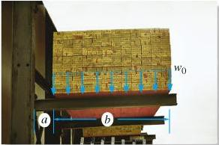
APPLICATIONS
A distributed load on the beam exists due to the weight of the lumber.
Is it possible to reduce this force system to a single force that will have the same external effect? If yes, how?

Slide 40
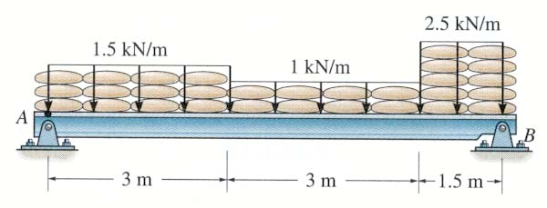
APPLICATIONS (continued)
The sandbags on the beam create a distributed load.
How can we determine a single equivalent resultant force and its location?

Slide 41
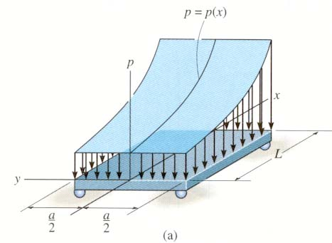
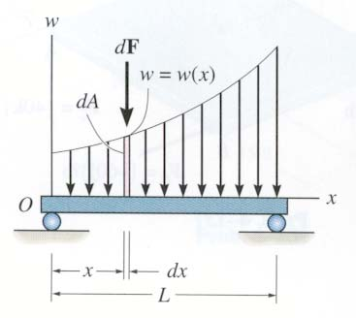
DISTRIBUTED LOADING
In many situations a surface area of a body is subjected to a distributed load. Such forces are caused by winds, fluids, or the weight of items on the body’s surface.
We will analyze the most common case of a distributed pressure loading. This is a uniform load along one axis of a flat rectangular body.
In such cases, w is a function of x and has units of force per length.

Slide 42
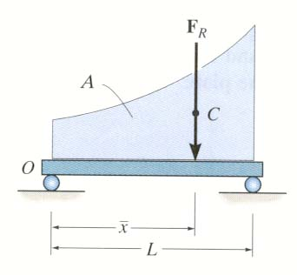
MAGNITUDE OF RESULTANT FORCE
Consider an element of length dx.
The force magnitude dF acting on it is given as
dF = w(x) dx
The net force on the beam is given by
+ ↓ F_{R} = ∫_{L} dF = ∫_{L} w(x) dx = A
Here A is the area under the loading curve w(x).

Slide 43
LOCATION OF THE RESULTANT FORCE
The force dF will produce a moment of (x)(dF) about point O.
The total moment about point O is given as
+ M_{RO} = ∫_{L} x dF = ∫_{L} x w(x) dx
Assuming that F_{R} acts at x, it will produce the moment about point O as
+ M_{RO} = ( x ) (F_{R}) = ∫_{L} x w(x) dx

Slide 44
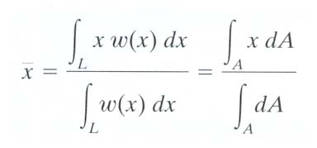
LOCATION OF THE RESULTANT FORCE (continued)
Comparing the last two equations, we get
You will learn later that F_{R} acts through a point “C,” which is called the geometric center or centroid of the area under the loading curve w(x).

Slide 45
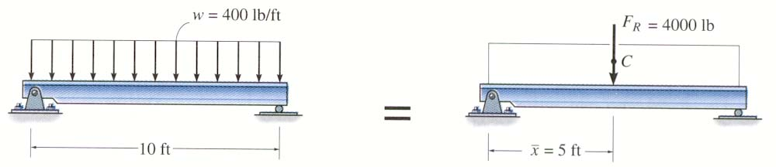
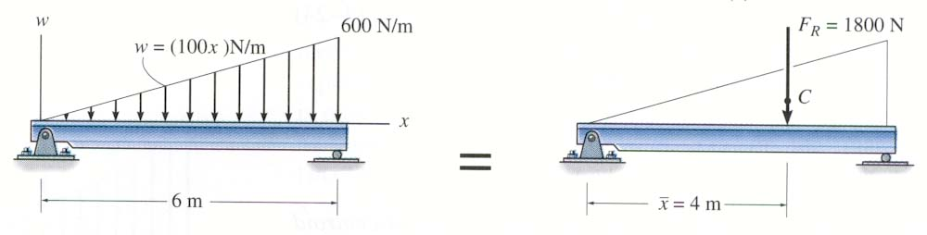
EXAMPLES
Until you learn more about centroids, we will consider only rectangular and triangular loading diagrams whose centroids are well defined and shown on the inside back cover of your textbook.
In a rectangular loading, F_{R} = 400 × 10 = 4,000 lb and x= 5 ft.
x
In a triangular loading ,
F_{R} = (0.5) (6000) (6) = 1,800 N and x = 6 – (1/3) 6 = 4 m.
Note that the centroid in a right triangle is at a distance one third the width of the triangle as measured from its base.

Slide 46
CONCEPT QUIZ
1. What is the location of F_{R}, i.e., the distance d?
A) 2 m B) 3 m C) 4 m
D) 5 m E) 6 m
F
R
A
B
A
B
d
3 m
3 m
2. If F₁ = 1 N, x₁ = 1 m, F₂ = 2 N and x₂ = 2 m, what is the location of F_{R}, i.e., the distance x.
A) 1 m B) 1.33 m C) 1.5 m
D) 1.67 m E) 2 m
x
F
F
2
1
F
x
R
2
x
1
Notes:
Answers:
1. D
2. D

Slide 47
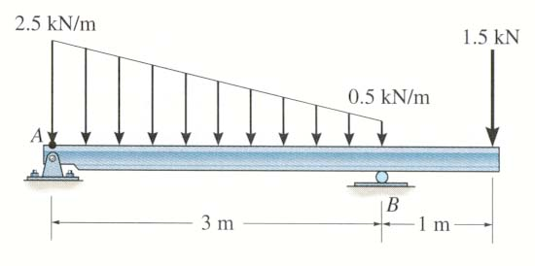
GROUP PROBLEM SOLVING
Given: The loading on the beam as shown.
Find: The equivalent force and its location from point A.
Plan:
1) Consider the trapezoidal loading as two separate loads (one rectangular and one triangular).
2) Find F_{R} and for each of these two distributed loads.
3) Determine the overall F_{R} and for the three point loadings.
x

Slide 48
GROUP PROBLEM SOLVING (continued)
For the rectangular loading of height
0.5 kN/m and width 3 m,
F_{R1} = 0.5 kN/m × 3 m = 1.5 kN
= 1.5 m from A
x
1
For the triangular loading of height 2 kN/m and width 3 m,
F_{R2} = (0.5) (2 kN/m) (3 m) = 3 kN
and its line of action is at = 1 m from A
x
2
For the combined loading of the three forces,
F_{R} = 1.5 kN + 3 kN + 1.5 kN = 6 kN
+ M_{RA} = (1.5) (1.5) + 3 (1) + (1.5) 4 = 11.25 kN • m
Now, F_{R} = 11.25 kN • m
Hence, = (11.25) / (6) = 1.88 m from A.
x
x

Slide 49
ATTENTION QUIZ
100 N/m
F
R
12 m
x
1. F_{R} = ____________
A) 12 N B) 100 N
C) 600 N D) 1200 N
2. x = __________.
A) 3 m B) 4 m
C) 6 m D) 8 m
Notes:
Answers:
1. C
2. B

Slide 50
Find the equivalent resultant force and couple moment acting at A.
Find the magnitudes of the forces P and F and the distance d.

