Slide 1
Chapter 4
Moments
Sections 1 - 4

Slide 2
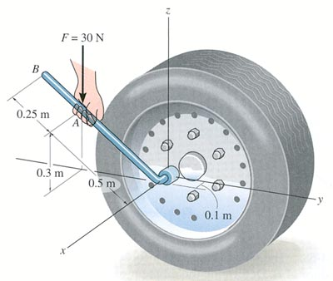
This is a MOMENT
or
TORQUE
What is the force on the lug nut?
How does it change if the hand moves to B?

Slide 3
Draw a FBD of the lug nut
Notes:
Where does the lug nut feel the force? Probably along the circumference, maybe more on one side than the other. Simplify the forces into one place and draw a vector. Notice that the vector is on the edge of the body. This is why we switched from a particle model to a FBD. It’s important WHERE the force is drawn on the body because a moment causes rotation.

Slide 4
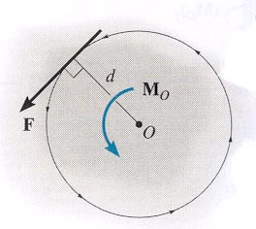
MOMENT OF A FORCE
In the 2-D case, the magnitude of the moment is M_{o} = F d
As shown, d is the perpendicular distance from point O to the line of action of the force.
In 2-D, the direction of M_{O} is either clockwise or
counter-clockwise depending on the tendency for rotation.

Slide 5
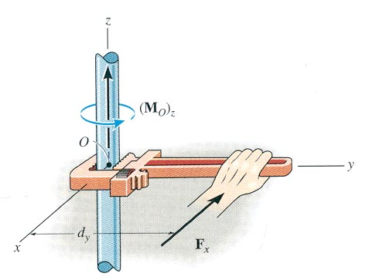
MOMENT OF A FORCE
The moment of a force about a point provides a measure of the
tendency for rotation (sometimes called torque).

Slide 6
Check
1. What is the moment of the 10 N force about point A (M_{A})?
A) 10 N·m B) 30 N·m C) 13 N·m
D) (10/3) N·m E) 7 N·m
F = 10 N
d = 3 m
A•
Notes:
Answers:
1. B
2. A

Slide 7
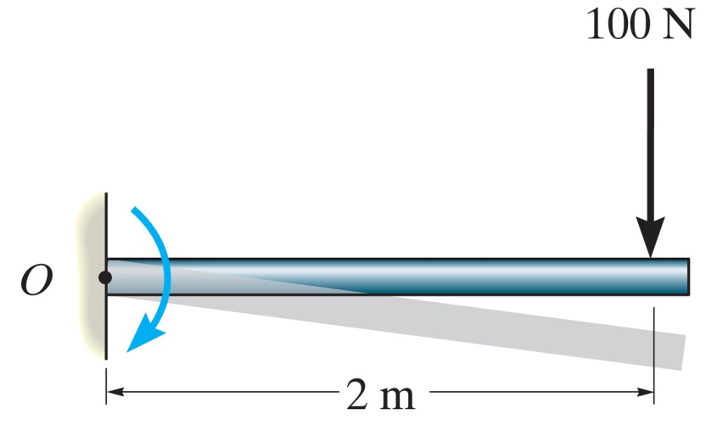
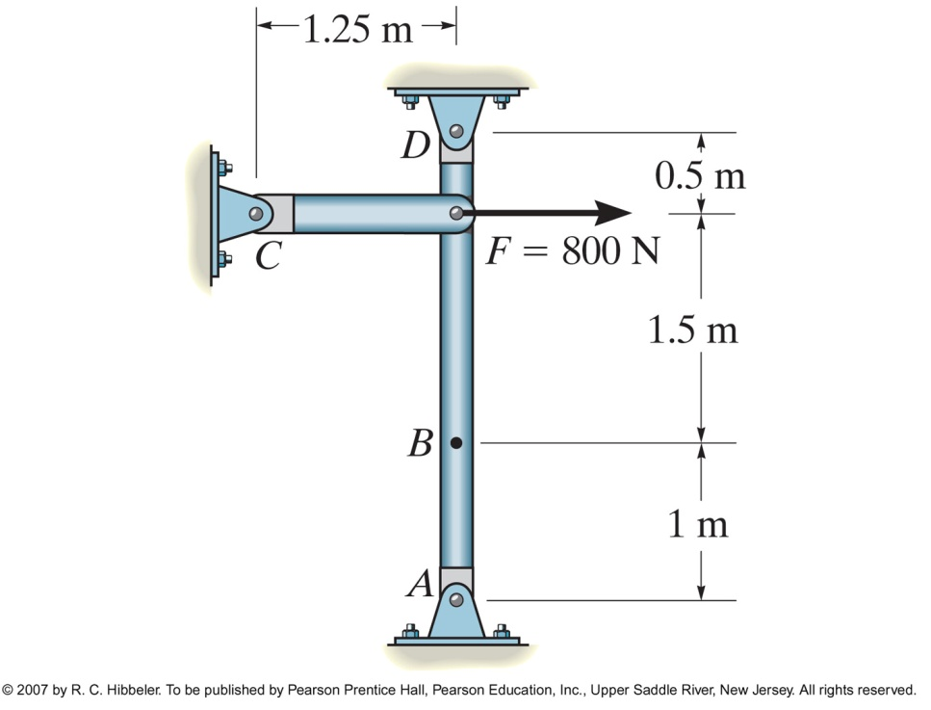
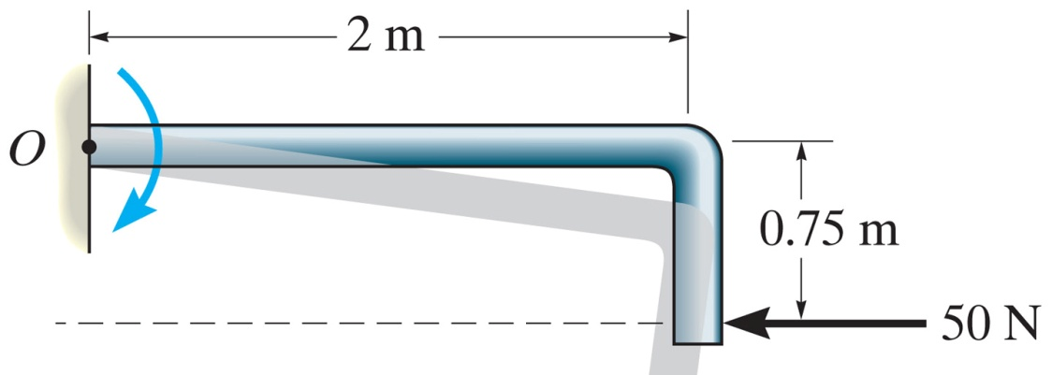
Notes:
Figure: 04-04aEx1

Slide 8
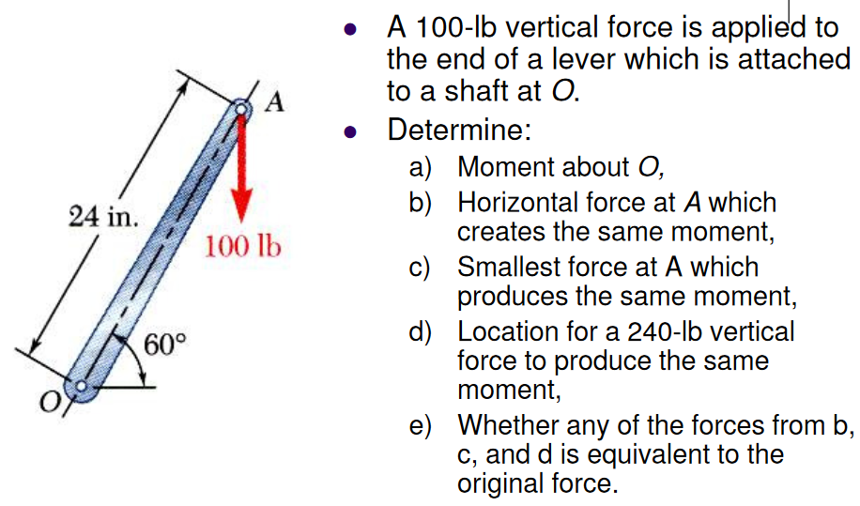

Slide 9
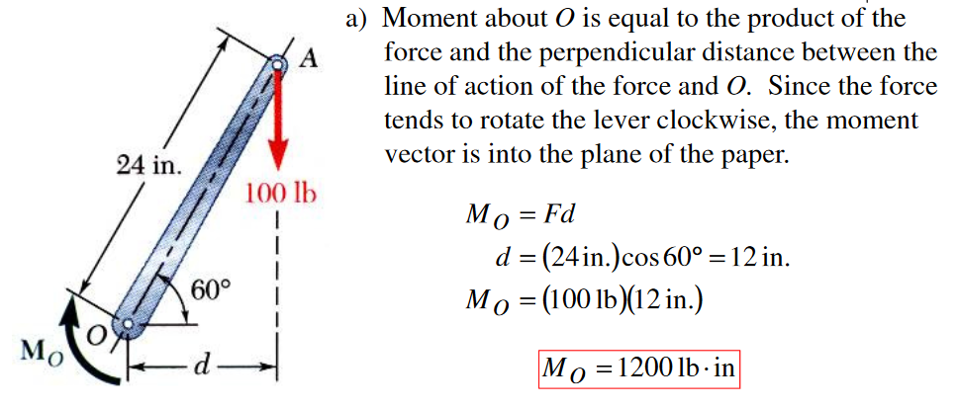
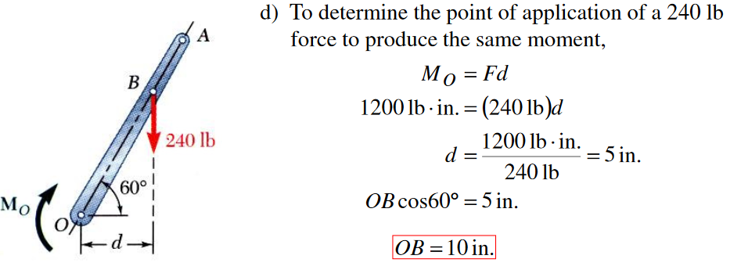
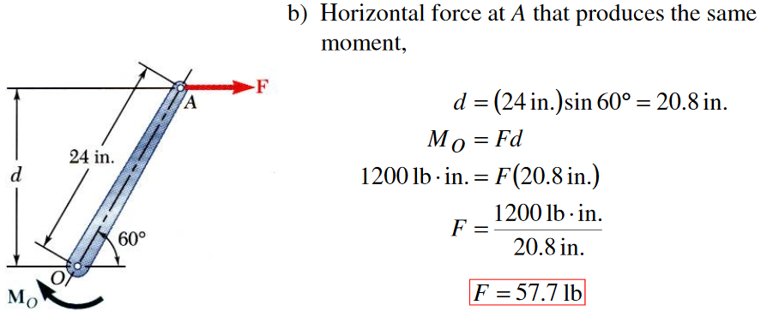
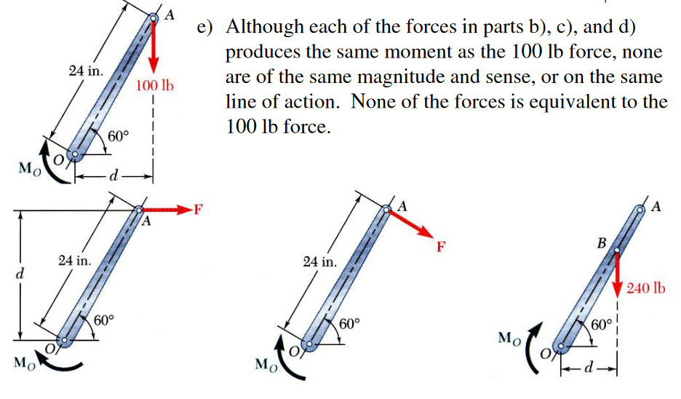
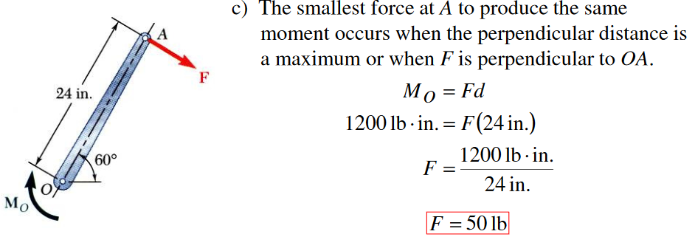

Slide 10
MOMENT OF A FORCE - SCALAR FORMULATION (continued)
F
a
b
For example, M_{O} = F d and the direction is counter-clockwise.
O
d
Often it is easier to determine M_{O} by using the components of F as shown.
F _{y}
F
F _{x}
b
a
O
Using this approach, M_{O} = (F_{Y} a) – (F_{X} b). Note the different signs on the terms! The typical sign convention for a moment in 2-D is that counter-clockwise is considered positive. We can determine the direction of rotation by imagining the body pinned at O and deciding which way the body would rotate because of the force.

Slide 11
CONCEPT QUIZ
If a force of magnitude F can be applied in four different 2-D configurations (P,Q,R, & S), select the cases resulting in the maximum and minimum torque values on the nut. (Max, Min).
A) (Q, P) B) (R, S)
C) (P, R) D) (Q, S)
Notes:
Answers:
1. D

Slide 12
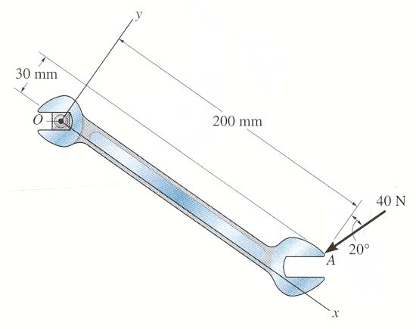
GROUP PROBLEM SOLVING
Find the moment of the force at O
Plan: 1) Resolve the force along x and y axes.
2) Determine M_{O} using scalar analysis.
Solution: + ↑ F_{y} = - 40 cos 20° N
+ → F_{x} = - 40 sin 20° N
+ M_{O} = {-(40 cos 20°)(200) + (40 sin 20°)(30)}N·mm
= -7107 N·mm = - 7.11 N·m

Slide 13
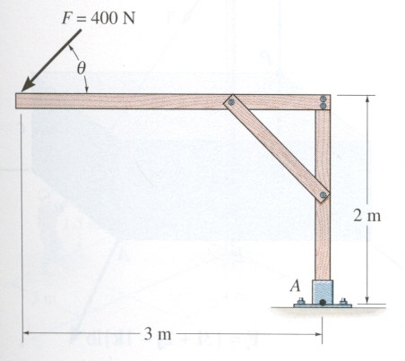
EXAMPLE #1
Given: A 400 N force is applied to the frame and θ = 20°.
Find: The moment of the force at A.
Plan:
1) Resolve the force along x and y axes.
2) Determine M_{A} using scalar analysis.

Slide 14
EXAMPLE #1 (continued)
Solution
+ ↑ F_{y} = -400 sin 20° N
+ → F_{x} = -400 cos 20° N
+ M_{A} = {(400 cos 20°)(2) + (400 sin 20°)(3)} N·m
= 1160 N·m

Slide 15
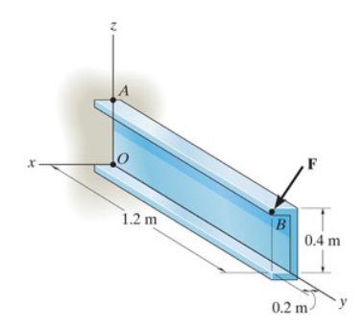

Slide 16
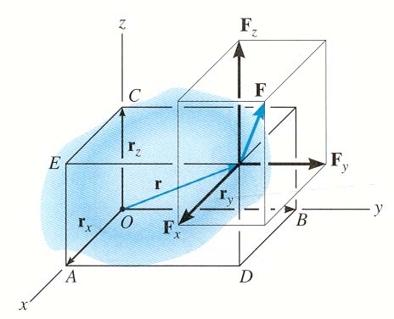
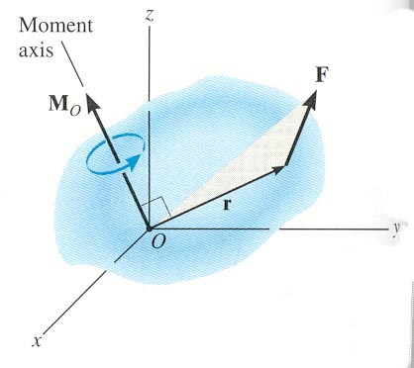
MOMENT OF A FORCE – 3-D
Moments in 3-D can be calculated using scalar (2-D) approach but it can be difficult and time consuming. It is often easier to use the vector cross product.
Using the vector cross product, M_{O} = r × F .
Here r is the position vector from point O to any point on the line of action of F.

Slide 17
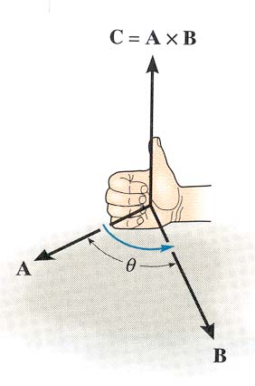
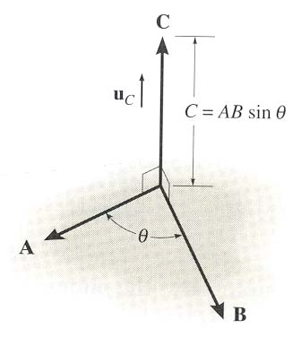
CROSS PRODUCT
In general, the cross product of two vectors A and B results in another vector C , i.e., C = A × B. The magnitude and direction of the resulting vector can be written as:
C = A × B = A B sin θ U_{C}
Here U_{C} is the unit vector perpendicular to both A and B vectors as shown.

Slide 18
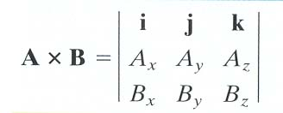
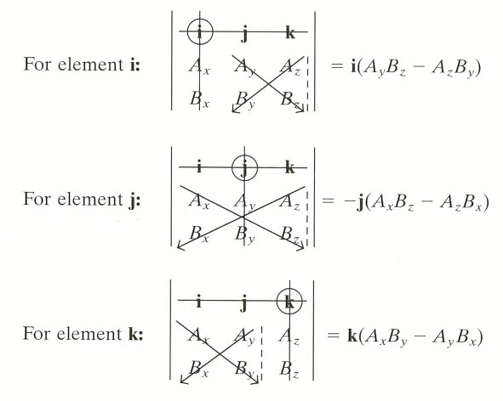
CROSS PRODUCT
The cross product can be written as:
Each component can be determined using 2 × 2 determinants.
Expanding the 2 × 2 determinants we get
M_{O} = (r _{y} F_{Z} - r_{Z} F_{y}) i - (r _{x} F_{z} - r_{z} F_{x} ) j + (r_{x} F_{y} - r_{y} F_{x} ) k

Slide 19
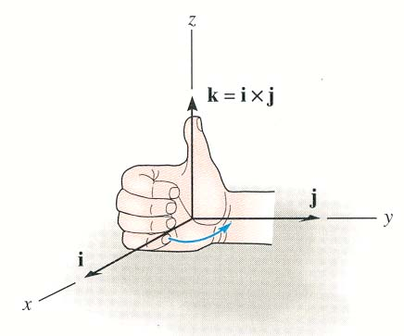
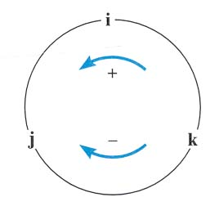
CROSS PRODUCT (continued)
The right hand rule is a useful tool for determining the direction of the resulting vector.
For example: i × j = k
Note that a vector crossed into itself is zero, e.g., i × i = 0

Slide 20
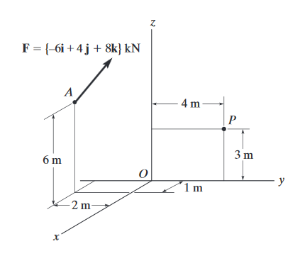

Slide 21
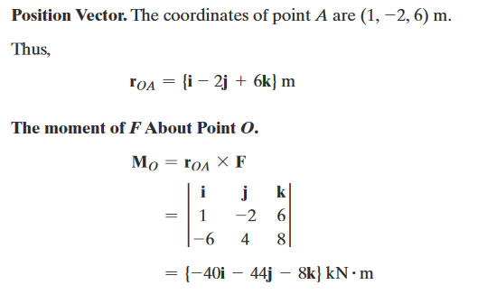

Slide 22
Check
1. Moment of force F about point O is defined as M_{O} = ___________ .
A) r x F B) F x r
C) r • F D) r * F
2. If M = r × F, then what will be the value of M • r ?
A) 0 B) 1
C) r ² F D) None of the above.
Notes:
Answer: A, A

Slide 23
3. Another word for moment is __________
4. If you use Cartesian vectors to determine the moment of a force, you will use the ____________ (cross product / dot product)
Notes:
Torque
Cross product

Slide 24
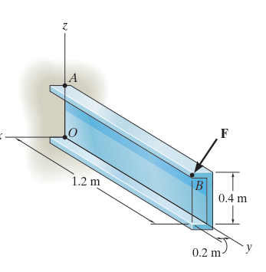

Slide 25
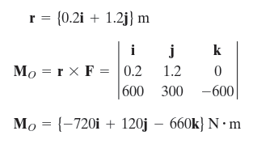

Slide 26
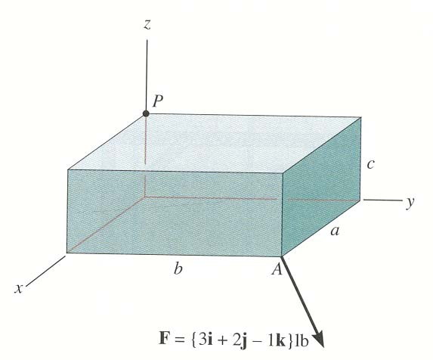
EXAMPLE # 2
Given: a = 3 in, b = 6 in and c = 2 in.
Find: Moment of F about point O.
Plan:
1) Find r_{OA}.
2) Determine M_{O} = r_{OA} × F .
o
Solution r_{OA} = {3 i + 6 j – 0 k} in
M_{O} =
i
j
k
= [{6(-1) – 0(2)} i – {3(-1) – 0(3)} j + {3(2) – 6(3)} k] lb·in
= {-6 i + 3 j – 12 k} lb·in
3 6 0
3 2 -1

Slide 27
ATTENTION QUIZ
10 N
5 N
3 m P 2 m
1. Using the CCW direction as positive, the net moment of the two forces about point P is
A) 10 N ·m B) 20 N ·m C) - 20 N ·m
D) 40 N ·m E) - 40 N ·m
2. If r = { 5 j } m and F = { 10 k } N, the moment
r x F equals { _______ } N·m.
A) 50 i B) 50 j C) –50 i
D) – 50 j E) 0
Notes:
Answers:
1. B
2. A

