Slide 1
Chapter 5
Sections 5.1 – 5.2

Slide 2
READING QUIZ
1. If a support prevents translation of a body, then the support exerts a ___________ on the body.
1) couple moment
2) force
3) Both 1 and 2.
4) None of the above
2. Internal forces are _________ shown on the free body diagram of a whole body.
A) always
B) often
C) rarely
D) never
Notes:
Answers:
1. 2
2. D

Slide 3
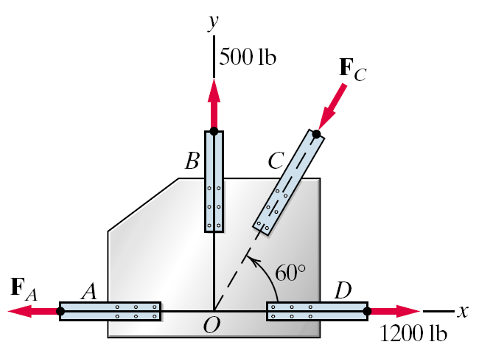
When we modeled particles……
…forces were concurrent and through the particle

Slide 4
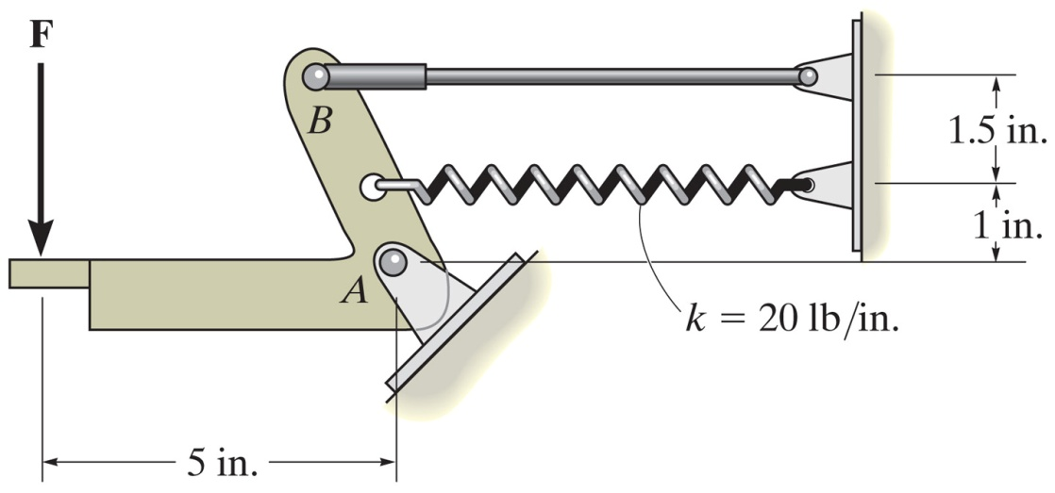
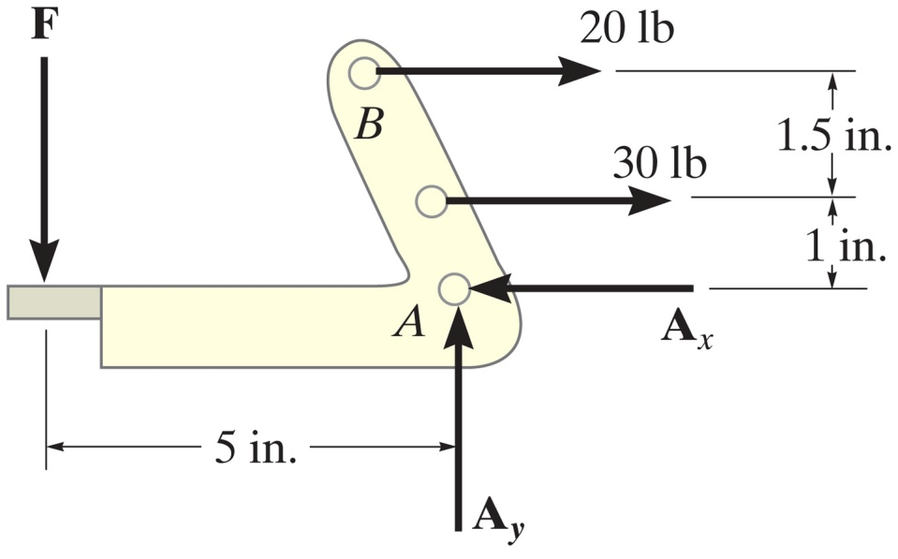
Now we model rigid bodies……
Notes:
Figure: 05-08bEx2

Slide 5
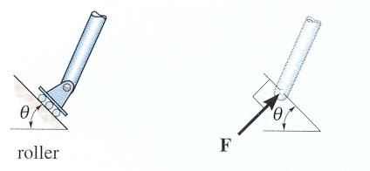
SUPPORT REACTIONS IN 2-D
As a general rule, if a support prevents translation of a body in a given direction, then a force is developed on the body in the opposite direction. Similarly, if rotation is prevented, a couple moment is exerted on the body.

Slide 12
Drawing Free-Body Diagrams
Isolate body and draw outlined shape
Draw support reactions (forces and moments)
Draw known forces
Draw weight forces at centroid
Identify all known force magnitudes, directions, angles, and locations

Slide 13
Draw the FBDs for Pulleys B (which has a pin support) and A.

Slide 14
………….

Slide 15
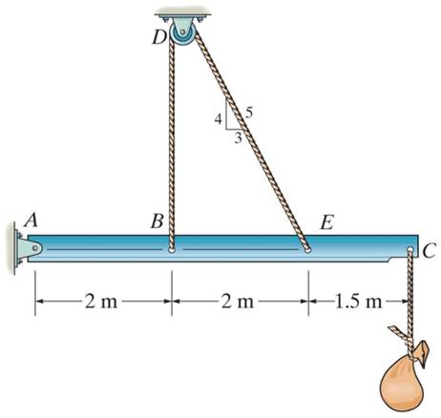
1. The beam and the cable (with a frictionless pulley at D) support an 80 kg load at C. In a FBD of only the beam, there are how many unknowns?
A) 2 forces and 1 couple moment
B) 3 forces and 1 couple moment
C) 3 forces
D) 4 forces
Notes:
Answers :
1. C

Slide 16
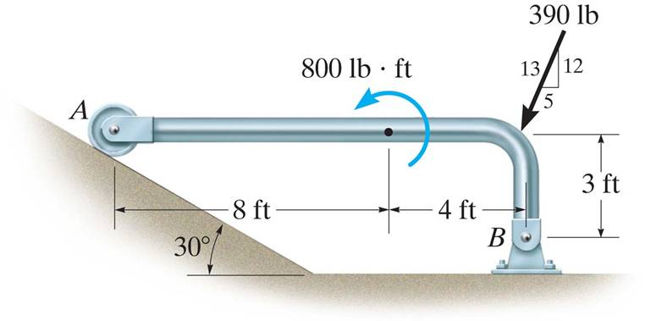
2. If the directions of the force and the couple moments are both reversed, what will happen to the beam?
A) The beam will lift from A. B) The beam will lift at B. C) The beam will be restrained.
D) The beam will break.
Notes:
Answer
2. A

Slide 17
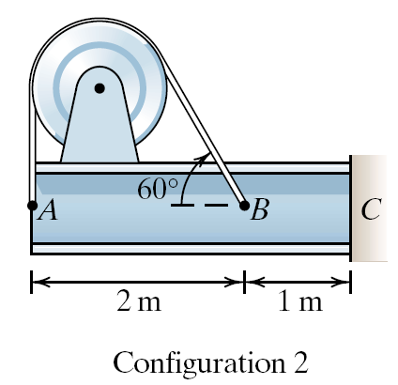
The beam and pulley systems are in equilibrium. The tension in the cable is 1.5 kN for both configurations. Assume that you can ignore the weight of the beam/pulley in the analysis. What loads act on the beam at C in the two configurations? In Configuration 1 the pulley is not included in the boundary and in Configuration 2 the pulley is included in the system.

Slide 18
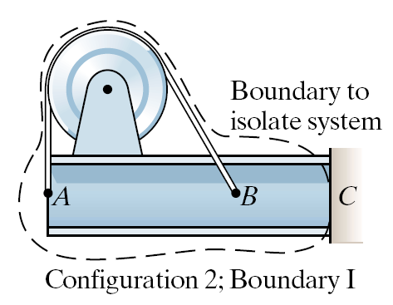

Slide 19
Notes:
Config 1: Fcx = 0.750 kN
Fcy = -2.80 kN
Mc = 5.80 kN
Config 2: Fcx = 0, Fcy = 0, M=0

Slide 20
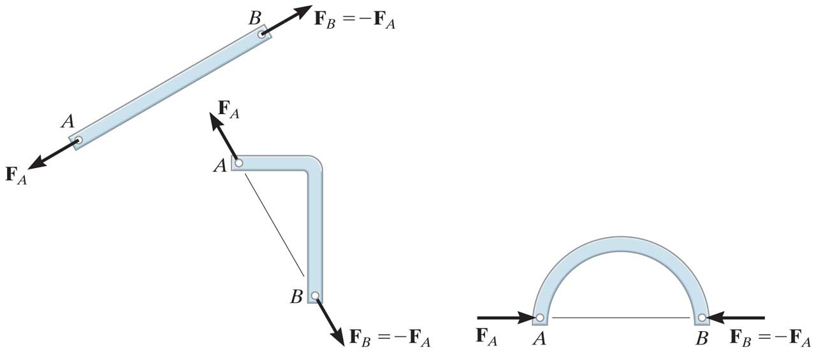
Two-Force & Three-Force Members

Slide 21
Other examples of two-force elements.

Slide 22
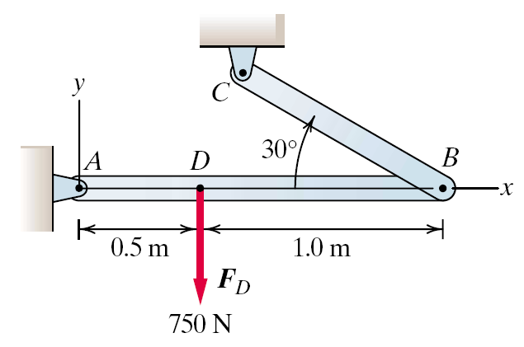
Three Force Member

Slide 23
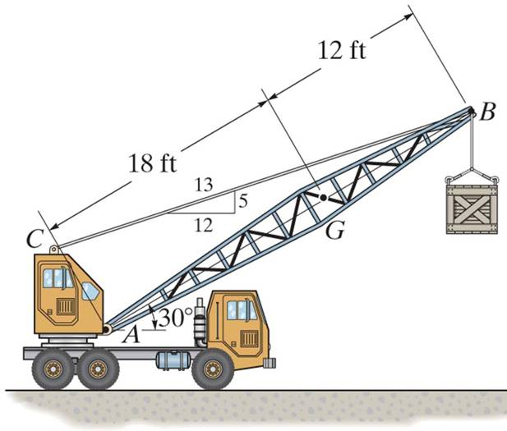
GROUP PROBLEM SOLVING
Draw a FBD of the crane boom, which is supported by a pin at A and cable BC. The load of 1250 lb is suspended at B and the boom weighs 650 lb.

Slide 24
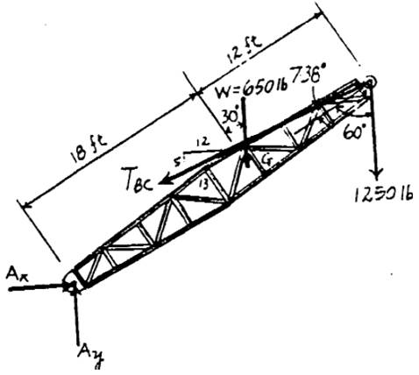
GROUP PROBLEM SOLVING (continued)
FBD

Slide 25
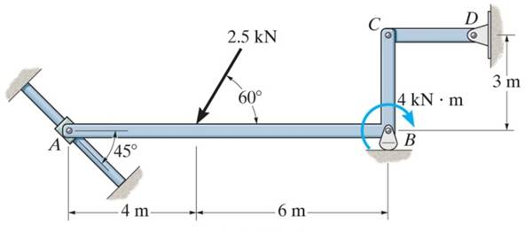
GROUP PROBLEM SOLVING
Draw a FBD of member ABC, which is supported by a smooth collar at A, roller at B, and link CD.

Slide 26
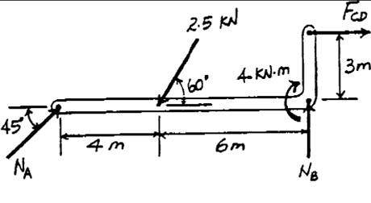
GROUP PROBLEM SOLVING (continued)
FBD

Slide 27
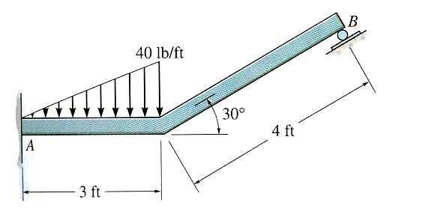
ATTENTION QUIZ
1. Internal forces are not shown on a free-body diagram because the internal forces are_____. (Choose the most appropriate answer.)
A) Equal to zero B) Equal and opposite and they do not affect the calculations
C) Negligibly small D) Not important
2. How many unknown support reactions are there in this problem?
A) 2 forces and 2 couple moments
B) 1 force and 2 couple moments
C) 3 forces
D) 3 forces and 1 couple moment
Notes:
Answers:
1.B
2.D

