Slide 1
Chapter 5
Sections 5.3 – 5.4

Slide 2
STEPS FOR SOLVING 2-D EQUILIBRIUM PROBLEMS
1. If not given, establish a suitable x - y coordinate system.
2. Draw a free body diagram (FBD) of the object under analysis.
Apply the three equations of equilibrium to solve for the unknowns.
ΣF_{x}=0; ΣF_{y}=0; ΣM=0

Slide 3
IMPORTANT NOTES
1. If we have more unknowns than the number of independent equations, then we have a statically indeterminate situation. We cannot solve these problems using just statics.
2. The order in which we apply equations may affect the simplicity of the solution. For example, if we have two unknown vertical forces and one unknown horizontal force, then solving ∑ F_{X} = O first allows us to find the horizontal unknown quickly.
3. If the answer for an unknown comes out as negative number, then the sense (direction) of the unknown force is opposite to that assumed when starting the problem.

Slide 4
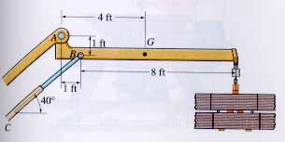
EXAMPLE
Given: Weight of the boom = 125 lb, the center of mass is at G, and the load = 600 lb.
Find: Support reactions at A and B.
Plan:
1. Put the x and y axes in the horizontal and vertical directions, respectively.
2. Determine if there are any two-force members.
3. Draw a complete FBD of the boom.
4. Apply the E-of-E to solve for the unknowns.

Slide 5
EXAMPLE (Continued)
FBD of the boom:
A_{Y}
A_{X}
A
1 ft
1 ft
3 ft
5 ft
D
40°
B
G
F_{B}
125 lb
600 lb
Note: Upon recognizing CB as a two-force member, the number of unknowns at B are reduced from two to one.
+ ∑M_{A} = 125 ∗ 4 + 600 ∗ 9 – F_{B} sin 40° ∗ 1 – F_{B} cos 40° ∗ 1 = 0
F_{B} = 4188 lb or 4190 lb
→ + ∑F_{X} = A_{X} + 4188 cos 40° = 0; A_{X} = – 3210 lb
↑ + ∑F_{Y} = A_{Y} + 4188 sin 40° – 125 – 600 = 0; A_{Y} = – 1970 lb

Slide 6
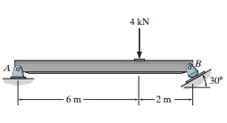

Slide 7
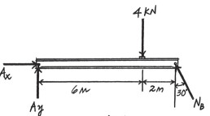
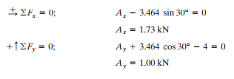

Slide 8
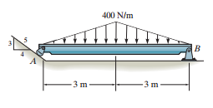

Slide 9
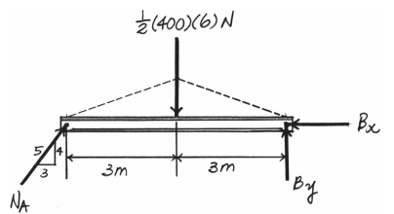
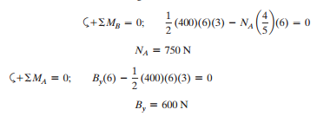

Slide 10
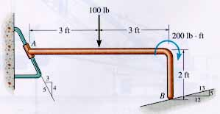
GROUP PROBLEM SOLVING
Given: The load on the bent rod is supported by a smooth inclined surface at B and a collar at A. The collar is free to slide over the fixed inclined rod.
Find: Support reactions at A and B.
Plan:
a) Establish the x – y axes.
b) Draw a complete FBD of the bent rod.
c) Apply the E-of-E to solve for the unknowns.

Slide 11
GROUP PROBLEM SOLVING (Continued)
100 lb
M_{A}
200 lb•ft
5
2 ft
3
3 ft
3 ft
N_{A}
4
5
FBD of the rod
13
12
→ + ∑F_{X} = (4 / 5) N_{A} – (5 / 13) N_{B} = 0
↑ + ∑F_{Y} = (3 / 5) N_{A} + (12 / 13) N_{B} – 100 = 0
N_{B}
Solving these two equations, we get N_{B} = 82.54 or 82.5 lb and N_{A} = 39.68 or 39.7 lb
+ ∑ M_{A} = M_{A} – 100 ∗ 3 – 200 + (12 / 13) N_{B}∗ 6 – (5 /13) N_{B}∗ 2 = 0
M_{A} = 106 lb • ft

Slide 12
CONCEPT QUIZ
For this beam, how many support reactions are there and is the problem statically determinate?
(2, Yes) B) (2, No)
C) (3, Yes) D) (3, No)
F₁
F₂
F₃
F₄
2. The beam AB is loaded and supported as shown: a) how many support reactions are there on the beam, b) is this problem statically determinate, and c) is the structure stable?
A) (4, Yes, No) B) (4, No, Yes)
C) (5, Yes, No) D) (5, No, Yes)
Fixed support
F
A
B
Notes:
Answers:
1. D
2. B

Slide 13
ATTENTION QUIZ
1. Which equation of equilibrium allows you to determine F_{B} right away?
A) ∑ F_{X} = 0 B) ∑ F_{Y} = 0
C) ∑ M_{A} = 0 D) Any one of the above.
100 lb
A_{X}
A
B
A_{Y}
F_{B}
2. A beam is supported by a pin joint and a roller. How many support reactions are there and is the structure stable for all types of loadings?
A) (3, Yes) B) (3, No)
C) (4, Yes) D) (4, No)
Notes:
Answers:
1. C
2. B

Slide 14
The weight of the boom = 125 lb, the center of mass is at G, and the load = 600 lb.
Find the support reactions at A and B.
The load on the bent rod is supported by a smooth inclined surface at B and a collar at A. The collar is free to slide over the fixed inclined rod. Find the support reactions at A and B.

Slide 16
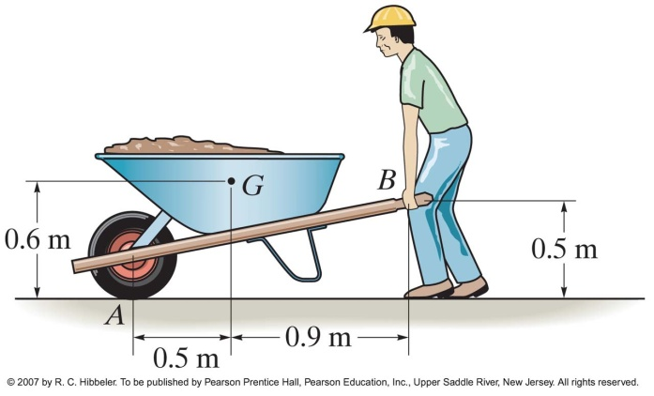
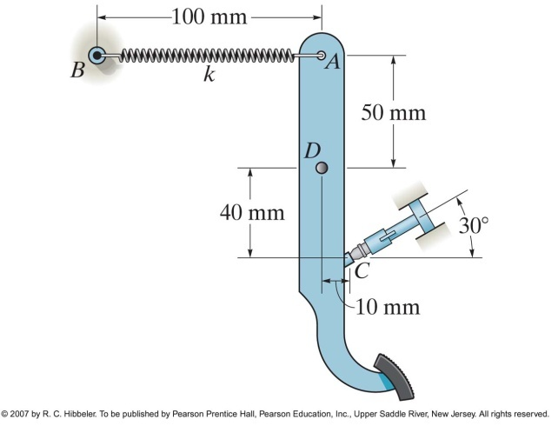
If the wheelbarrow and its contents have a mass of 60 kg and center of mass at G, determine the magnitude of the resultant force which the man must exert on each of the two handles in order to hold the wheelbarrow in equilibrium.
When no force is applied to the brake pedal of the lightweight truck, the retainer spring AB keeps the pedal in contact with the smooth brake light switch at C. If the force on the switch is 3 N, determine the unstretched length of the spring if the stiffness of the spring is k = 80 Nm.

