Slide 1
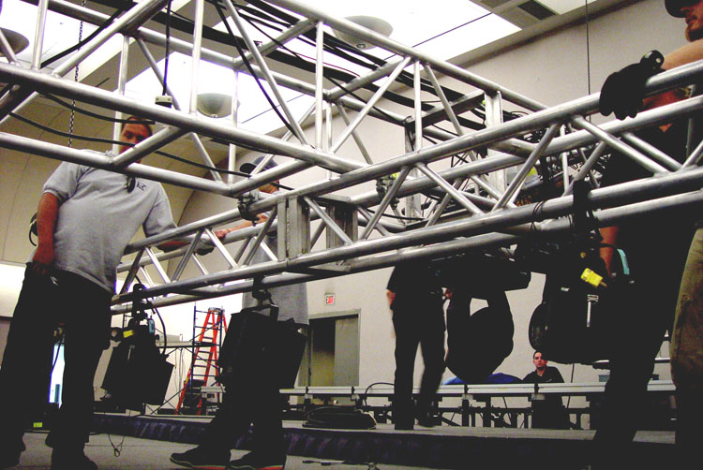
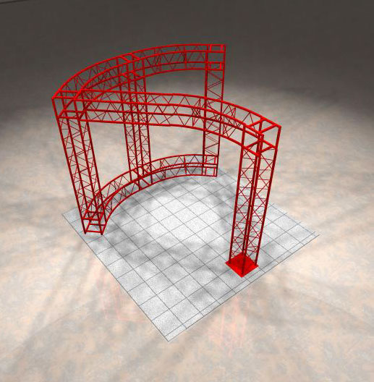
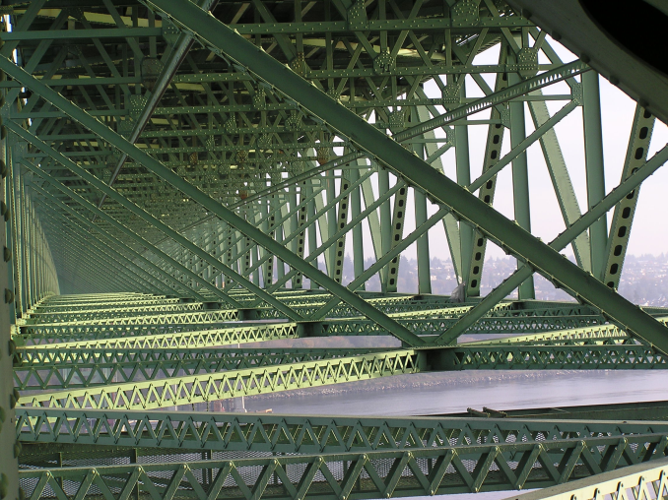
Structural Analysis
Chapter 6

Slide 2
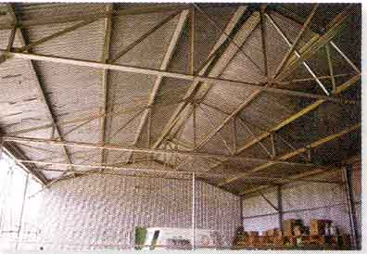
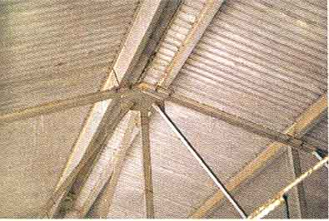
Trusses are commonly used to support a roof.
For a given truss geometry and load, how can we determine the forces in the truss members and select their sizes?
A more challenging question is that for a given load, how can we design the trusses’ geometry to minimize cost?

Slide 3
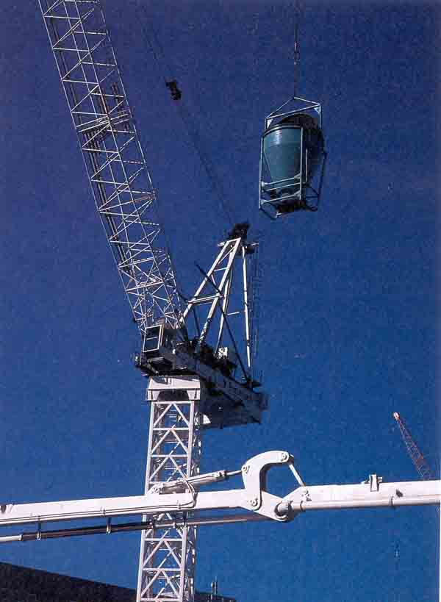
Trusses are also used in a variety of structures like cranes and the frames of aircraft or space stations.
How can we design a light weight structure that will meet load, safety, and cost specifications?

Slide 4
Truss = structural system made up of two-force members generally lightweight compared to the loads it supports
Two-force member = element of negligible weight with only two forces acting on it .
The two forces are equal, opposite, and along the same line of action (colinear).

Slide 5
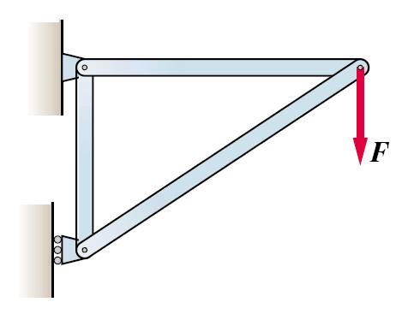
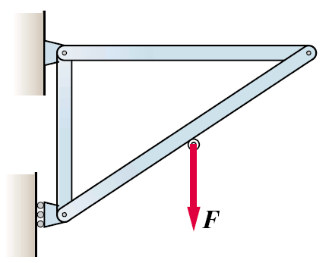
A truss defined:
Straight members joined at their ends (forms rigid frame).
Joints can be represented as pin connections even though they may be welds, rivets, bolts, or other; the pins are “idealized.”
Carry external forces (no moments) exclusively at the joints.
Constructed with only 2-force members - as contrasted with frames that have some multiforce members

Slide 6
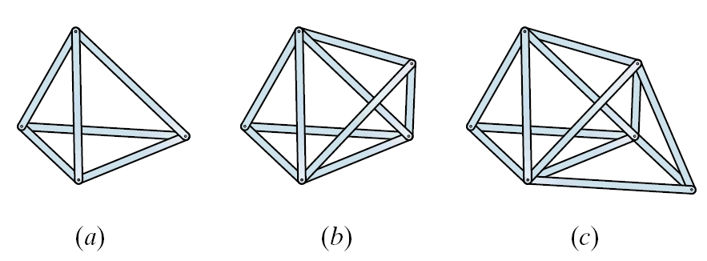
Trusses
Planar Space
(2-D) (3-D)

Slide 7
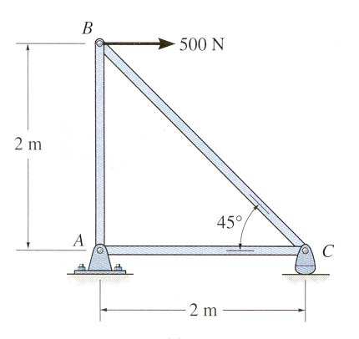
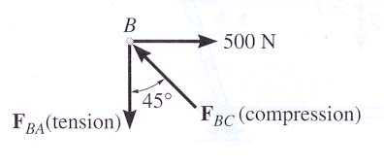
THE METHOD OF JOINTS (Section 6.2)
Start at joint (pin)
Draw FBD (including external forces and reactions at supports)
Solve for unknowns using ∑ F_{X}= 0 and ∑ F_{Y} = 0
No moments

Slide 8
IS IT IN TENSION OR COMPRESSION?
If “pulling” on pin = member in tension (T)
If “pushing” on pin = member in compression (C)
Assume pulling →if negative in compression; positive tension
Correct sense by inspection

Slide 9
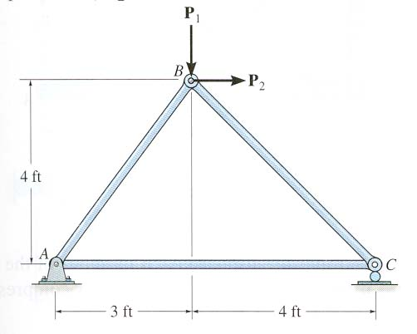
EXAMPLE
Given: P₁ = 200 lb, P₂ = 500 lb
Find: The forces in each member of the truss.
Plan: First analyze pin B and then pin C

Slide 10
EXAMPLE
Given: P₁ = 200 lb, P₂ = 500 lb
Find: The forces in each member of the truss.
Plan: First analyze pin B and then pin C
+ → ∑ F_{X} = 500 + F_{BC} cos 45° – (3 / 5) F_{BA} = 0
+ ↑ ∑ F_{Y} = – 200 – F_{BC} sin 45° – (4 / 5) F_{BA} = 0
F_{BA} = 214 lb (T) and F_{BC} = – 525.3 lb (C)
200 lb
B
500 lb
5 4
3
45 º
F_{BA}
F_{BC}
525.3
FBD of pin B
45º
F_{CA}
C
+ → ∑ F_{X} = – F_{CA} + 525.3 cos 45° = 0
F_{CA} = 371 (T)
C_{Y}
FBD of pin C

Slide 11
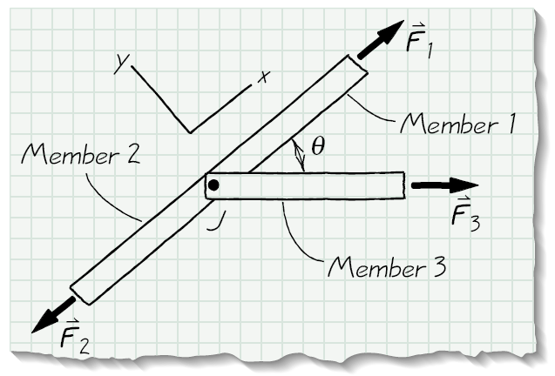
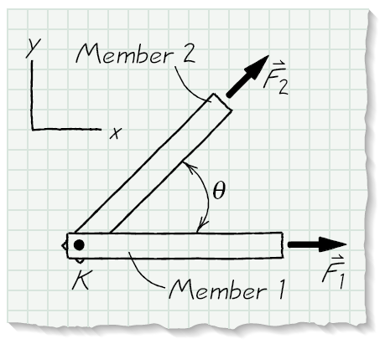
Zero-force members
When three 2-force members are pinned together and:
No external loads or supports are applied to the pin connection
Two of the members have the same line of action and the third member is at an angle to that line of action
When two 2-force members are pinned together and:
No external loads or supports are applied to the pin connection
The members do not have the same line of action

Slide 12
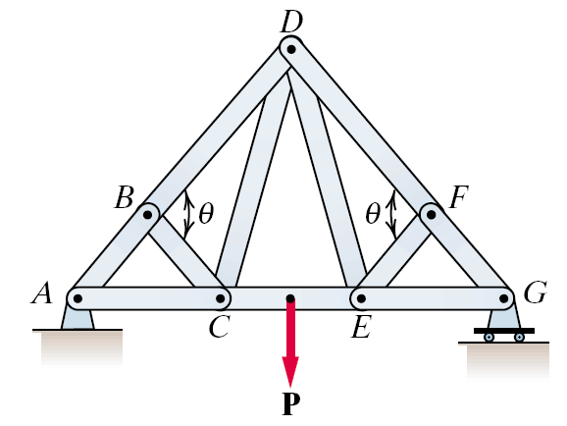
Pick the zero-force members

Slide 13
Truss Analysis
Method of Joints
Good for determining the force acting on every 2-force member in a truss
Method of Sections
Good for determining the forces for only a few members

Slide 14
Method of Joints

Slide 15
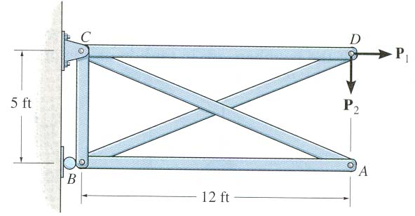
GROUP PROBLEM SOLVING
Given: P₁ = 240 lb and
P₂ = 100 lb
Find: Determine the force in all the truss members (do not forget to mention whether they are in T or C).
Plan:
a) Check if there are any zero-force members.
b) Draw FBDs of pins D and B, and then apply EE at those pins to solve for the unknowns.
Solution:
Members AB and AC are zero-force members.

Slide 16
GROUP PROBLEM SOLVING (continued)
FBD of pin D
Analyzing pin D:
+ ∑F_{Y} = – 100 – (5 / 13) F_{DB} = 0
F_{DB} = – 260 lb (C)
Y
F_{DC}
D
240 lb
X
13 5
12
F_{DB}
100 lb
+ ∑ F_{X} = 240 – F_{DC} – (12 / 13) (– 260) = 0
F_{DC} = 480 lb (T)
F_{BC}
Y
260 lb
Analyzing pin B:
+ ∑ F_{Y} = F_{BC} – (5 / 13) 260 = 0
F_{BC} = 100 lb (T)
13 5
12
X
B_{X}
B
FBD of pin B

Slide 17
CONCEPT QUIZ
1. Truss ABC is changed by decreasing its height from H to 0.9 H. Width W and load P are kept the same. Which one of the following statements is true for the revised truss as compared to the original truss?
A) Force in all its members have decreased.
B) Force in all its members have increased.
C) Force in all its members have remained the same.
D) None of the above.
P
A
H
B
C
W
Notes:
Answers:
1. B

Slide 18
CONCEPT QUIZ (continued)
F
F
F
For this truss, determine the number of zero-force members.
A) 0 B) 1 C) 2
D) 3 E) 4
Notes:
Answer:
2. D

Slide 19
Given: P₁ = 200 lb, P₂ = 500 lb
Find: The forces in each member of the truss.
Plan: First analyze pin B and then pin C
Given: P₁ = 240 lb and
P₂ = 100 lb
Find: Determine the force in all the truss members.

Slide 20
Method of Sections

