Slide 1
Chapter 6
Method of Sections

Slide 2
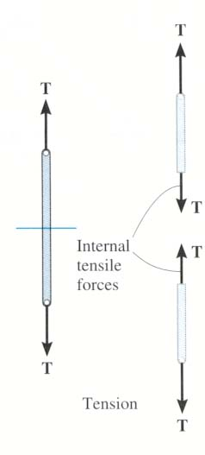
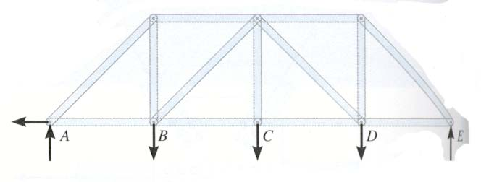
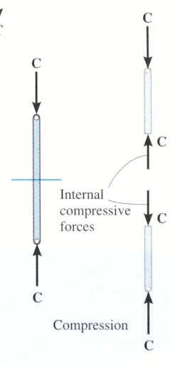
In the method of sections, generally a “cut” passes through no more than _____ members with unknown forces.
A) 1 B) 2
C) 3 D) 4
Notes:
Answers:
1. C
2. D

Slide 3
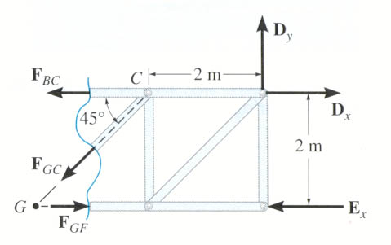
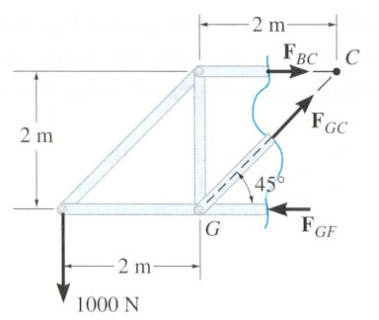
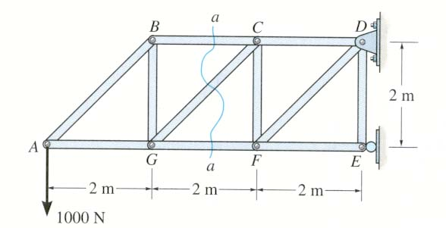
STEPS FOR ANALYSIS
1. Decide how you need to “cut” the truss. This is based on:
a) where you need to determine forces, and, b) where the total number of unknowns does not exceed three (in general).
2. Decide which side of the cut truss will be easier to work with (minimize the number of reactions you have to find).
3. If required, determine the necessary support reactions by drawing the FBD of the entire truss and applying the E-of-E.

Slide 4
STEPS FOR ANALYSIS (continued)
4. Draw the FBD of the selected part of the cut truss
- Indicate the unknown forces at the cut members
- Initially assume all the members are in tension
5. Apply the equations of equilibrium to the selected cut section of the truss to solve for the unknown member forces. Please note that in most cases it is possible to write one equation to solve for one unknown directly.

Slide 5
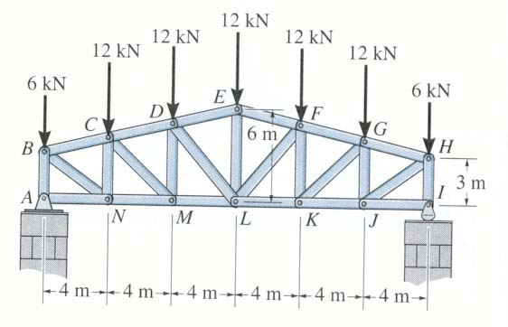
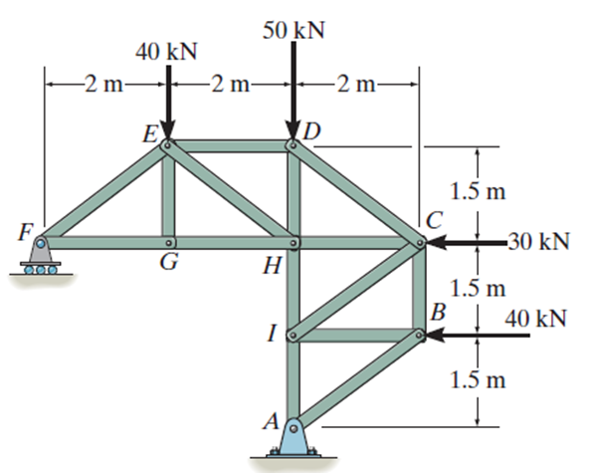
Find: The force in members DE, DL, and ML.
Find: The forces in members ED, EH, and GH.

Slide 6
Given: Loads as shown on the roof truss.
Find: The force in members DE, DL, and ML.
Plan:
a) Take a cut through the members DE, DL, and ML.
b) Work with the left part of the cut section. Why?
c) Determine the support reactions at A.
d) Apply the E-of-E to find the forces in DE, DL, and ML.

Slide 7
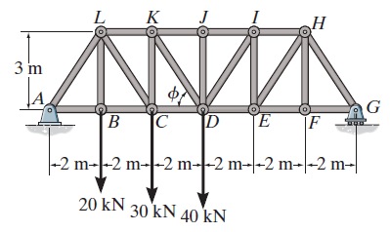
A_{X}
A_{Y}
G_{Y}
Analyzing the entire truss for the reactions at A, we get
Σ F_{X} = A_{X} = 0.
A moment equation about G to find A_{Y} results in:
Σ M_{G} = A_{Y} (12) – 20 (10) – 30 (8) – 40 (6) = 0; A_{Y} = 56.7 kN

Slide 8
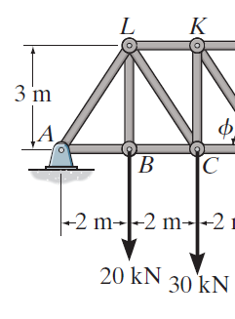
2
F_{KJ}
3
F_{KD}
F_{CD}
56.7 kN
Now take moments about point D. Why do this?
+ M_{D} = – 56.7 (6) + 20 (4) + 30 (2) – F_{KJ} (3) = 0
F_{KJ} = − 66.7 kN or 66.7 kN ( C )

Slide 9
EXAMPLE (continued)
2
F_{KJ}
3
F_{KD}
F_{CD}
56.7 kN
Now use the x and y-directions equations of equilibrium.
↑ + Σ F_{Y} = 56.7 – 20 – 30 – (3/√13) F_{KD} = 0;
F_{KD} = 8.05 kN (T)
→ + Σ F_{X} = (– 66.7) + (2/√13) ( 8.05 ) + F_{CD} = 0;
F_{CD} = 62.2 kN (T)

Slide 10
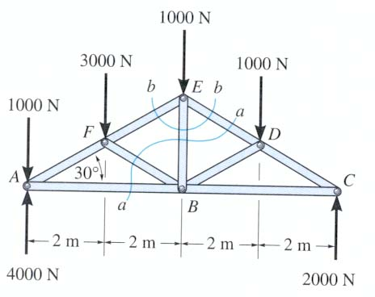
Can you determine the force in member ED by making the cut at section a-a or b-b?
Notes:
Answer:
A-a and the moment at B

Slide 11
If you know F_{ED}, how will you determine F_{EB} ?
A) By taking section b-b and using Σ M_{E} = 0
B) By taking section b-b, and using Σ F_{X} = 0 and Σ F_{Y} = 0
C) By taking section a-a and using Σ M_{B} = 0
D) By taking section a-a and using Σ M_{D} = 0
Notes:
Answer:
2. B

Slide 12

GROUP PROBLEM SOLVING
Given: Loads as shown on the truss.
Find: The forces in members ED, EH, and GH.
Plan:
a) Take the cut through members ED, EH, and GH.
b) Analyze the left section. Determine the support reactions at F. Why?
c) Draw the FBD of the left section.
d) Apply the equations of equilibrium (if possible, try to do it so that every equation yields an answer to one unknown.
Notes:
Source : P6-28

Slide 13
GROUP PROBLEM SOLVING (continued)
1) Determine the support reactions
at F by drawing the FBD of the
entire truss.
F_{y}
A_{x}
A_{y}
+ Σ M_{A} = – F_{y} (4) + 40 (2) + 30 (3) + 40 (1.5) = 0;
F_{y} = 57.5 kN

Slide 14
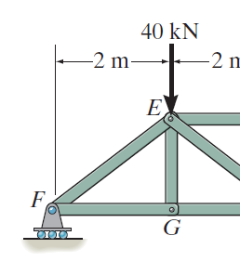
GROUP PROBLEM SOLVING (continued)
2) Analyze the left section.
F_{ED}
+ Σ M_{E} = – 57.5 (2) + F_{GH} (1.5) = 0;
F_{GH} = 76.7 kN (T)
1.5 m
4
3
F_{EH}
↑ + Σ F_{y} = 57.5 – 40 – F_{EH} (3/5)= 0;
F_{EH} = 29.2 kN (T)
F_{GH}
F_{y}= 57.5 kN
+ Σ M_{H} = – 57.5 (4) + 40 (2) – F_{ED} (1.5) = 0;
F_{ED} = -100 kN = 100 kN (C)

Slide 15
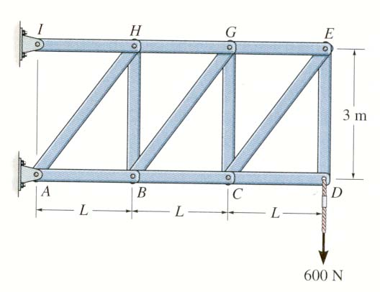
As shown, a cut is made through members GH, BG and BC to determine the forces in them. Which section will you choose for analysis and why?
A) Right, fewer calculations.
B) Left, fewer calculations.
C) Either right or left, same amount of work.
D) None of the above, too many unknowns.
Notes:
Answer:
1. A

Slide 16
Using the cut as shown, which equation would be best to use to find force in member HG?
A) Σ M_{H} = 0
B) Σ M_{G} = 0
C) Σ M_{B} = 0
D) Σ M_{C} = 0
Notes:
Answer:
2. C

Slide 17
Frames and Machines
Ch 6.6

Slide 18
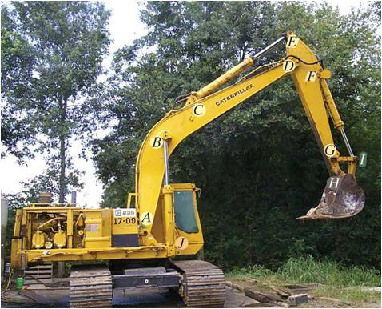
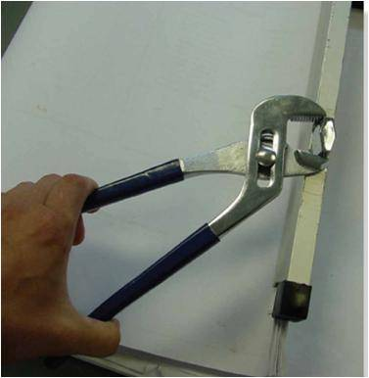
“Machines” are used in a variety of applications. How are they different from trusses and frames?
How can you determine the loads at the joints and supports? These forces and moments are required when designing the machine’s members.

Slide 19
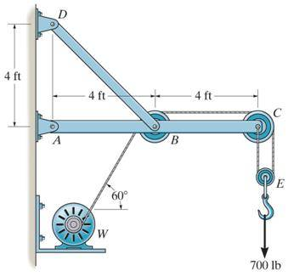
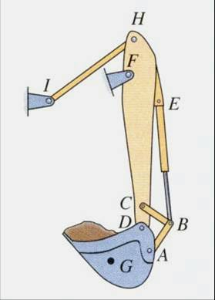
FRAMES AND MACHINES: DEFINITIONS
Frame
Machine
Frames and machines are two common types of structures that have at least one multi-force member. (Recall that trusses have nothing but two-force members).
Frames are generally stationary and support external loads.
Machines contain moving parts and are designed to alter the effect of forces.

Slide 20
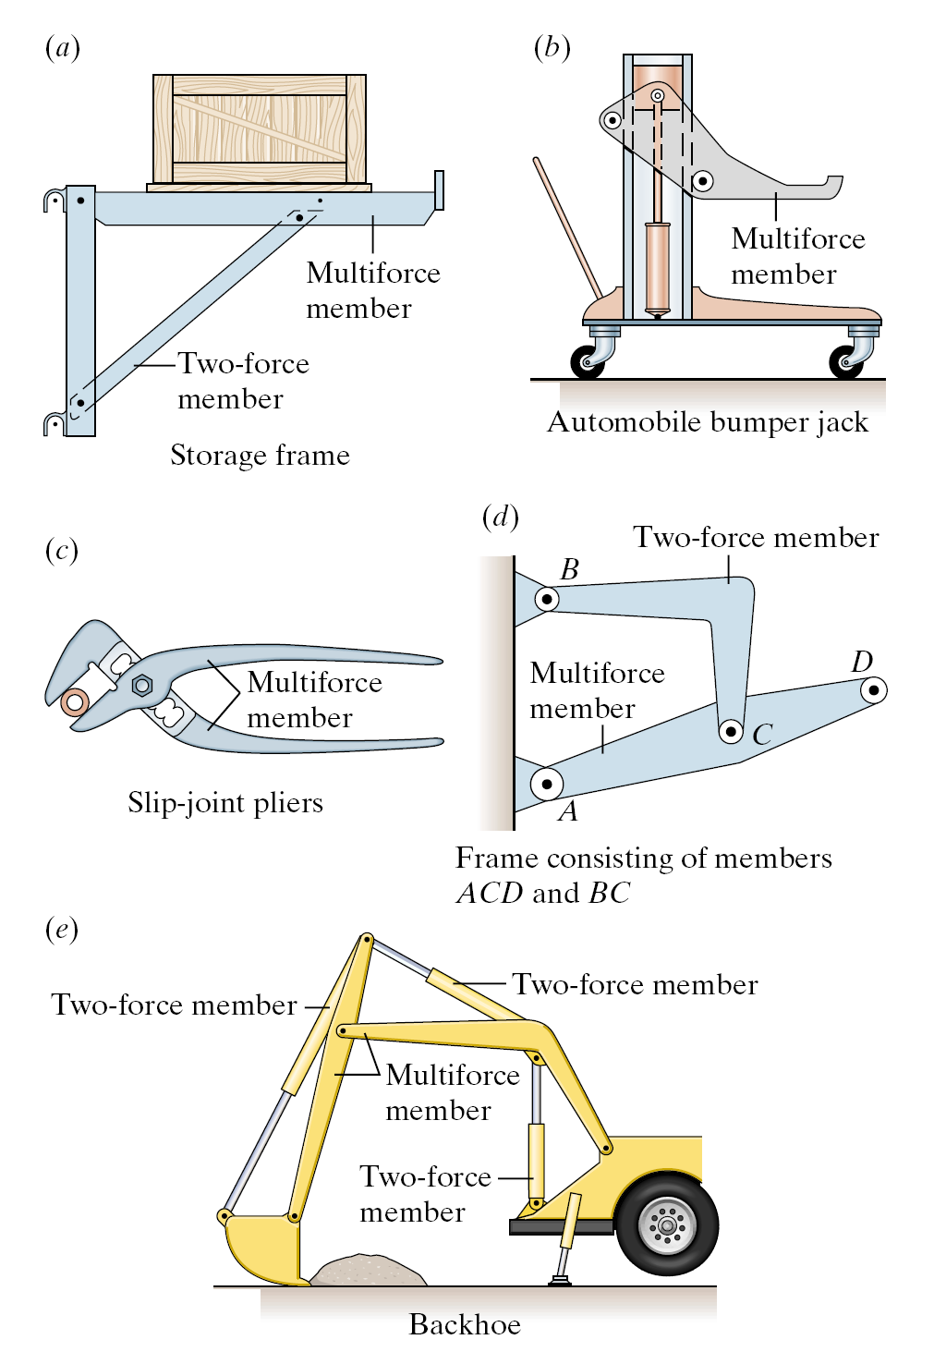

Slide 21
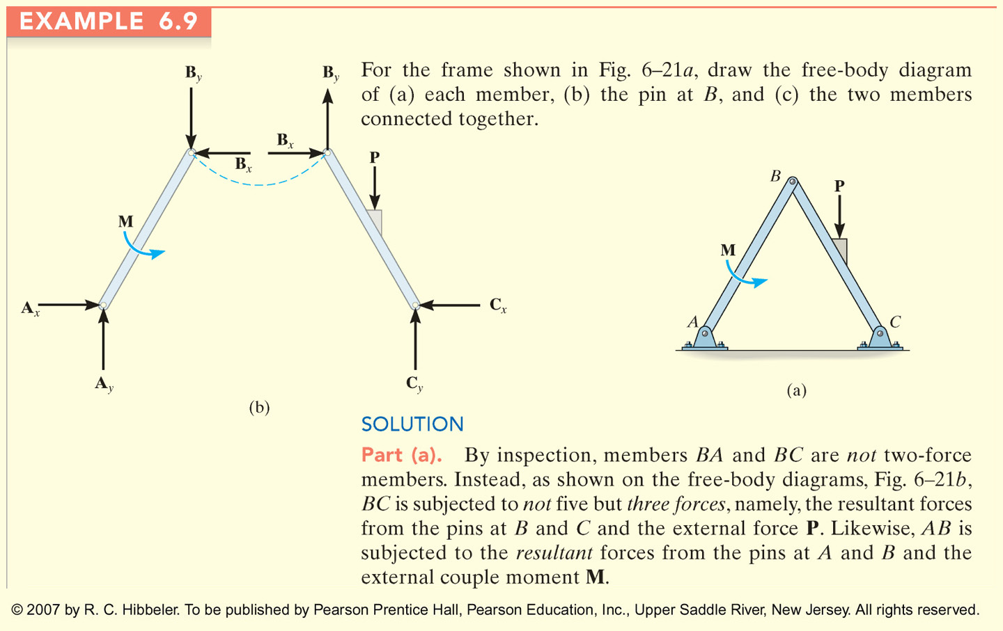
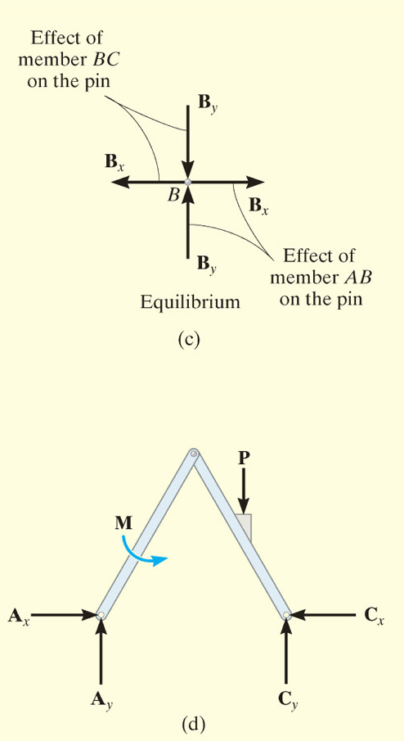
Consider the different ways to view frames and machines:
1) FBD for each member
2) pin at B
3) two members connected together

Slide 22
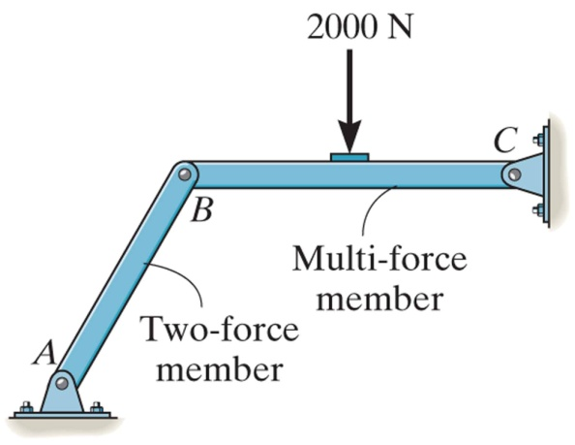
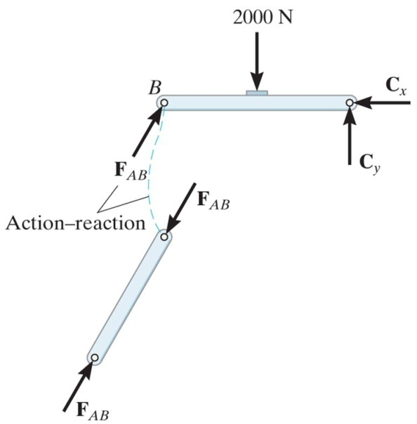
STEPS FOR ANALYZING A FRAME OR MACHINE
1. Draw a FBD of the frame or machine and its members, as necessary.
Hints:
a) Identify any two-force members,
b) Note that forces on contacting surfaces (usually between a pin and a member) are equal and opposite, and,
c) For a joint with more than two members or an external force, it is advisable to draw a FBD of the pin.
F_{AB}

Slide 23
STEPS FOR ANALYZING A FRAME OR MACHINE
2. Develop a strategy to apply the equations of equilibrium to solve for the unknowns. Look for ways to form single equations and single unknowns.
Problems are going to be challenging since there are usually several unknowns. A lot of practice is needed to develop good strategies and ease of solving these problems.
F_{AB}

Slide 24
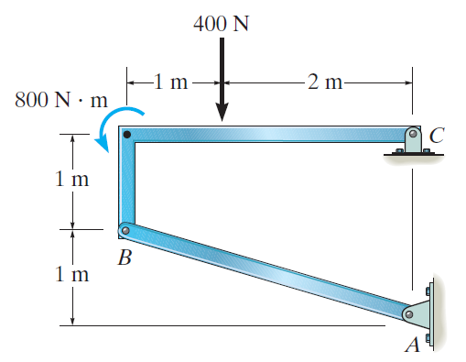
EXAMPLE
Given: The frame supports an external load and moment as shown.
Find: The horizontal and vertical components of the pin reactions at C and the magnitude of reaction at B.
Plan:
a) Draw a FBD of frame member BC. Why pick this part of the frame?
b) Apply the equations of equilibrium and solve for the unknowns at C and B.
Notes:
Source : F6-16

Slide 25
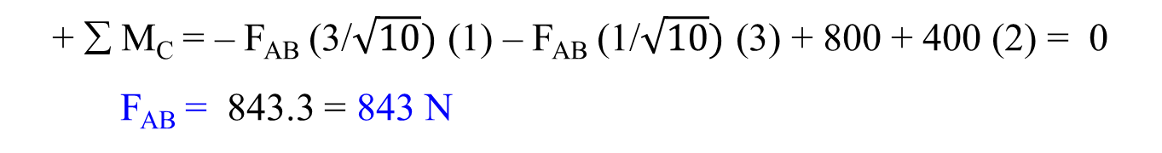
FBD of member BC
800 N m
400 N
C_{X}
1 m
C_{Y}
1 m
2 m
B
1
F_{AB}
3
Note that member AB is a two-force member.
Equations of Equilibrium:
Start with ∑ M_{C} since it yields one unknown.
+ ∑ M_{C} = – F_{AB} (3/$\sqrt{10})$ (1) – F_{AB} (1/$\sqrt{10})$ (3) + 800 + 400 (2) = 0
F_{AB} = 843.3 = 843 N

Slide 26
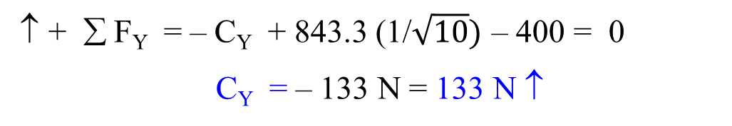
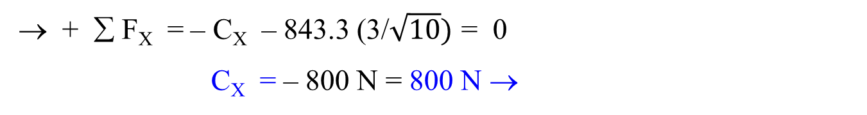
EXAMPLE (continued)
FBD of member BC
800 N m
400 N
C_{X}
1 m
C_{Y}
1 m
2 m
B
1
F_{AB}
3
Now use the x and y-direction Equations of Equilibrium:
+ ∑ F_{X} = – C_{X} – 843.3 (3/$\sqrt{10})$ = 0
C_{X} = – 800 N = 800 N →
↑ + ∑ F_{Y} = – C_{Y} + 843.3 (1/$\sqrt{10})$ – 400 = 0
C_{Y} = – 133 N = 133 N ↑

Slide 27
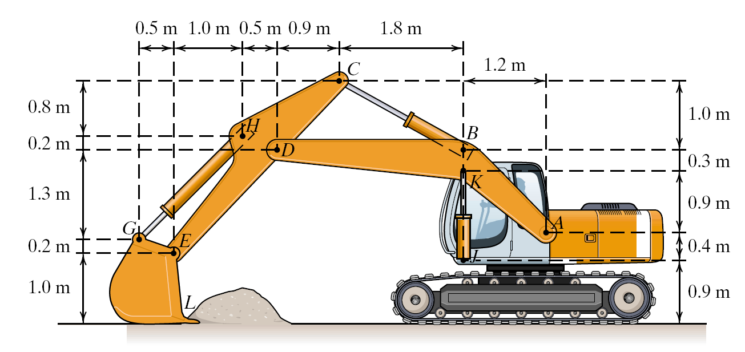
1. Find force acting at A (assume backhoe arm weight is negligible)
2. Determine whether the force acting on hydraulic cylinder HG exceeds its capacity of 40 kN
14 kN

Slide 28
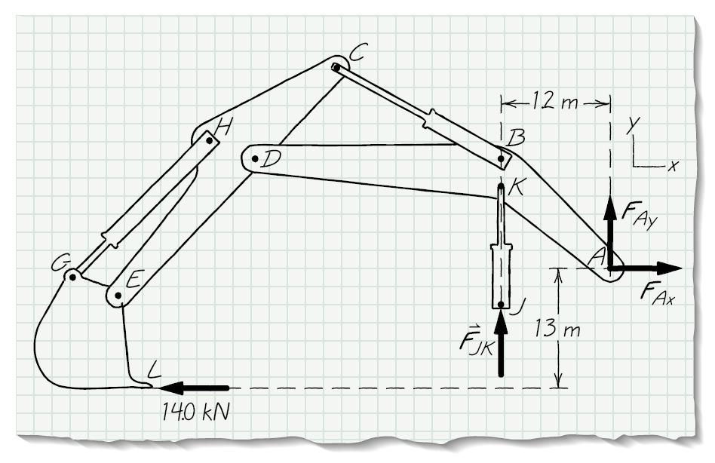
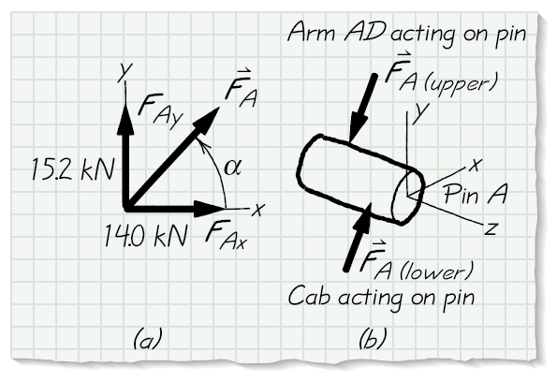
Step 1, finding forces at A
14 kN

Slide 29
1. Find force acting at A (assume backhoe arm weight is negligible)
2. Determine whether the force acting on hydraulic cylinder HG exceeds its capacity of 40 kN
14 kN

Slide 30
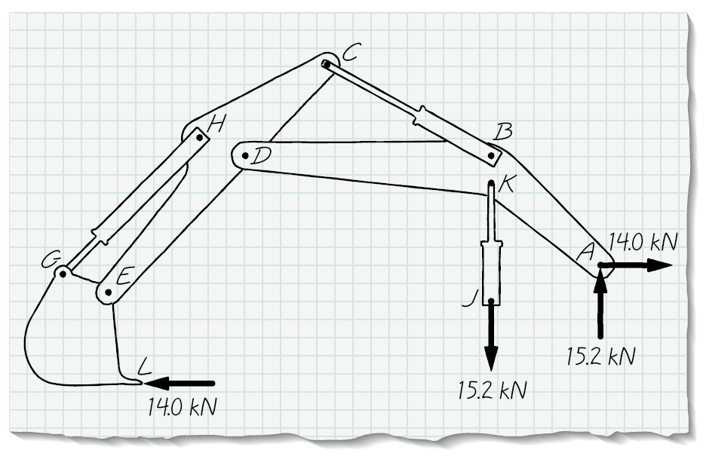
14 kN

Slide 31
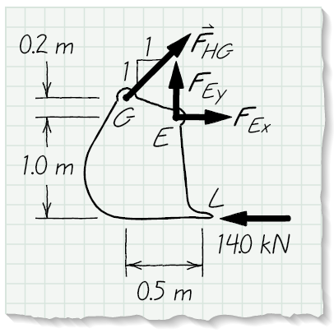
Step 2, finding F_{HG}

Slide 32
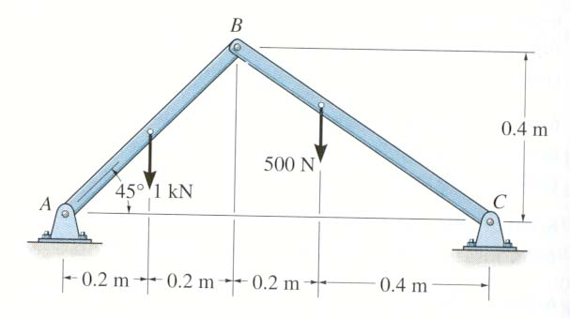
Find reactions on pins at A, B, & C
1) FBD for each member
2) FBD for two members connected together
3) E-of-E for pin reactions using the different FBDs

Slide 33
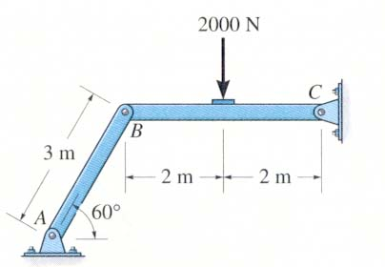
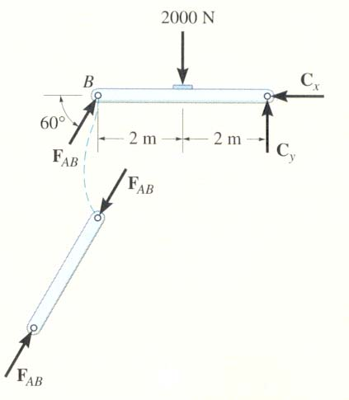
1. The figures show a frame and its FBDs. If an additional couple moment is applied at C, how will you change the FBD of member BC at B?
A) No change, still just one force (F_{AB}) at B.
B) Will have two forces, B_{X} and B_{Y}, at B.
C) Will have two forces and a moment at B.
D) Will add one moment at B.
Notes:
1. A

Slide 34
• D
2. The figures show a frame and its FBDs. If an additional force is applied at D, how will you change the FBD of member BC at B?
A) No change, still just one force (F_{AB}) at B.
B) Will have two forces, B_{X} and B_{Y}, at B.
C) Will have two forces and a moment at B.
D) Will add one moment at B.
Notes:
2. B

Slide 35
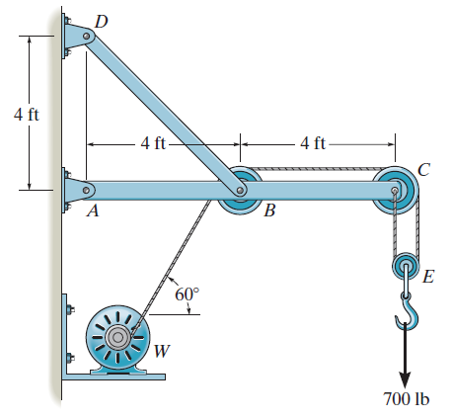
GROUP PROBLEM SOLVING
Given: The wall crane supports
an external load of 700 lb.
Find: The force in the cable at
winch motor W and
the horizontal and vertical
components of pin
reactions at A, B, C,
and D.
Plan:
a) Draw FBDs of the frame’s members and pulleys.
b) Apply the equations of equilibrium and solve for the unknowns.
Notes:
Source : P6-74

Slide 36
FBD of the Pulley E
T
T
E
700 lb
Necessary Equations of Equilibrium:
↑+ ∑ F_{Y} = 2 T – 700 = 0
T = 350 lb

Slide 37
350 lb
C_{Y}
+ ∑ F_{X} = C_{X} – 350 = 0
C_{X} = 350 lb
+ ↑ ∑ F_{Y} = C_{Y} – 350 = 0
C_{Y} = 350 lb
C
C_{X}
350 lb
FBD of pulley C
350 lb
+ ∑ F_{X} = – B_{X} + 350 – 350 sin 30° = 0
B_{X} = 175 lb
↑ + ∑ F_{Y} = B_{Y} – 350 cos 30° = 0
B_{Y} = 303.1 lb
B_{Y}
B
30°
B_{X}
350 lb
FBD of pulley B

Slide 38
GROUP PROBLEM SOLVING (continued)
Please note that member BD is a two-force member.
T_{BD}
A_{X}
A
45°
175 lb
350 lb
B
700 lb
A_{Y}
303.11 lb
4 ft
4 ft
FBD of member ABC
+ ∑ M_{A} = T_{BD} sin 45° (4) – 303.1 (4) – 700 (8) = 0
T_{BD} = 2409 lb
+ ∑ F_{X} = A_{X} – 2409 cos 45° + 175 – 350 = 0
A_{X} = 1880 lb
+ ∑ F_{Y} = A_{Y} + 2409 sin 45° – 303.1 – 700 = 0
A_{Y} = – 700 lb

Slide 39
GROUP PROBLEM SOLVING (continued)
FBD of member BD
D_{Y}
D_{X}
D
45°
B
2409 lb
At D, the X and Y component are
+ D_{X} = –2409 cos 45° = –1700 lb
↑ + D_{Y} = 2409 sin 45° = 1700 lb

