Slide 1
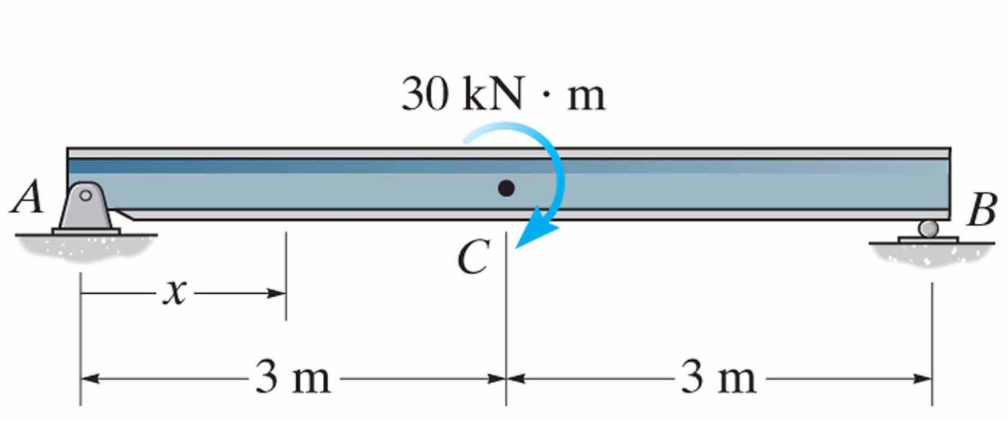
Find the shear and moment as a function of x, then draw the shear and moment diagrams.

Slide 2
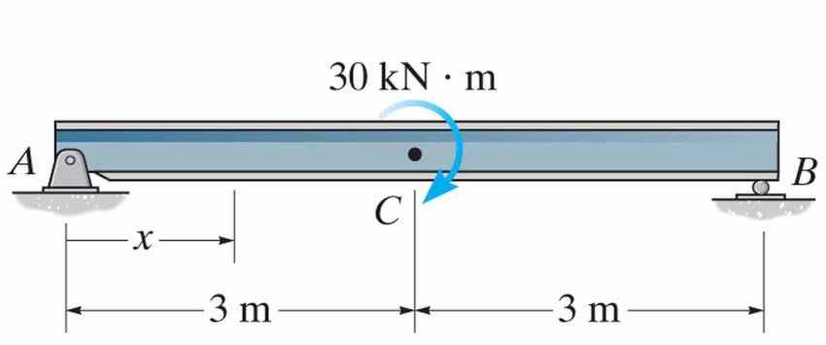
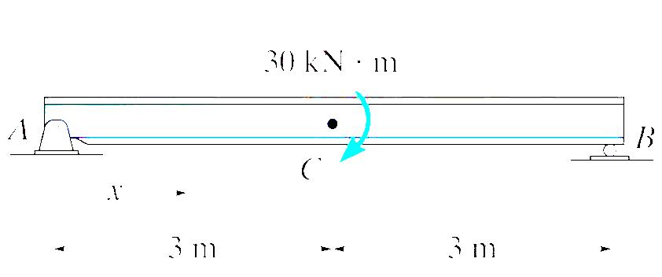
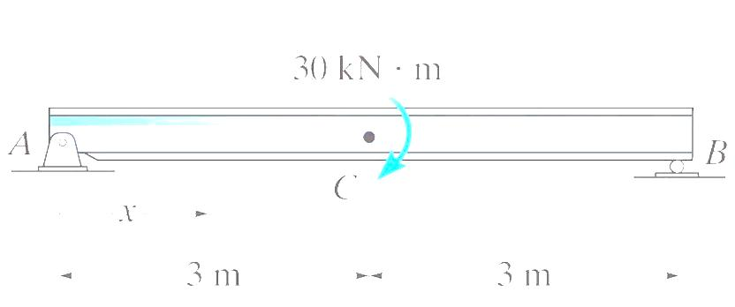
Find the shear and moment as a function of x, then draw the shear and moment diagrams.

