Slide 1
Chapter 7
Section 7.1
Internal Forces

Slide 2
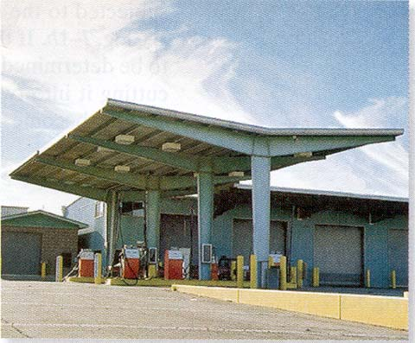
APPLICATIONS
These beams are used to support the roof of this gas station.
The beams are tapered to reduce the internal forces.

Slide 3
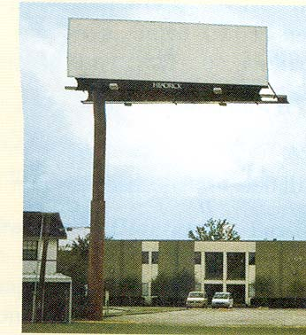
APPLICATIONS (continued)
A fixed column supports this rectangular billboard.
Statics Rules
Usually such columns are wider at the bottom than at the top. Why?

Slide 4
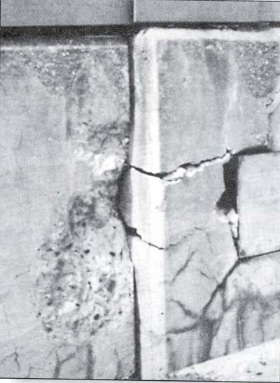
APPLICATIONS (continued)
The concrete supporting a
bridge has fractured.
What might have caused the concrete to do this?
How can we analyze or design these structures to make them safer?

Slide 5
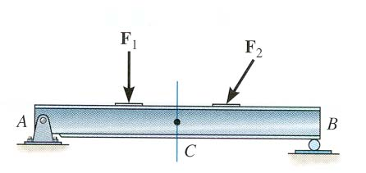
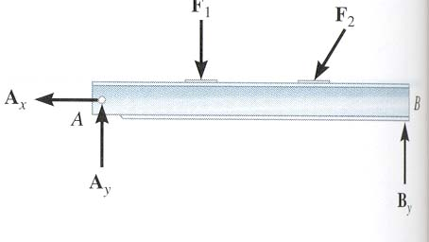
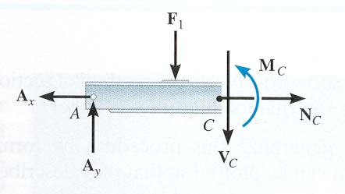
INTERNAL FORCES
The design of any structural member requires finding the forces acting within the member to make sure the material can resist those loads.
For example, we want to determine the internal forces acting on the cross section at C. First, we need to determine the support reactions.
Then we need to cut the beam at C and draw a FBD of one of the halves of the beam. This FBD will include the internal forces acting at C. Finally, we need to solve for these unknowns using the E-of-E.

Slide 6
In two-dimensional cases, typical internal
loads are normal or axial forces (N, acting perpendicular to the section), shear forces (V, acting along the surface), and the bending moment (M).
The loads on the left and right sides of the section at C are equal in magnitude but opposite in direction. This is because when the two sides are reconnected, the net loads are zero at the section.

Slide 7
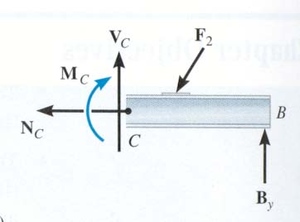
INTERNAL FORCES (continued)
In two-dimensional cases, typical internal
loads are normal or axial forces (N, acting perpendicular to the section), shear forces (V, acting along the surface), and the bending moment (M).
The loads on the left and right sides of the section at C are equal in magnitude but opposite in direction. This is because when the two sides are reconnected, the net loads are zero at the section.

Slide 8
STEPS FOR DETERMINING INTERNAL FORCES
1. Take an imaginary cut at the place where you need to determine the internal forces. Then, decide which resulting section or piece will be easier to analyze.
2. If necessary, determine any support reactions or joint forces you need by drawing a FBD of the entire structure and solving for the unknown reactions.
3. Draw a FBD of the piece of the structure you’ve decided to analyze. Remember to show the N, V, and M loads at the “cut” surface.
4. Apply the Equations of Equilibrium to the FBD (drawn in step 3) and solve for the unknown internal loads.

Slide 9
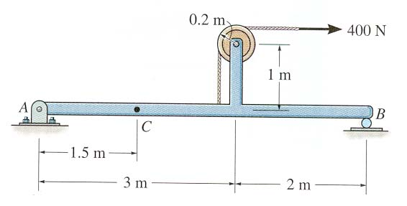
EXAMPLE
Given: The loading on the beam.
Find: The internal forces at point C.
Plan: Follow the procedure!!
Solution
1. Plan on taking the imaginary cut at C. It will be easier to work with the left section (point A to the cut at C) since the geometry is simpler.

Slide 10
2. We need to determine A_{x} and A_{y} using a FBD of the entire frame.
FBD:
400 N
1.2 m
A_{x}
A_{y}
B_{y}
3 m
2 m
Applying the E-of-E to this FBD, we get
→ + Σ F_{x} = A_{x} + 400 = 0 ; A_{x} = – 400 N
+ Σ M_{B} = -A_{y}(5) - 400 (1.2) = 0 ; A_{y} = – 96 N

Slide 11
EXAMPLE (continued)
3. Now draw a FBD of the left section. Assume directions for V_{C}, N_{C} and M_{C}.
1.5 m
400 N
N_{C}
M_{C}
C
A
96 N
V_{C}
4. Applying the EofE to this FBD, we get
→ + Σ F_{x} = N_{C} – 400 = 0; N_{C} = 400 N
↑ + Σ F_{y} = – V_{C} – 96 = 0; V_{C} = – 96N
+ Σ M_{C} = 96 (1.5) + M_{C} = 0 ; M_{C} = -144 N m

