Slide 1
Shear and Moment Equations and Diagrams
Section 7.2

Slide 3
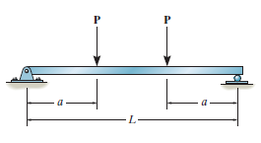

Slide 4
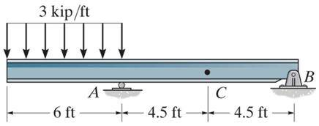

Slide 5
18 kip
3 ft
3 ft
9 ft
B_{x}
A_{y}
B_{y}

