Slide 1
Chapter 8
Sections 8.1 – 8.3
Dry Friction, Wedges

Slide 2
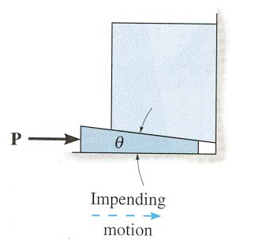
What’s important about this chapter?
1. A friction force always acts _____ to the contact surface.
A) normal B) at 45°
C) parallel D) at the angle of static friction
2. A wedge allows a ______ force P to lift
a _________ weight W.
A) (large, large) B) (small, small)
C) (small, large) D) (large, small)
Notes:
Answers:
1. C
2. C

Slide 3
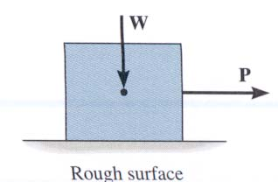
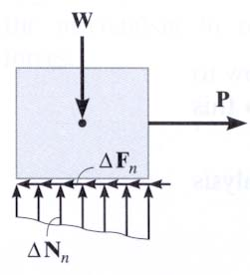
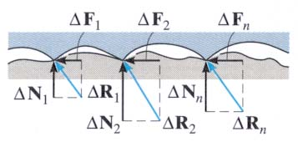
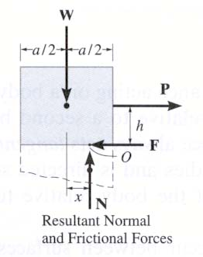
CHARACTERISTICS OF DRY FRICTION (Section 8.1)
Friction is defined as a force of resistance acting on a body which prevents or retards slipping of the body relative to a second body.
Experiments show that frictional forces act tangent (parallel) to the contacting surface in a direction opposing the relative motion or tendency for motion.
For the body shown in the figure to be in equilibrium, the following must be true: F = P, N = W, and Wx = Ph.

Slide 4
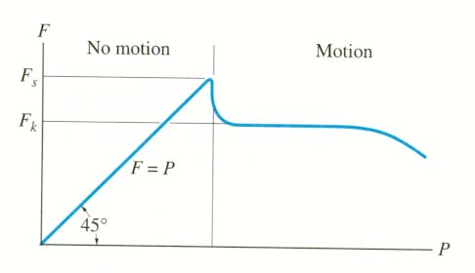

Slide 5
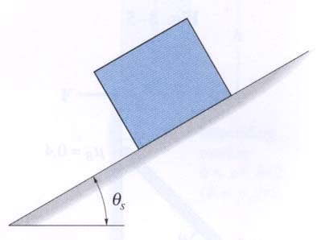
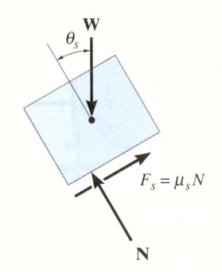
DETERMING μ_{s} EXPERIMENTALLY
A block with weight W is placed on an inclined plane. The plane is slowly tilted until the block just begins to slip.
The inclination is θ_{s}. Analysis of the block just before it begins to move gives (using F_{s} = μ_{s} N): + ∑ F_{y} = N – W cos θ_{s} = 0
+ ∑ F_{X} = μ_{S} N – W sin θ_{s} = 0
Using these two equations, we get μ_{s} = (W sin θ_{s} ) / (W cos θ_{s} ) = tan θ_{s} This simple experiment allows us to find the μ_{S} between two materials in contact.

Slide 6
PROBLEMS INVOLVING DRY FRICTION (Section 8.2)
Steps for solving equilibrium problems involving dry friction:
1. Draw the necessary free body diagrams. Make sure that you show the friction force in the correct direction (it always opposes the motion or impending motion).
2. Determine the number of unknowns. Do not assume F = μ_{S} N unless the impending motion condition is given.
3. Apply the equations of equilibrium and appropriate frictional equations to solve for the unknowns.

Slide 7
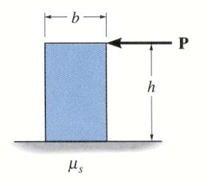
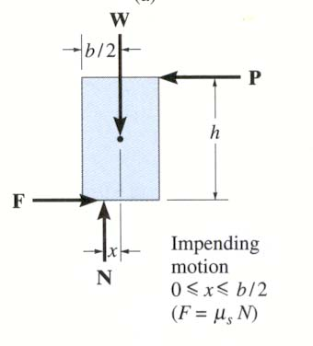
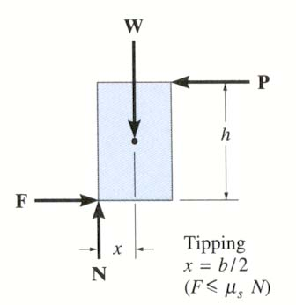
IMPENDING TIPPING versus SLIPPING
For a given W and h, how can we determine if the block will slide first or tip first? In this case, we have four unknowns (F, N, x, and P) and only three E-of-E.
Make an assumption to give us another equation. Then we can solve for the unknowns using the three E-of-E. Finally, we check if our assumption was correct.

Slide 8
IMPENDING TIPPING versus SLIPPING (continued)
Assume: Slipping occurs
Known: F = μ_{s} N
Solve: x, P, and N
Check: 0 ≤ x ≤ b/2
or:
Assume: Tipping occurs
Known: x = b/2
Solve: P, N, and F
Check: F ≤ μ_{s} N

Slide 9
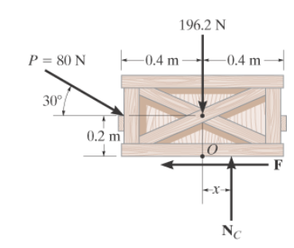
The crate has a mass of 20 kg. The coefficient of static friction is µ_{s} = 0.3. P = 80 N. will the crate move?

Slide 10
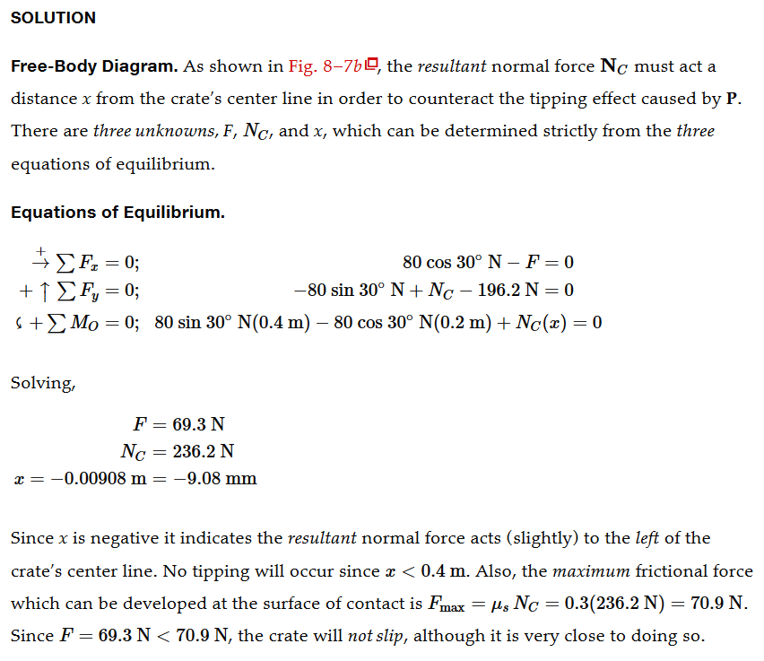

Slide 11
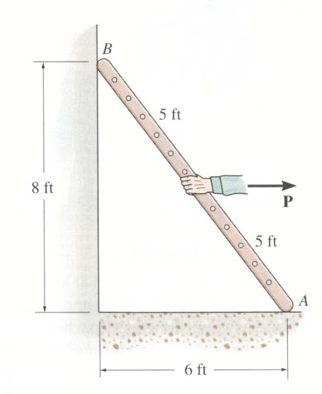
EXAMPLE
Given: A uniform ladder weighs 20 lb. The vertical wall is smooth (no friction). The floor is rough and μ_{s} = 0.8.
Find: The minimum force P needed to move ( tip or slide) the ladder.
Plan:
a) Draw a FBD.
b) Determine the unknowns.
c) Make any necessary friction assumptions.
d) Apply E-of-E to solve for the unknowns. Since one scenario is tipping, there would be a moment about point A.
e) Compare the slipping value to the tipping value.

Slide 12
EXAMPLE (continued)
N_{B}
FBD of the ladder
4 ft
P
20 lb
4 ft
F_{A}
N_{A}
3 ft
3 ft
There are four unknowns: N_{A}, F_{A}, N_{B}, and P. Let us assume that the ladder will tip first. Hence, N_{B} = 0
↑ Σ F_{Y} = N_{A} – 20 = 0 ; N_{A} = 20 lb
+ Σ M_{A} = 20 ( 3 ) – P( 4 ) = 0 ; P = 15 lb
+ → Σ F_{X} = 15 – F_{A} = 0 ; F_{A} = 15 lb

Slide 13
EXAMPLE (continued)
N_{B}
FBD of the ladder
4 ft
P
20 lb
4 ft
F_{A}
N_{A}
3 ft
3 ft
Now check the assumption.
F_{max} = μ_{s} N_{A} = 0.8 * 20 lb = 16 lb
Is F_{A} = 15 lb ≤ F_{max} = 16 lb? Yes, our assumption of tipping is correct.

Slide 14
1. A ladder is positioned as shown. Indicate the direction of the friction force on the ladder at B.
A) ↑ B) ↓
C) D)
B
A
2. The ladder AB is postioned as shown. What is the direction of the friction force on the ladder at B.
A) B)
C) ← D) ↑
B
A
Notes:
Answer:
1. C
2. D

Slide 15
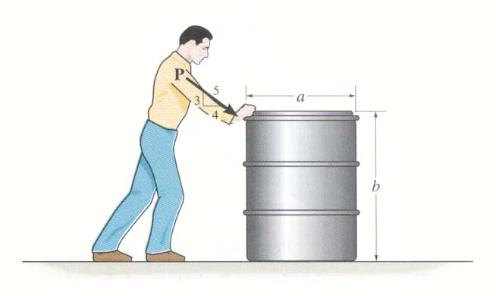
GROUP PROBLEM SOLVING
Given: Drum weight = 100 lb, μ_{s} = 0.5 , a = 3 ft and b = 4 ft.
Find: The smallest magnitude of P that will cause impending motion (tipping or slipping) of the drum.
Plan:
a) Draw a FBD of the drum.
b) Determine the unknowns.
c) Make friction assumptions, as necessary.
d) Apply E-of-E (and friction equation as appropriate) to solve for the unknowns.
e) Check assumptions.

Slide 16
GROUP PROBLEM SOLVING (continued)
P
5
3
1.5 ft
1.5 ft
4
100 lb
4 ft
A FBD of the drum:
0
F
X
N
There are four unknowns: P, N, F and x.
First, let’s assume the drum slips. Then the friction equation is F = μ_{s} N = 0.5 N.

Slide 17
GROUP PROBLEM SOLVING (continued)
P
5
3
1.5 ft
1.5 ft
4
100 lb
4 ft
A FBD of the drum:
+ → ∑ F_{X} = (4 / 5) P – 0.5 N = 0
+ ↑ ∑ F_{Y} = N – (3 / 5) P – 100 = 0
These two equations give:
0
F
X
N
P = 100 lb and N = 160 lb
+ ∑ M_{O} = (3 /5) 100 (1.5) – (4 / 5) 100 (4) + 160 (x) = 0
Check: x = 1.44 ≤ 1.5 OK!
Drum slips as assumed at P = 100 lb

Slide 18
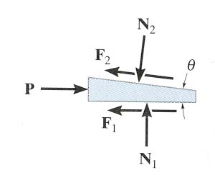
ANALYSIS OF A WEDGE
A wedge is a simple machine in which a small force P is used to lift a large weight W.
W
To determine the force required to push the wedge in or out, it is necessary to draw FBDs of the wedge and the object on top of it.
It is easier to start with a FBD of the wedge since you know the direction of its motion.
Note that: a) the friction forces are always in the direction opposite to the motion, or impending motion, of the wedge; b) the friction forces are along the contacting surfaces; and, c) the normal forces are perpendicular to the contacting surfaces.

Slide 19
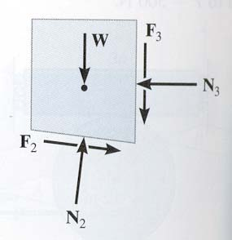
ANALYSIS OF A WEDGE (continued)
Next, a FBD of the object on top of the wedge is drawn. Please note that: a) at the contacting surfaces between the wedge and the object the forces are equal in magnitude and opposite in direction to those on the wedge; and, b) all other forces acting on the object should be shown.
To determine the unknowns, we must apply E-of-E, ∑ F_{x} = 0 and ∑ F_{y} = 0, to the wedge and the object as well as the impending motion frictional equation, F = μ_{S} N.
Now of the two FBDs, which one should we start analyzing first? We should start analyzing the FBD in which the number of unknowns are less than or equal to the number of equations.

Slide 20
ANALYSIS OF A WEDGE (continued)
If the object is to be lowered, then the wedge needs to be pulled out. If the value of the force P needed to remove the wedge is positive, then the wedge is self-locking, i.e., it will not come out on its own.
W
However, if the value of P is negative, or zero, then the wedge will come out on its own unless a force is applied to keep the wedge in place. This can happen if the coefficient of friction is small or the wedge angle θ is large.

Slide 21
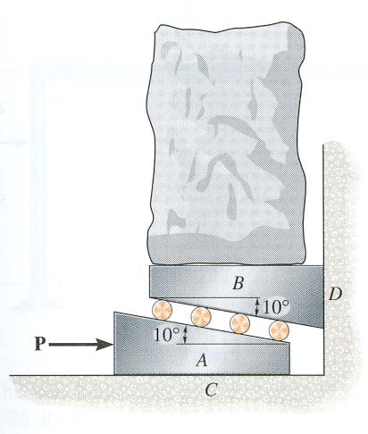
Given: The load weighs 100 lb and the μ_{S} between surfaces AC and BD is 0.3. Smooth rollers are placed between wedges A and B. Assume the rollers and the wedges have negligible weights.
Find: The force P needed to lift the load.
Plan:
1. Draw a FBD of wedge A. Why do A first?
2. Draw a FBD of wedge B.
3. Apply the E-of-E to wedge B. Why do B first?
4. Apply the E-of-E to wedge A.

Slide 22
EXAMPLE (continued)
N₂
10º
The FBDs of wedges A and B are shown in the figures. Applying the EofE to wedge B, we get
P
A
+ ∑ F_{X} = N₂ sin 10° – N₃ = 0
+ ∑ F_{Y} = N₂ cos 10° – 100 – 0.3 N₃ = 0
Solving the above two equations, we get
N₂ = 107.2 lb and N₃ = 18.6 lb
F₁= 0.3N₁
N₁
100 lb
F₃= 0.3N₃
B
N₃
N₂
10º
Applying the E-of-E to the wedge A, we get
↑+ ∑ F_{Y} = N₁ – 107.2 cos 10° = 0; N₁ = 105.6 lb
→+ ∑ F_{X} = P – 107.2 sin 10° – 0.3 N₁ = 0; P = 50.3 lb

Slide 23
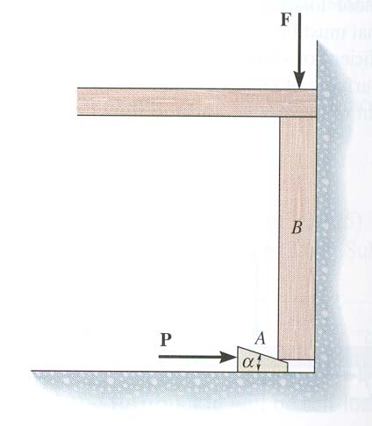
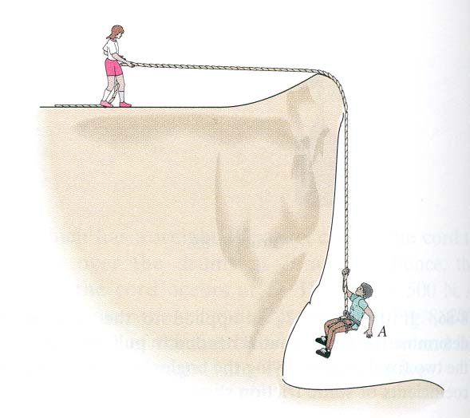
CONCEPT QUIZ
1. Determine the direction of the friction force on object B at the contact point between A and B.
A) → B) ←
C) D)
2. The boy (hanging) in the picture weighs 100 lb and the woman weighs 150 lb. The coefficient of static friction between her shoes and the ground is 0.6. The boy will ______ ?
A) be lifted up. B) slide down.
C) not be lifted up. D) not slide down.
Notes:
Answers:
1. C
2. C The maximum force she can apply before she slides is 150 (0.6) = 90 lb. This will not be enough to lift the boy up as she needs to apply more than 100 lb to lift the boy up. Without knowing the coefficient of friction between the cliff and the rope, we can not say whether the boy will slide down or not.

Slide 24
Given: Drum weight = 100 lb, μ_{s} = 0.5 , a = 3 ft and b = 4 ft.
Find: The smallest magnitude of P that will cause impending motion (tipping or slipping) of the drum.
Given: A uniform ladder weighs 20 lb. The vertical wall is smooth (no friction). The floor is rough and μ_{s} = 0.8.
Find: The minimum force P needed to move ( tip or slide) the ladder.

Slide 25
Given: A uniform ladder weighs 20 lb. The vertical wall is smooth (no friction). The floor is rough and μ_{s} = 0.8.
Find: The minimum force P needed to move ( tip or slide) the ladder.

