Slide 1
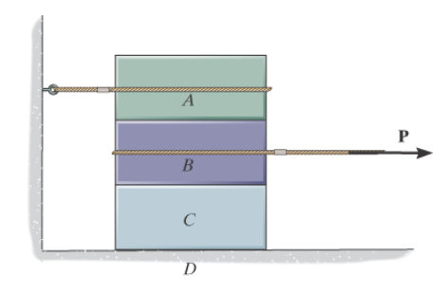
1. Find the friction developed between the 50-kg crate and the ground if
P=200 N, and
b) P=400 N.
The coefficients of static and kinetic friction between the crate and the ground are µ_{s} = 0.3 and µ_{k} = 0.2
2. If the coefficient of static friction at contact points A and B is µ_{s} = 0.3, determine the maximum force P that can be applied without causing the 100-kg spool to move.
Include correct FBDs for all problems!
Determine the maximum force P that can be applied without causing movement of the 250-lb crate that has a center of gravity at G. The coefficient of static friction at the floor is µ_{s} = 0.4.
Draw the free body diagram for the boxes below. Each surface is subject to friction.

