Slide 1
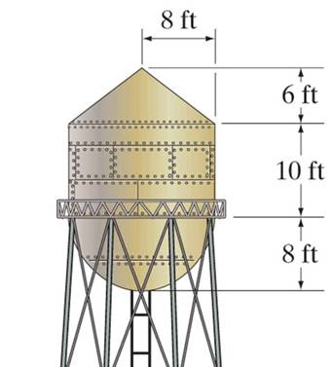
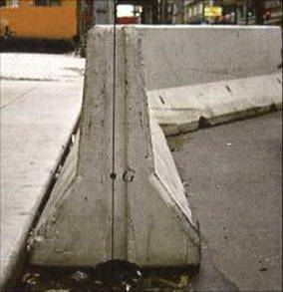
COMPOSITE BODIES
Chap 9.2 and 9.5

Slide 2
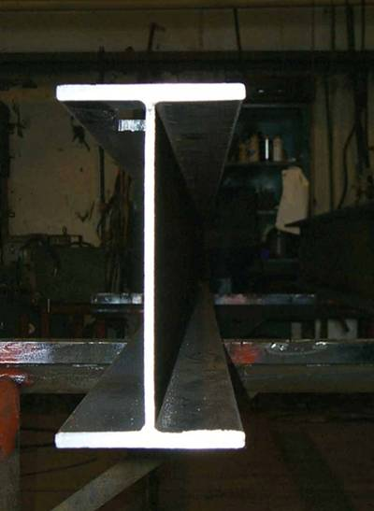
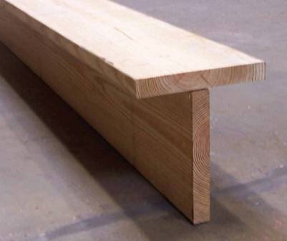
APPLICATIONS
The I-beam or tee-beam shown are commonly used in building various types of structures.
When doing a stress or deflection analysis for a beam, the location of the centroid is very important.
How can we easily determine the location of the centroid for a given beam shape?

Slide 3
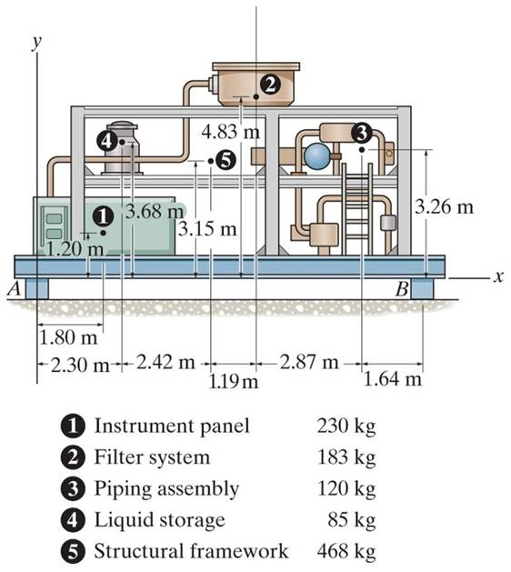
APPLICATIONS (continued)
The compressor is assembled with many individual components.
In order to design the ground support structures, the reactions at blocks A and B have to be found. To do this easily, it is important to determine the location of the compressor’s center of gravity (CG).
If we know the weight and CG of individual components, we need a simple way to determine the location of the CG of the assembled unit.

Slide 4
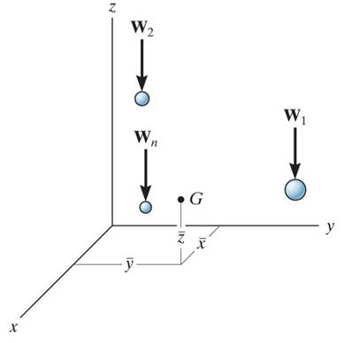
CG / CM OF A COMPOSITE BODY
Consider a composite body which consists of a series of particles(or bodies) as shown in the figure. The net or the resultant weight is given as W_{R} = ∑W.
Summing the moments about the y-axis, we get
x W_{R} = x₁W₁ + x₂W₂ + ……….. + x_{n}W_{n}
where x₁ represents x coordinate of W₁, etc..
~
~
~
~
Similarly, we can sum moments about the x- and z-axes to find the coordinates of G.
By replacing the W with a M in these equations, the coordinates of the center of mass can be found.

Slide 5
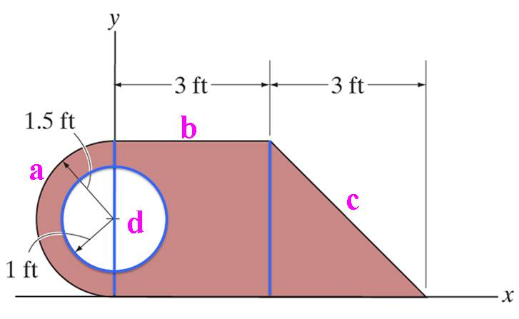
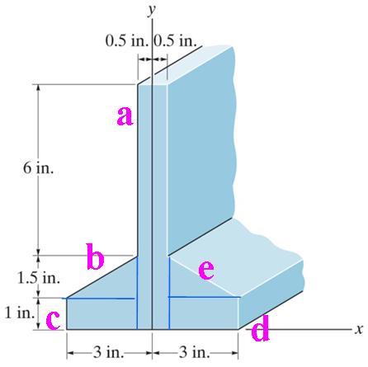
CONCEPT OF A COMPOSITE BODY
Many industrial objects can be considered as composite bodies made up of a series of connected “simple” shaped parts or holes, like a rectangle, triangle, and semicircle.
Knowing the location of the centroid, C, or center of gravity, G, of the simple shaped parts, we can easily determine the location of the C or G for the more complex composite body.

Slide 6
STEPS FOR ANALYSIS
1. Divide the body into pieces that are known shapes. Holes are considered as pieces with negative weight or size.
2. Make a table with the first column for segment number, the second column for weight, mass, or size (depending on the problem), the next set of columns for the moment arms, and, finally, several columns for recording results of simple intermediate calculations.
3. Fix the coordinate axes, determine the coordinates of the center of gravity of centroid of each piece, and then fill in the table.
4. Sum the columns to get x, y, and z. Use formulas like
x = ( Σ x_{i} A_{i} ) / ( Σ A_{i} ) or x = ( Σ x_{i} W_{i} ) / ( Σ W_{i} )
∼
∼

Slide 7
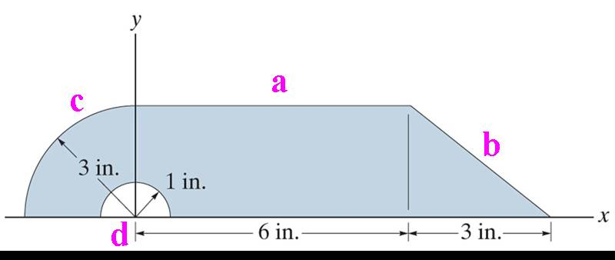
EXAMPLE
Given: The part shown.
Find: The centroid of the part.
Plan: Follow the steps for analysis.
Solution:
1. This body can be divided into the following pieces: rectangle (a) + triangle (b) + quarter circular (c) – semicircular area (d). Note the negative sign on the hole!

Slide 8
EXAMPLE (continued)
Steps 2 & 3: Make up and fill the table using parts a, b, c, and d.
Segment
Area A (in²)
∼
∼
∼
∼
x (in)
y (in)
x A ( in³)
y A ( in³)
Rectangle Triangle
Q. Circle Semi-Circle
18 4.5 9 π / 4 – π / 2
3 7 – 4(3) / (3 π) 0
1.5 1 4(3) / (3 π) 4(1) / (3 π)
54 31.5 – 9 0
27 4.5 9
- 2/3
Σ
28.0
76.5
39.83

Slide 9
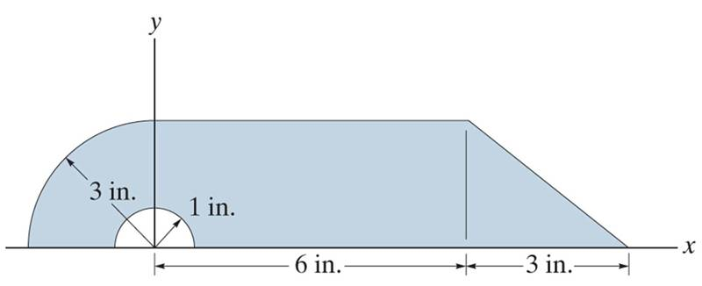
EXAMPLE (continued)
C
4. Now use the table data results and the formulas to find the coordinates of the centroid.
∼
∼
Area A x A y A
28.0 76.5 39.83
∼
x = ( Σ x A) / ( Σ A ) = 76.5 in³/ 28.0 in² = 2.73 in
y = ( Σ y A) / (Σ A ) = 39.83 in³ / 28.0 in² = 1.42 in
∼

Slide 10
CONCEPT QUIZ
3cm
1 cm
1. Based on the typical centroid information, what are the minimum number of pieces you will have to consider for determining the centroid of the area shown at the right?
A) 1 B) 2 C) 3 D) 4
1 cm
3cm
2. A storage box is tilted up to clean the rug underneath the box. It is tilted up by pulling the handle C, with edge A remaining on the ground. What is the maximum angle of tilt (measured between bottom AB and the ground) possible before the box tips over?
A) 30° B) 45 ° C) 60 ° D) 90 °
C
G
30º
B
A
Notes:
Answers:
1. C
2. C

Slide 11
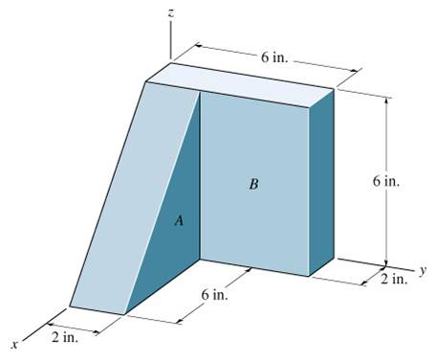
GROUP PROBLEM SOLVING
Given: Two blocks of different materials are assembled as shown.
The densities of the materials are:
ρ_{A} = 150 lb / ft³ and ρ_{B} = 400 lb / ft³.
Find: The center of gravity of this assembly.
Plan: Follow the steps for analysis.
Solution
1. In this problem, the blocks A and B can be considered as two pieces (or segments).

Slide 12
GROUP PROBLEM SOLVING (continued)
Weight = w = ρ (Volume in ft³)
w_{A} = 150 (0.5) (6) (6) (2) / (12)³ = 3.125 lb
w_{B} = 400 (6) (6) (2) / (12)³ = 16.67 lb
Segment
w (lb)
∼
∼
∼
∼
∼
∼
x (in)
y (in)
z (in)
xA (lb·in)
yA (lb·in)
zA (lb·in)
A
B
3.125
16.67
4
1
1
3
2
3
12.5
16.67
3.125
50.00
6.25
50.00
Σ
19.79
29.17
53.12
56.25

Slide 13
GROUP PROBLEM SOLVING (continued)
Table Summary
∼
∼
∼
W (lb) x w y w z w
(lb·in) (lb·in) (lb·in)
19.79 29.17 53.12 56.25
Substituting into the equations:
~
x = (Σ x w) / ( Σw ) = 29.17/19.79 = 1.47 in
y = (Σ y w) / ( Σw ) = 53.12/ 19.79 = 2.68 in
z = (Σ z w) / ( Σw ) = 56.25 / 19.79 = 2.84 in
~
~

Slide 14
ATTENTION QUIZ
y
1. A rectangular area has semicircular and triangular cuts as shown. For determining the centroid, what is the minimum number of pieces that you can use?
A) Two B) Three
C) Four D) Five
2cm
4cm
x
2cm
2cm
2. For determining the centroid of the area, two square segments are considered; square ABCD and square DEFG. What are the coordinates (x, y ) of the centroid of square DEFG?
A) (1, 1) m B) (1.25, 1.25) m
C) (0.5, 0.5 ) m D) (1.5, 1.5) m
y
1m
1m
A
D
~
~
E
1m
G
F
1m
B
x
C
Notes:
Answers:
1. B
2. D

Slide 15
Given: Two blocks of different materials are assembled as shown.
The densities of the materials are:
ρ_{A} = 150 lb / ft³ and ρ_{B} = 400 lb / ft³.
Find: The center of gravity of this assembly.
Plan: Follow the steps for analysis.

Slide 16
Find: The centroid of the part.

Slide 17
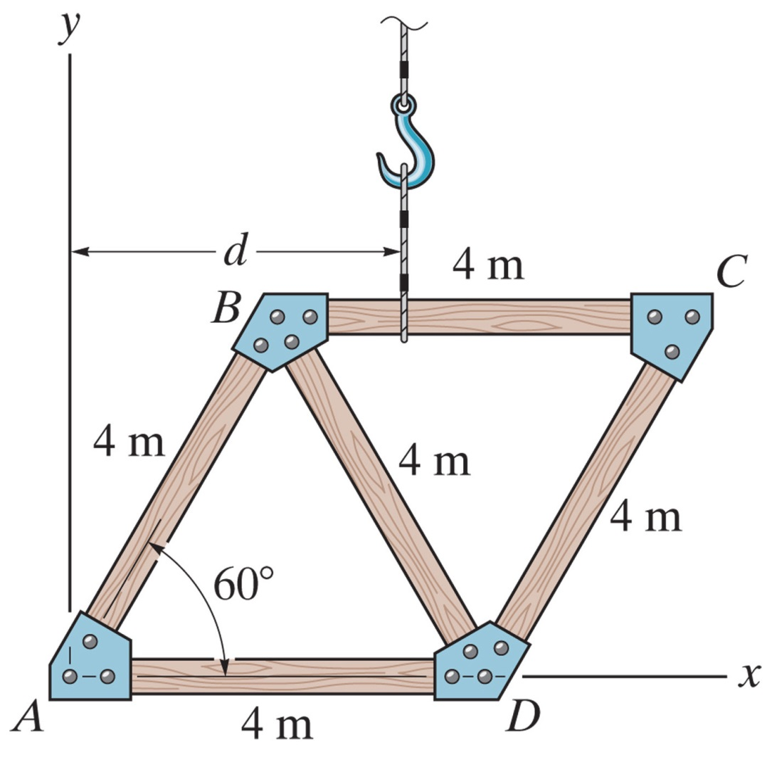
The truss is made from five members each having a length of 4-m and a mass of 7 kg/m. If the mass of the gusset plates at the joints and the thickness of the members can be neglected, determine the distance d to where the hoisting cable must be attached so that the truss does not tip when lifted.

Slide 18
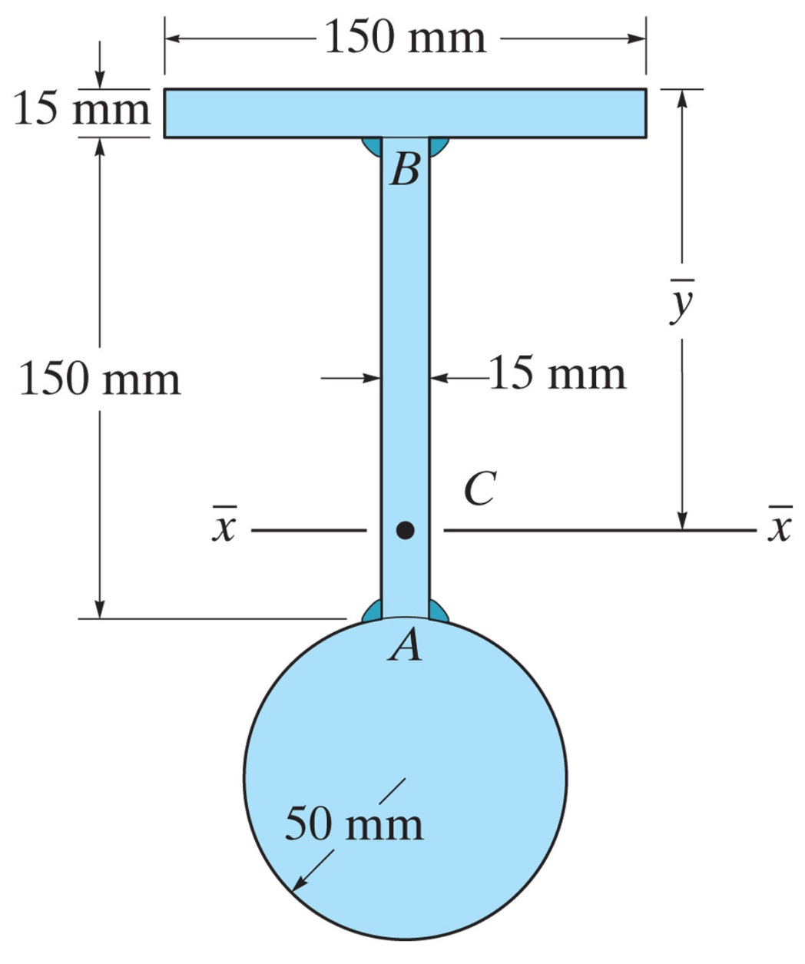
Find the location y of the centroid from the top. Neglect the size of the corner welds at A and B for the calculation.

Slide 19
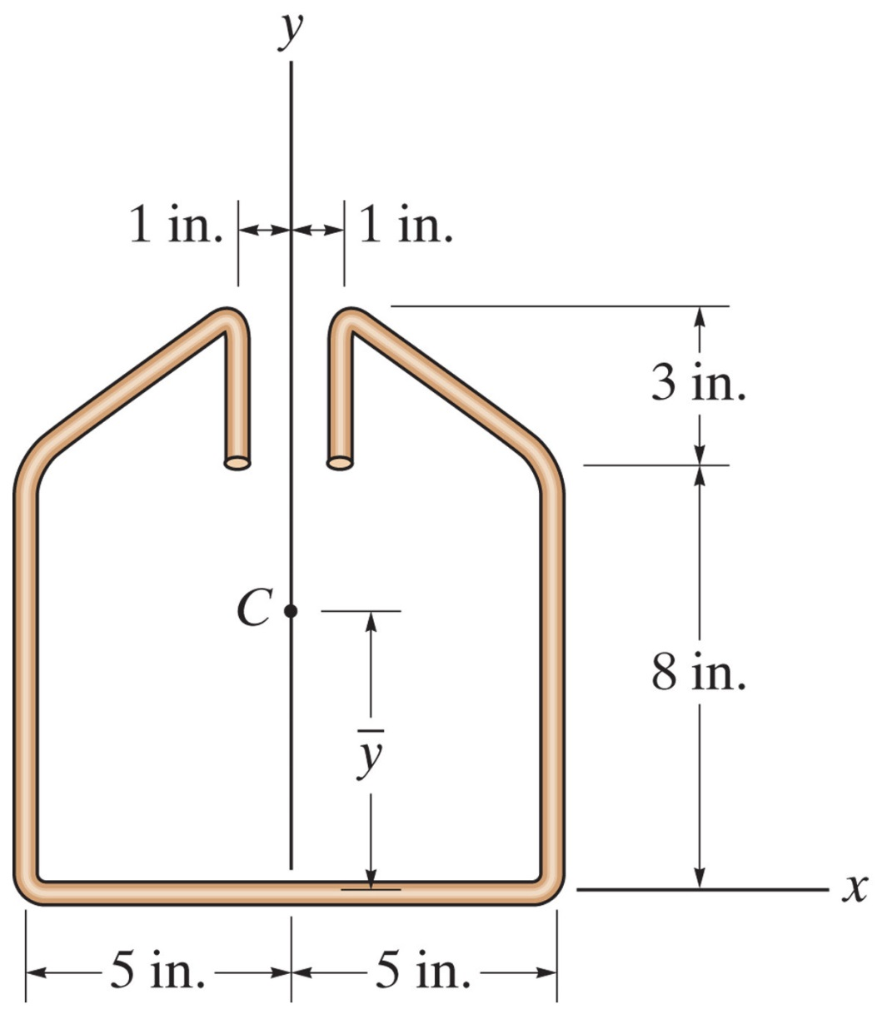
Locate the centroid for the wire. Neglect the thickness of the material and slight bends at the corners.

Slide 20
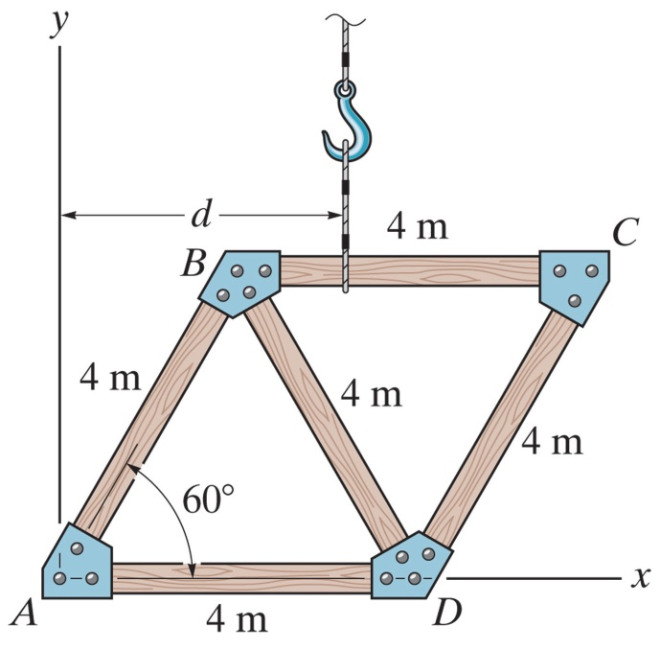
The truss is made from five members each having a length of 4-m and a mass of 7 kg/m. If the mass of the gusset plates at the joints and the thickness of the members can be neglected, determine the distance od to where the hoisting cable must be attached so that the truss does not tip when lifted.

Slide 21
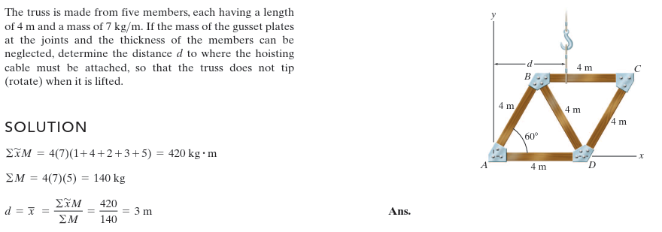

Slide 22
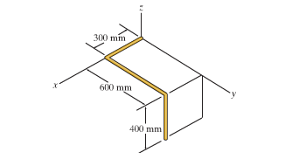
Locate the centroid (x, y, z) for the wire bent in the shape shown.
Notes:
X = 265 mm; y=323 mm; z=-61.5 mm

Slide 23
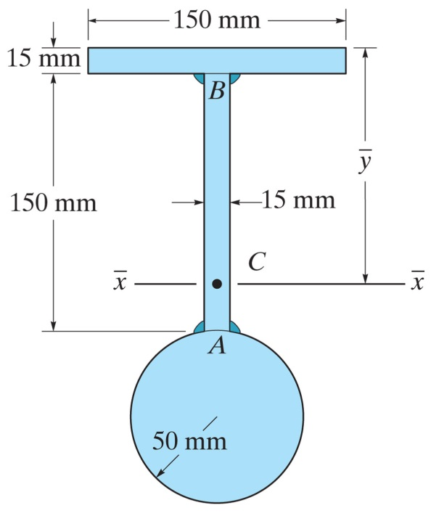
Find the location y of the centroid from the top. Neglect the size of the corner welds at A and B for the calculation.

