Slide 1
Center of Gravity and Centroid
Sections 9.1 & 9.2

Slide 2
READING QUIZ
1. The _________ is the point defining the geometric center of an object .
A) center of gravity B) center of mass
C) centroid D) none of the above
The sum of the moments for a homogeneous body at the centroid is zero.
True False
A composite body means:
Very smooth C) contains graphite
Round D) made of connected simpler shapes
Notes:
Answers:
1. C
2. True
3. D

Slide 3
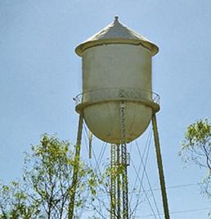
APPLICATIONS
To design the structure for supporting a water tank, we will need to know the weights of the tank and water as well as the locations where the resultant forces representing these distributed loads are acting.
How can we determine these weights and their locations?

Slide 4
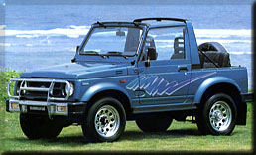
APPLICATIONS (continued)
One concern about a sport utility vehicle (SUVs) is that it might tip over while taking a sharp turn.
One of the important factors in determining its stability is the SUV’s center of mass.
Should it be higher or lower for making a SUV more stable?
How do you determine its location?

Slide 5
CONCEPT OF CG & CM
4N
3m
1m
The center of gravity (G) is a point which locates the resultant weight of a system of particles or body.
•
A
•
•
B
1 N
G
3 N
From the definition of a resultant force, the sum of moments due to individual particle weight about any point is the same as the moment due to the resultant weight located at G. For the figure above, try taking moments about A and B.
Also, note that the sum of moments due to the individual particle’s weights about point G is equal to zero.
Similarly, the center of mass is a point which locates the resultant mass of a system of particles or body. Generally, its location is the same as that of G.

Slide 6
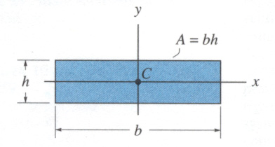
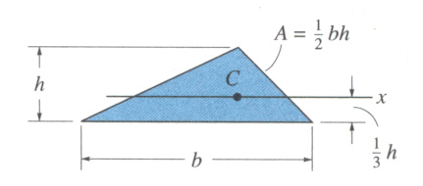
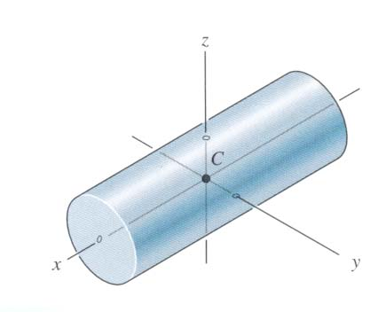
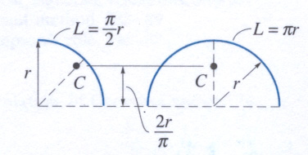
CONCEPT OF CENTROID
The centroid C is a point which defines the geometric center of an object.
The centroid coincides with the center of mass or the center of gravity only if the material of the body is homogenous (density or specific weight is constant throughout the body).
If an object has an axis of symmetry, then the centroid of object lies on that axis.
In some cases, the centroid is not located on the object.

Slide 7
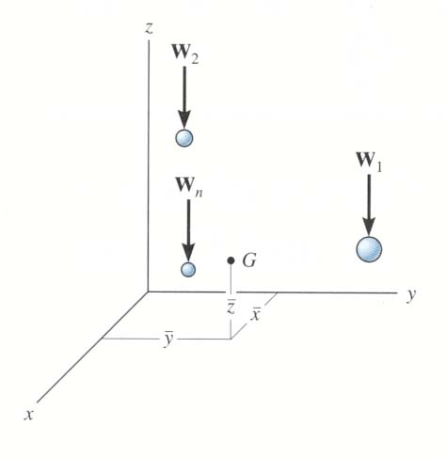
CG / CM FOR A SYSTEM OF PARTICLES (Section 9.1)
Consider a system of n particles as shown in the figure. The net or the resultant weight is given as W_{R} = ∑W.
Summing the moments about the y-axis, we get
x W_{R} = x₁W₁ + x₂W₂ + ……….. + x_{n}W_{n}
where x₁ represents x coordinate of W₁, etc..
~
~
~
~
Similarly, we can sum moments about the x- and z-axes to find the coordinates of G.
Replacing W with M in these equations, the coordinates of the center of mass can be found.

Slide 8
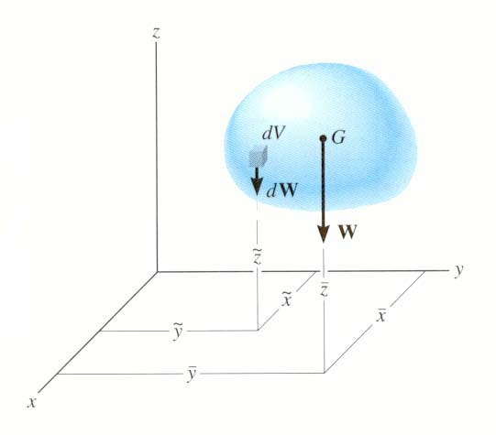
CG / CM & CENTROID OF A BODY (Section 9.2)
A rigid body can be considered as made up of an infinite number of particles. Using the same principles as in the previous slide, we get the coordinates of G by simply replacing the discrete summation sign ( ∑ ) by the continuous summation sign ( ∫ ) and W by dW.
Similarly, the coordinates of the center of mass and the centroid of volume, area, or length can be obtained by replacing W by m, V, A, or L, respectively.

Slide 9
STEPS FOR DETERMING AREA CENTROID
1. Choose an appropriate differential element dA at a general point (x,y). Hint: Generally, if y is easily expressed in terms of x (e.g., y = x² + 1), use a vertical rectangular element. If the converse is true, then use a horizontal rectangular element.
2. Express dA in terms of the differentiating element dx (or dy).
~
~
3. Determine coordinates (x , y ) of the centroid of the rectangular element in terms of the general point (x,y).
4. Express all the variables and integral limits in the formula using either x or y depending on whether the differential element is in terms of dx or dy, respectively, and integrate.
Note: Similar steps are used for determining CG, CM, etc.. These steps will become clearer by doing a few examples.

Slide 10
WARNING
This statics text and your math text likely handle the variables differently.
For example, in one of the LC Calculus texts, centroids use this formula:
$x_{CM}=\frac{M_{y}}{M}$; and $y_{CM}=\frac{M_{x}}{M}$
Which is different than the statics text which is:
$\overline{X}=\frac{\int{\tilde{x} da}}{\int{da}}$ and $\overline{Y}=\frac{\int{\tilde{y}}da}{\int{da}}$
The difference is the math text is describing the distance from the y-axis and the statics text is describing the actual value on the x (or y) axis.

Slide 11
Locate the centroid (x, y) of the shaded area.

Slide 12
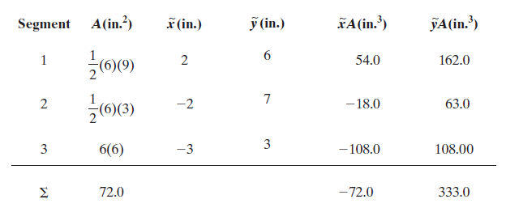
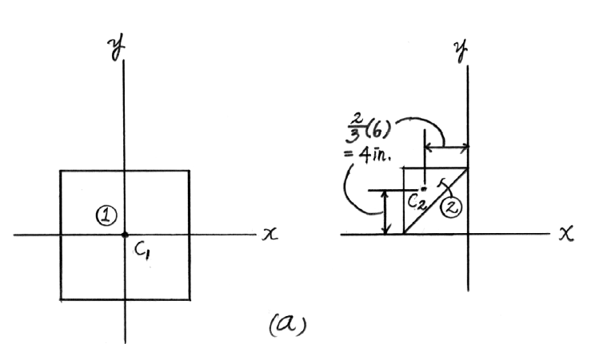

Slide 13
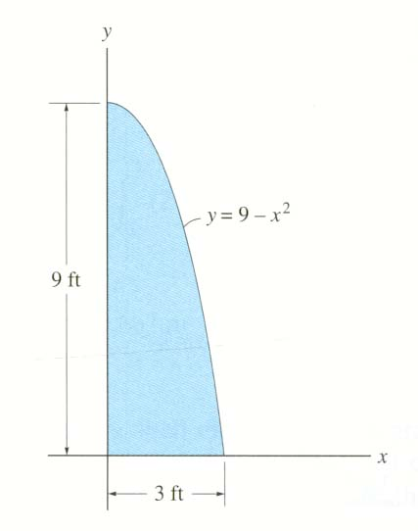
EXAMPLE
Given: The area as shown.
Find: The centroid location (x , y)
Plan: Follow the steps.
Solution
1. Since y is given in terms of x, choose dA as a vertical rectangular strip.
x,y
•
~
~
x , y
2. dA = y dx = (9 – x²) dx
3. x = x and y = y / 2
•
~
~

Slide 14
EXAMPLE (continued)
~
4. x = ( ∫_{A} x dA ) / ( ∫_{A} dA )
³
₀ ∫ x ( 9 – x²) d x [ 9 (x²)/2 – (x⁴) / 4] ³
₀ ∫ ( 9 – x²) d x [ 9 x – (x³) / 3 ] ³
= ( 9 ( 9 ) / 2 – 81 / 4 ) / ( 9 ( 3 ) – ( 27 / 3 ) )
= 1.13 ft
=
=
0
³
0
~
³
∫_{A} y dA 1 ₀ ∫ ( 9 – x²) ( 9 – x²) dx
∫_{A} dA 2 ₀ ∫ ( 9 – x²) d x
y =
=
=
3.60 ft
³

Slide 16
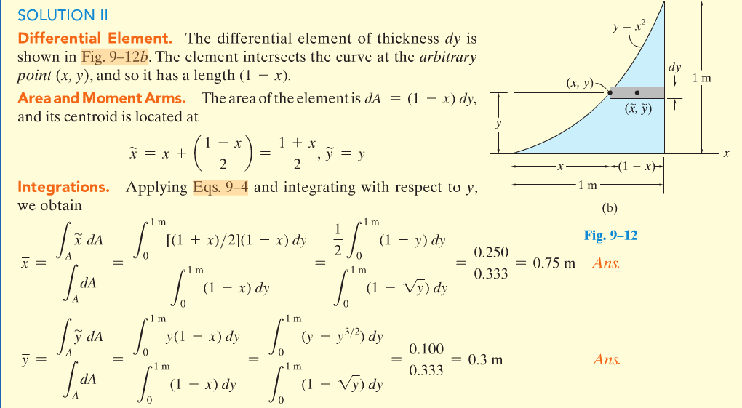

Slide 17
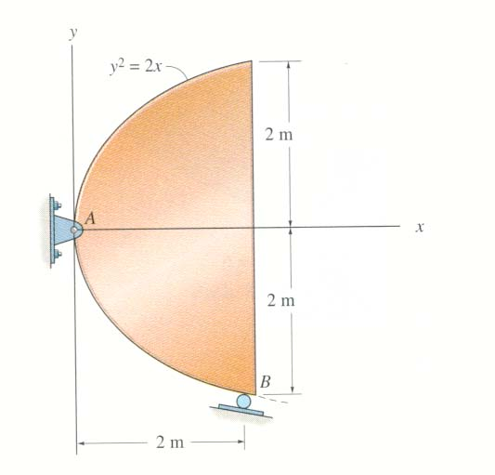
CONCEPT QUIZ
1. The steel plate with known weight and non-uniform thickness and density is supported as shown. Of the three parameters (CG, CM, and centroid), which one is needed for determining the support reactions? Are all three parameters located at the same point?
A) (center of gravity, no) B) (center of gravity, yes) C) (centroid, yes) D) (centroid, no)
2. When determining the centroid of the area above, which type of differential area element requires the least computational work?
A) Vertical B) Horizontal
C) Polar D) Any one of the above.
Notes:
Answers:
1. A
2. A

Slide 18
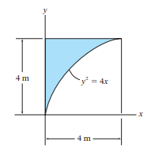
Find the area and centroid

Slide 19
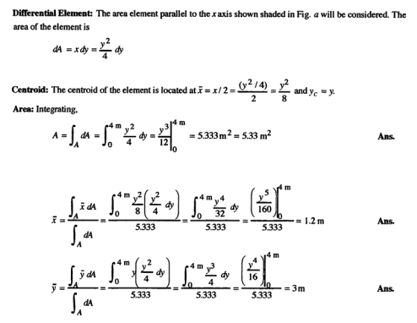

Slide 20
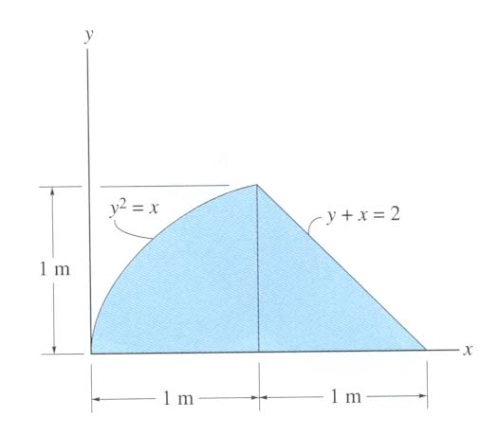
GROUP PROBLEM SOLVING
Given: The area as shown.
Find: The x of the centroid.
Plan: Follow the steps.
Solution
1. Choose dA as a horizontal rectangular strip.
(x_{1,},y)
(x₂,y)
2. dA = ( x₂ – x₁) dy
= ((2 – y) – y²) dy
3. x = ( x₁ + x₂) / 2
= 0.5 (( 2 – y) + y² )

Slide 21
GROUP PROBLEM SOLVING (continued)
~
4. x = ( ∫_{A} x dA ) / ( ∫_{A} dA )
1
∫_{A} dA = ₀∫ ( 2 – y – y²) dy
[ 2 y – y² / 2 – y³ / 3] ¹ = 1.167 m²
0
~
1
∫_{A} x dA = ₀∫ 0.5 ( 2 – y + y² ) ( 2 – y – y² ) dy
= 0.5 ₀∫ ( 4 – 4 y + y² – y⁴ ) dy
= 0.5 [ 4 y – 4 y² / 2 + y³ / 3 – y⁵ / 5 ] ¹
= 1.067 m³
1
0
x = 1.067 / 1.167 = 0.914 m

Slide 22
ATTENTION QUIZ
1. If a vertical rectangular strip is chosen as the differential element, then all the variables, including the integral limit, should be in terms of _____ .
A) x B) y
C) z D) Any of the above.
2. If a vertical rectangular strip is chosen, then what are the values of x and y?
A) (x , y) B) (x / 2 , y / 2)
C) (x , 0) D) (x , y / 2)
~
~
Notes:
Answers:
1. A
2. C

Slide 24
Find: The centroid location (x , y)

